Slide 1
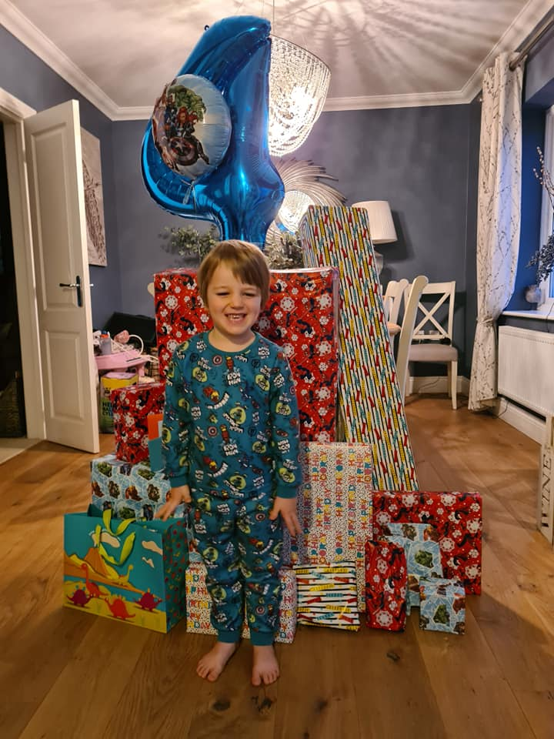
Big Balloon Numbers
Two days ago it was my son’s 4th birthday. Yesterday it was my 40th birthday.
Every year we buy big balloon numbers to celebrate. This year, we re-used the number 4 balloon to make part of the number 40 the next day.
I wonder when we’ll next be able to re-use a balloon?
Is this unique to our ages or can any two people re-use balloons?

