Slide 1
Arithmetic Progression Intro Questions
(Sequence and Series)

Slide 2
Arithmetic Progression Intro Questions
(Sequence and Series)
(This slide so that slides print out nicely as 6-slides-horizontal per page)

Slide 3
1, 3, 5, 7…
-6, -6.5, -7, -7.5…
a =
d =
u_{n} =
u₁₀ =
a =
d =
u_{n} =
u₁₀ =
1

Slide 4


1, 3, 5, 7…
-6, -6.5, -7, -7.5…
a = 1
d = 2
u_{n} = $a+\left(n−1\right)d$ = $1+2\left(n−1\right)=2n−1$
u₁₀ = 19
a = -6
d = -0.5
u_{n} =
$a+\left(n−1\right)d$ = $−6−0.5\left(n−1\right)=−0.5n−5.5$
u₁₀ = -10.5
1

Slide 5
u₁ = 6 d = -3
u₂ = 5
d = 0.25
u_{n} =
u₇ =
u_{n} =
u₁₀₀ =
2

Slide 6


u₁ = 6 d = -3
u₂ = 5
d = 0.25
u_{n} =$a+\left(n−1\right)d$ = $6−3\left(n−1\right)=9−3n$
u₇ = -12
u_{n} =
$a+\left(n−1\right)d$
= $4.75−0.25\left(n−1\right)=4.5+0.25n$
u₁₀₀ = 29.5
2

Slide 7
u₂ = 7 u₄ = 15
u₂ = -1
u₆ = 15
d =
a =
u₉ =
d =
a =
u₁₂ =
3

Slide 8
u₂ = 7 u₄ = 15
u₂ = -1
u₆ = 15
d = 4
a = 3
u₉ = 35
d = 4
a = -5
u₁₂ = 39
7
15
-1
15
3
11
-5
3
7
11
3

Slide 9
u₃ = -7 u₈= -27
u₃ = -7
u₁₀ = -6
a =
d =
u₁₀ =
d =
a =
u₁₂ =
4

Slide 10


u₃ = -7 u₈= -27
u₃ = -7
u₁₀ = -6
a = 1
d = $\frac{−27−−7}{5}=\frac{−20}{5}=−4$
u₁₀ = -35
a =
d = $\frac{−6−−7}{7}=\frac{1}{7}$
u₁₂ = $−5\frac{5}{7}$
-7
-27
4

Slide 11
u₁ = 5 d = -2
u₁ = 5
d = -2
u₅ =
S₅ =
u₂₅ =
S₂₅ =
5

Slide 12
u₁ = 5 d = -2
u₁ = 5
d = -2
u₅ = 5, 3, 1, -1, -3
S₅ = 5
u₂₅ = -43
S₂₅ = -425
5

Slide 13
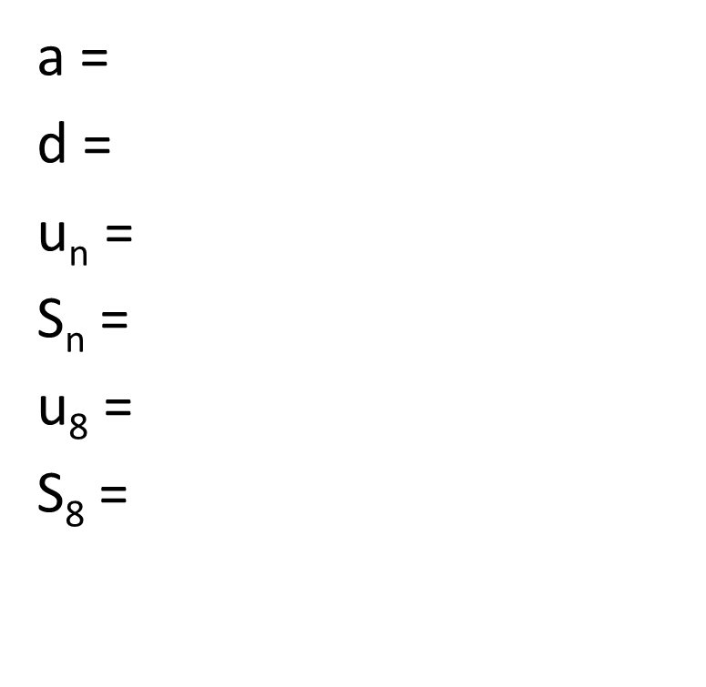
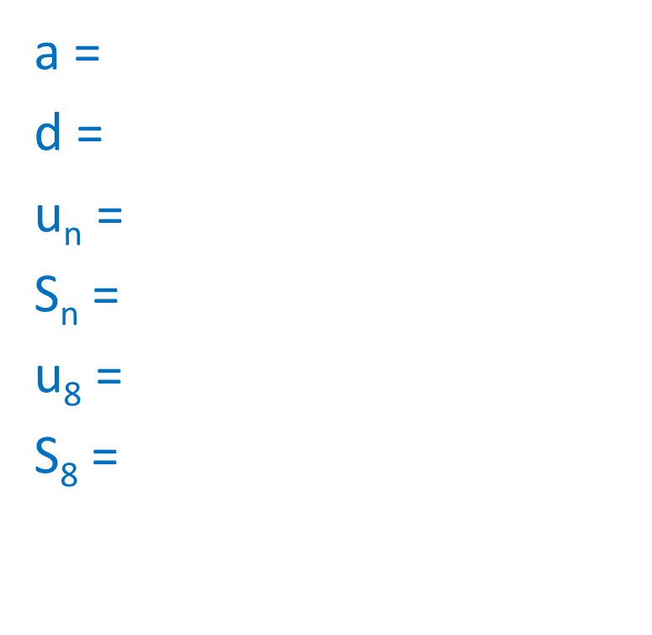
3, 8, 13, 18…
3, 2, 1, 0…
a =
d =
u_{n} =
S_{n} =
u₈ =
S₈ =
a =
d =
u_{n} =
S_{n} =
u₈ =
S₈ =
6

Slide 14
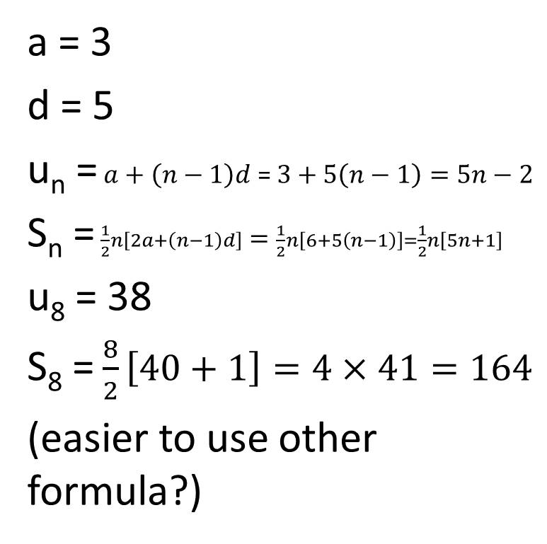

3, 8, 13, 18…
3, 2, 1, 0…
a = 3
d = 5
u_{n} =$a+\left(n−1\right)d$ = $3+5\left(n−1\right)=5n−2$
S_{n} = $\frac{1}{2}n\left[2a+\left(n−1\right)d\right]=\frac{1}{2}n\left[6+5\left(n−1\right)\right]=\frac{1}{2}n\left[5n+1\right]$
u₈ = 38
S₈ = $\frac{8}{2}\left[40+1\right]=4×41=164$
(easier to use other formula?)
a = 3
d = -1
u_{n} =$3+\left(n−1\right)=4−n$
S_{n} = $\frac{1}{2}n\left[6+\left(n−1\right)\right]=\frac{n}{2}\left[7−n\right]$
u₈ = -4
S₈ = -4
6

Slide 15
7, 11, 15, 19…
6.5, 11, 15.5, 20…
u₆ =
S₆ =
u₁₀ =
S₁₀ =
7

Slide 16
7, 11, 15, 19…
6.5, 11, 15.5, 20…
u₆ = 27
S₆ = 102
u₁₀ = 47
S₁₀ = 267.5
7

Slide 17
10, 7, 4…
10, -90, -190…
u₆ =
S_{n} =
u₆ =
S_{n} =
8

Slide 18


10, 7, 4…
10, -90, -190…
u₆ = …1, -2, -5
S_{n} = $\frac{1}{2}n\left[2a+\left(n−1\right)d\right]=\frac{1}{2}n\left[20+3\left(n−1\right)\right]=\frac{1}{2}n\left[3n+17\right]$
u₆ = …-290, -390, -490
S_{n} = $\frac{1}{2}n\left[20−100\left(n−1\right)\right]=\frac{1}{2}n\left[19−100n\right]$
8

Slide 19
u₃ = -5 u₇ = -21
u₃ = -11
u₇ = -21
a =
d =
S₇ =
a =
d =
S₇ =
9

Slide 20


u₃ = -5 u₇ = -21
u₃ = -11
u₇ = -21
a = 3
d = $\frac{−21−−5}{4}=\frac{−16}{4}=−4$
S₇ = $\frac{7}{2}\left(3−21\right)=\frac{−18×7}{2}=−63$
a = -6
d = $\frac{−21−−11}{4}=\frac{−10}{4}=−2.5$
S₇ = $\frac{7}{2}\left(−6−21\right)=\frac{−27×7}{2}=−94.5$
-5
-21
3
-1
-11
-21
9
-6
-8.5

Slide 21
u₁₂ = -5 u₂₀ = -13
u₁₂ = -5
u₁₁₂ = -105
S₂₀ =
d =
a =
S₂₀ =
d =
a =
10

Slide 22
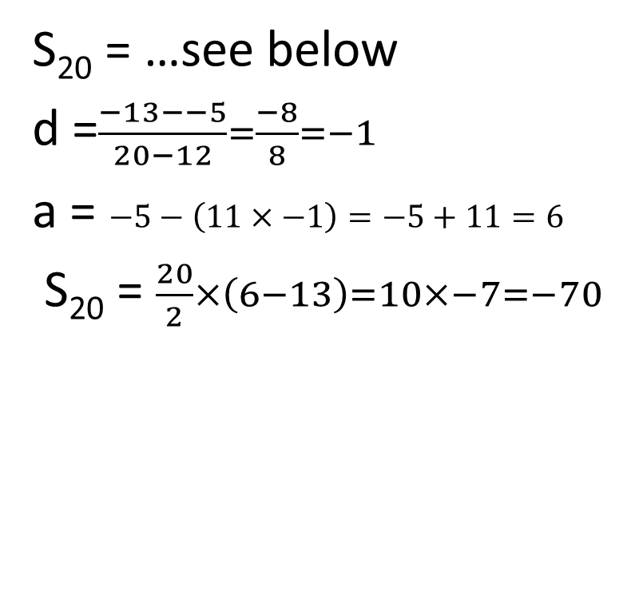
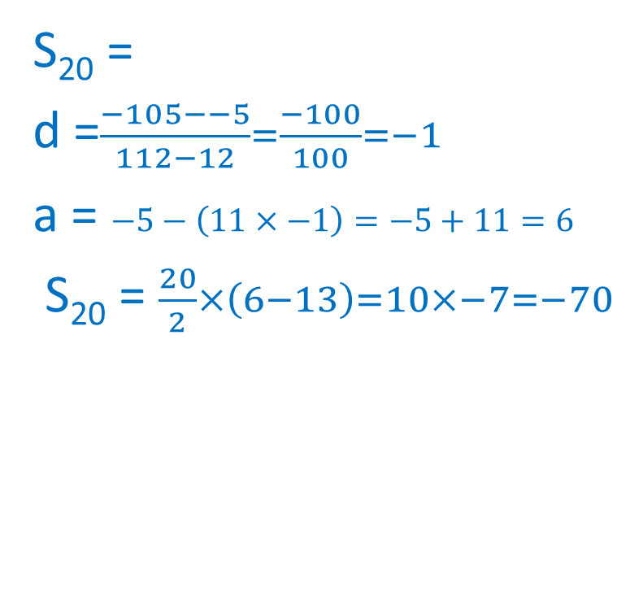
u₁₂ = -5 u₂₀ = -13
u₁₂ = -5
u₁₁₂ = -105
S₂₀ = …see below
d =$\frac{−13−−5}{20−12}=\frac{−8}{8}=−1$
a = $−5−\left(11×−1\right)=−5+11=6$
S₂₀ = $\frac{20}{2}×\left(6−13\right)=10×−7=−70$
S₂₀ =
d =$\frac{−105−−5}{112−12}=\frac{−100}{100}=−1$
a = $−5−\left(11×−1\right)=−5+11=6$
S₂₀ = $\frac{20}{2}×\left(6−13\right)=10×−7=−70$
10

Slide 23
u₁₀ = 44 d = 4
u₁₀ = 44
d = -3
a =
S₁₀ =
a =
S₁₀ =
11

Slide 24


u₁₀ = 44 d = 4
u₁₀ = 44
d = -3
a =44-36=8
S₁₀ = $\frac{10}{2}\left(44+8\right)=5×52=260$
a =44+27=71
S₁₀ = $\frac{10}{2}\left(44+71\right)=5×115=575$
11

Slide 25
S₁₀ = 135 a = 9
S₅ = 13
a = 3
d =
d =
12

Slide 26


S₁₀ = 135 a = 9
S₅ = 13
a = 3
d =
$$S_{10}=135$$
$$=\frac{10}{2}\left[2×9+\left(10−1\right)d\right]$$
$$=5\left[18+9d\right]$$
$$9d=\frac{135}{5}−18$$
$$=27−18$$
$$=9$$
$$d=1$$
u₁₀ = $a+\left(n−1\right)d$
$$=9+9×1$$
$$=18$$
d =
$$S_{5}=13$$
$$=\frac{5}{2}\left[2×3+\left(5−1\right)d\right]$$
$$=\frac{5}{2}\left[6+4d\right]$$
$$4d=\frac{13}{2.5}−6$$
$$=−0.8$$
$$d=−0.2$$
u₉ = $a+\left(n−1\right)d$
$$=3+8×−0.2$$
$=1.4$
12

Slide 27
u₃ = 6 u₁₃ = 41
u₃ = 41
u₁₃ = 6
d =
a =
S₁₀ =
d =
a =
S₁₀ =
13

Slide 28
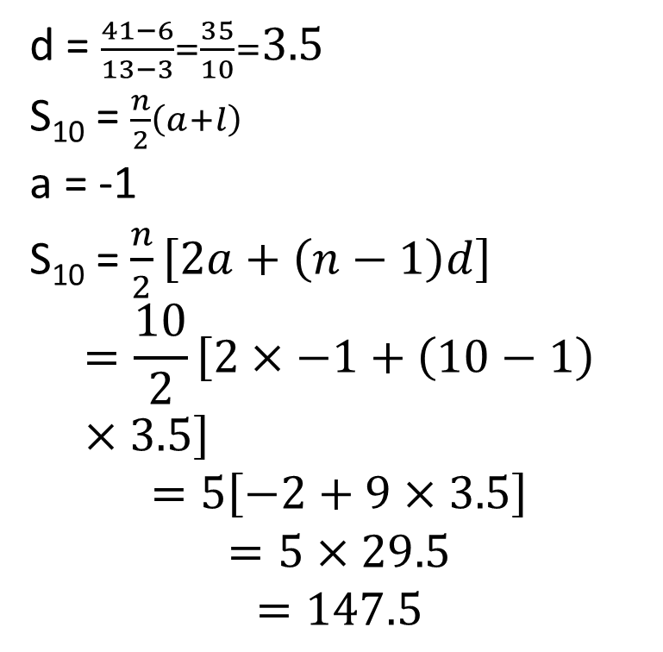
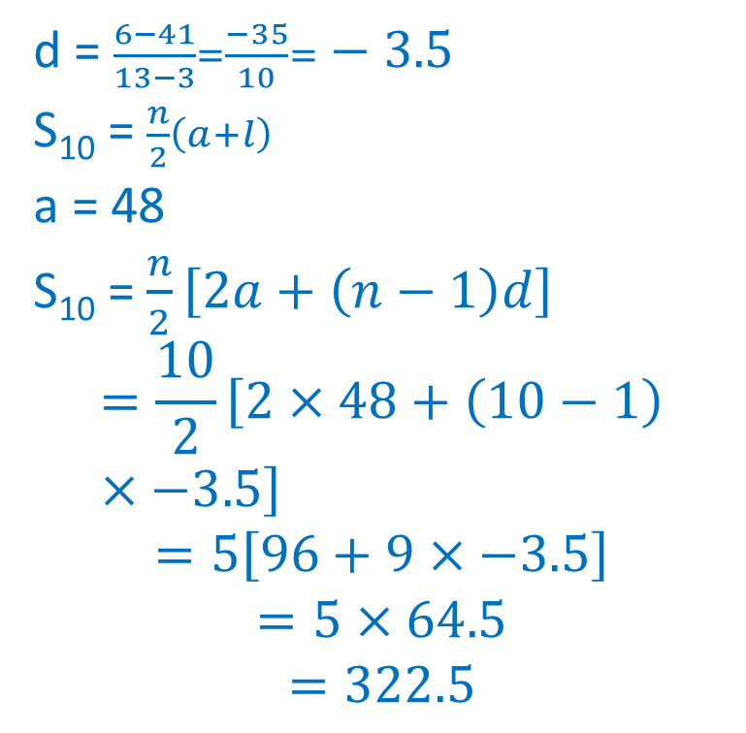
u₃ = 6 u₁₃ = 41
u₃ = 41
u₁₃ = 6
d = $\frac{41−6}{13−3}=\frac{35}{10}=3.5$
S₁₀ =$\frac{n}{2}\left(a+l\right)$
a = -1
S₁₀ = $\frac{n}{2}\left[2a+\left(n−1\right)d\right]$
$$=\frac{10}{2}\left[2×−1+\left(10−1\right)×3.5\right]$$
$$=5\left[−2+9×3.5\right]$$
$$=5×29.5$$
$$=147.5$$
d = $\frac{6−41}{13−3}=\frac{−35}{10}=−3.5$
S₁₀ =$\frac{n}{2}\left(a+l\right)$
a = 48
S₁₀ = $\frac{n}{2}\left[2a+\left(n−1\right)d\right]$
$$=\frac{10}{2}\left[2×48+\left(10−1\right)×−3.5\right]$$
$$=5\left[96+9×−3.5\right]$$
$$=5×64.5$$
$$=322.5$$
13

Slide 29
S₁₀ = -90 d = -4
S₁₀ = -90
d = -1.1
u₁ =
u₁ =
1

Slide 30
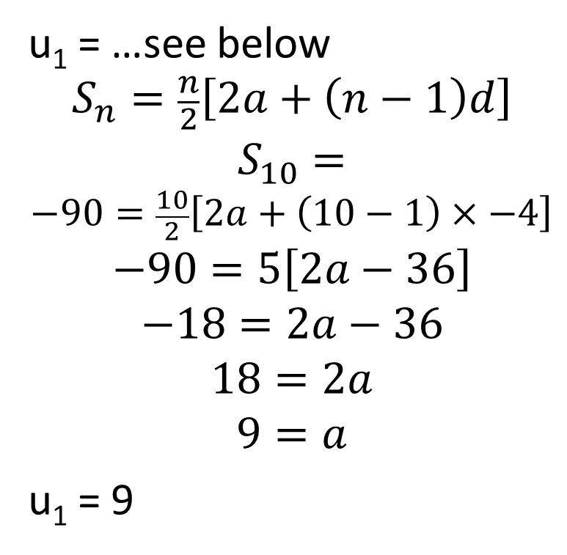
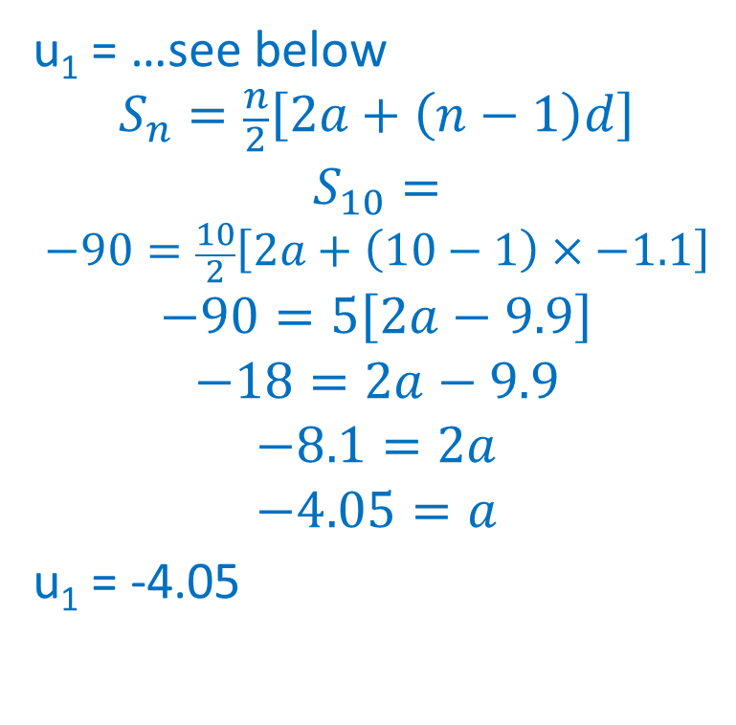
S₁₀ = -90 d = -4
S₁₀ = -90
d = -1.1
u₁ = …see below
$$S_{n}=\frac{n}{2}\left[2a+\left(n−1\right)d\right]$$
$$S_{10}=$$
$$−90=\frac{10}{2}\left[2a+\left(10−1\right)×−4\right]$$
$$−90=5\left[2a−36\right]$$
$$−18=2a−36$$
$$18=2a$$
$$9=a$$
u₁ = 9
u₁ = …see below
$$S_{n}=\frac{n}{2}\left[2a+\left(n−1\right)d\right]$$
$$S_{10}=$$
$$−90=\frac{10}{2}\left[2a+\left(10−1\right)×−1.1\right]$$
$$−90=5\left[2a−9.9\right]$$
$$−18=2a−9.9$$
$$−8.1=2a$$
$$−4.05=a$$
u₁ = -4.05
1

