Slide 1
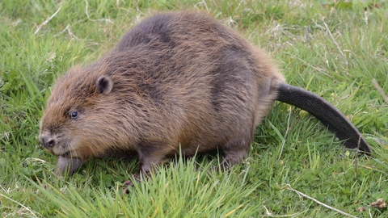
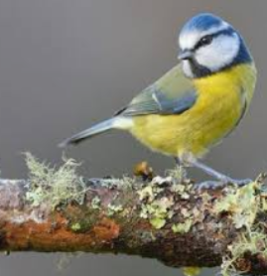
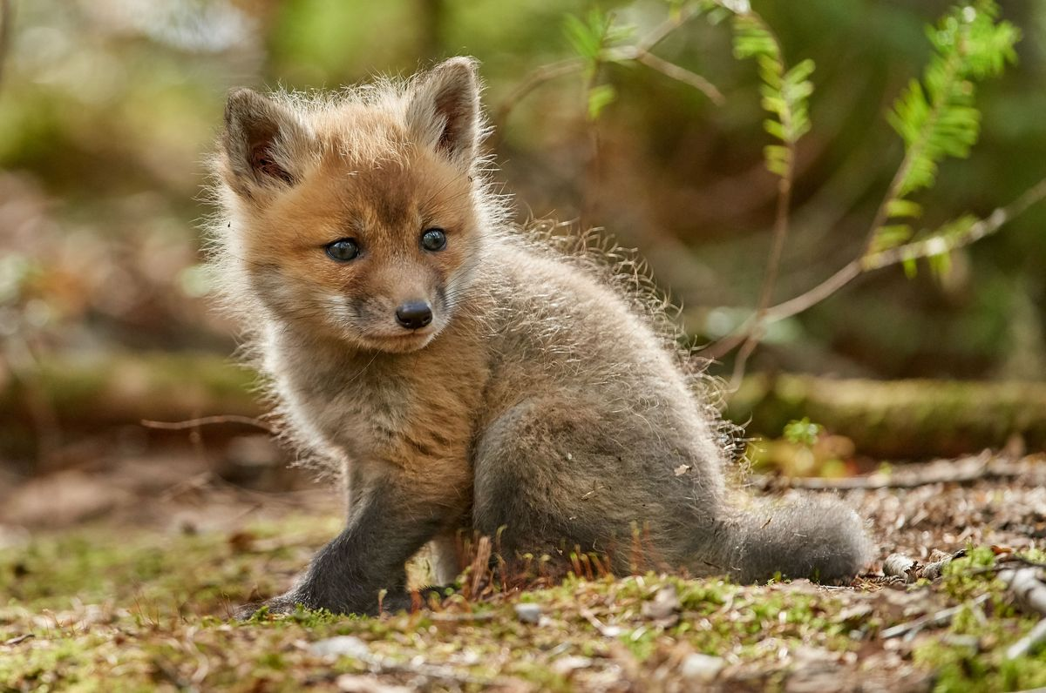
d
o
n

Slide 2
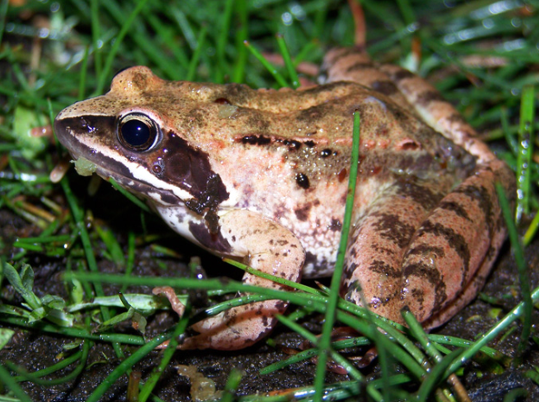
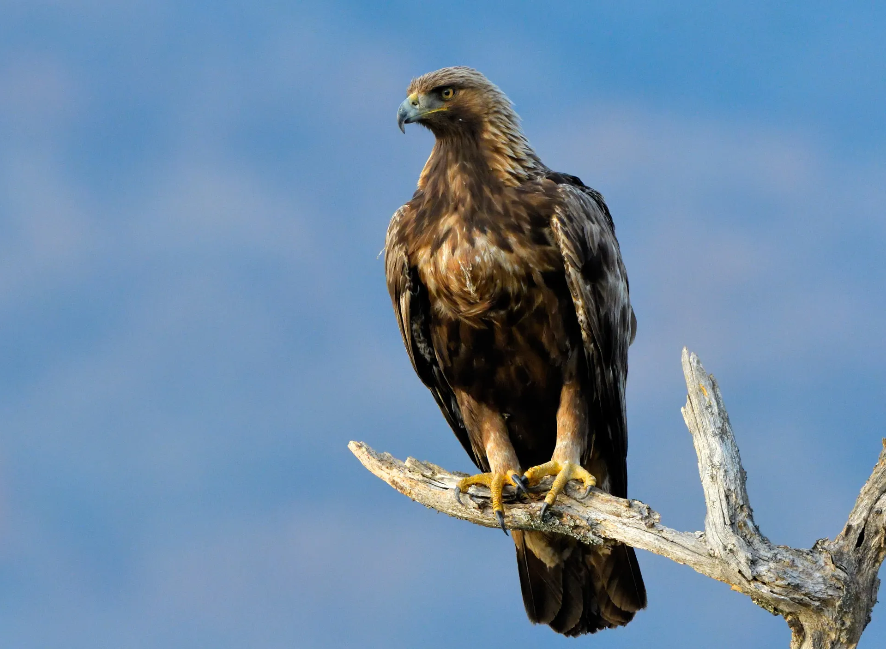
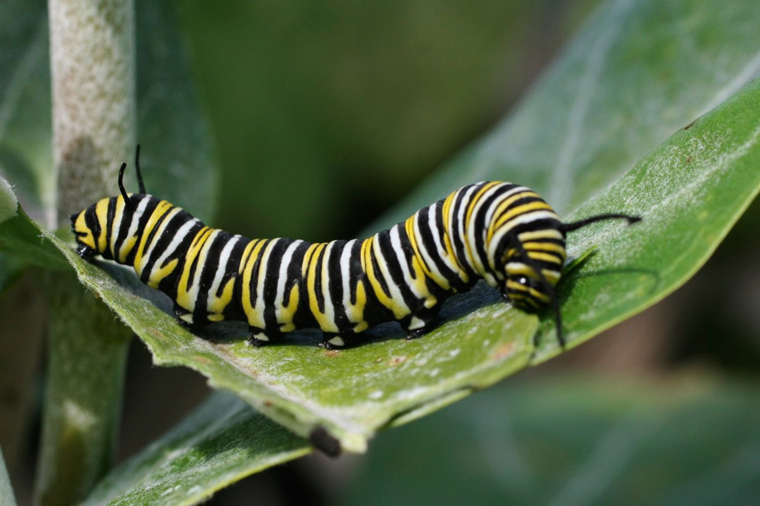
k
e
y

Slide 3
d
These animals like areas with scattered trees such as woodlands, hedgerows, parks and gardens.
These animals are found in the uplands of Scotland in moorlands and heathlands, which are wide open landscapes.
r
These animals live around the world in forests, grasslands, mountains, and deserts. They also adapt well to human environments such as farms and cities.
a
These animals hibernate and breed in puddles, ponds, lakes and canals, muddy burrows or at the bottom of ponds.
g
These animals live in freshwater habitats like rivers and streams, and prefer areas surrounded by wetland plants, trees and woodland. Some of these animals live in local community centres and Scout huts.
o

Slide 4
These animals hunt rabbits. They also catch foxes and large birds.
a
These animals eat insects, caterpillars, seeds and nuts.
L
These animals eat fruits, berries and grasses as well as birds and small mammals like squirrels, rabbits and mice.
r
These animals catch their prey on their long sticky tongues.
u
These animals are herbivores. Their diet is made up of aquatic plants and grasses, as well as the bark, twigs and leaves of trees.
s

Slide 5
This animal eats apples, pears, plums, strawberries, oranges, chocolate cake, ice cream cones, pickle, Swiss cheese, salami, lollipops, cherry pie, sausage, cupcakes, watermelon, and a nice green leaf on Sunday.
w
These animals lives on the undersides of leaves and among clumps of nettles.
n

Slide 6


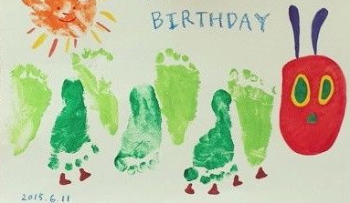
g
e
r

Slide 7

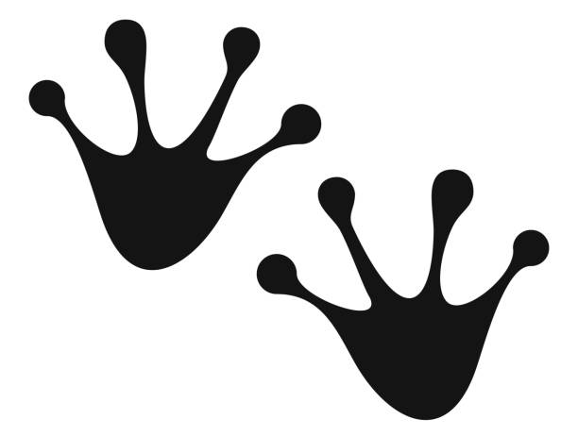

b
i
L

