Slide 1
Gravity in the Solar System
These tins have been weighted according to what they would feel like on other planets.
Which tin is which planet?
Which ones are the moon and the sun?
Which one is a little heavier than Earth, which one is a little lighter than Earth and what planets could these be?
Answers overleaf…

Slide 2
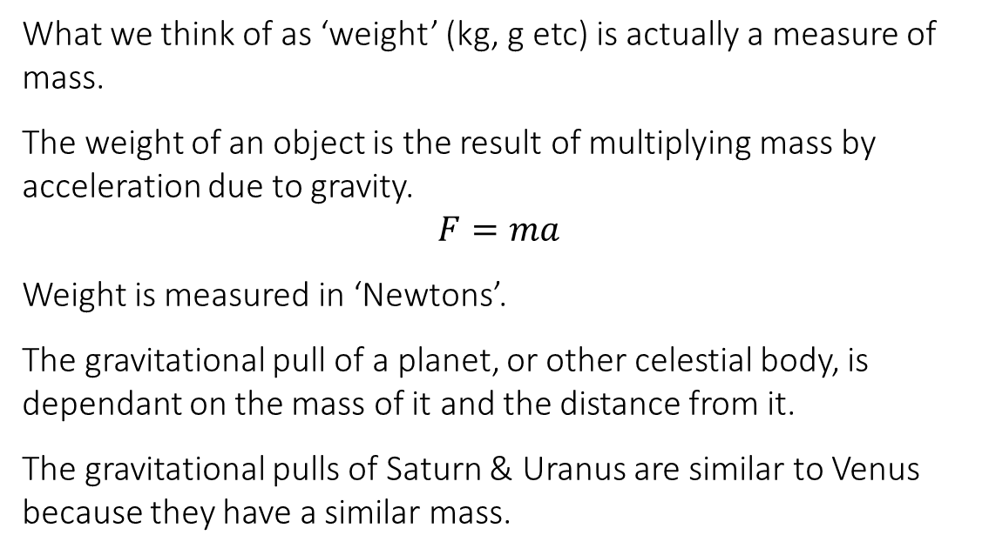
Answers
Which tin? | Planet | Gravity | Relative (Earth = 1) | Feels like
A | Jupiter | 23.12 | 2.359 | 990g
B | Earth | 9.8 | 1 | 420g
C | Mars | 3.71 | 0.379 | 160g
C | Mercury | 3.7 | 0.378 | 160g
D | Venus | 8.87 | 0.905 | 380g
D | Saturn | 8.96 | 0.914 | 380g
D | Uranus | 8.69 | 0.887 | 370g
E | The Moon | 1.622 | 0.166 | 70g
F | Pluto | 0.6 | 0.061 | 30g
G | Neptune | 11 | 1.122 | 470g
H | The Sun | 274 | 27.959 | 11,740g
What we think of as ‘weight’ (kg, g etc) is actually a measure of mass.
The weight of an object is the result of multiplying mass by acceleration due to gravity.
$$F=ma$$
Weight is measured in ‘Newtons’.
The gravitational pull of a planet, or other celestial body, is dependant on the mass of it and the distance from it.
The gravitational pulls of Saturn & Uranus are similar to Venus because they have a similar mass.

Slide 3
Pluto
Neptune
The Sun

Slide 4
Jupiter
Earth
Mercury and Mars
Venus, Saturn, Uranus
The Moon

Slide 5
Jupiter
Mercury & Mars
Earth
Venus, Saturn, Uranus
The Moon
Pluto
Neptune
The Sun

