Slide 1
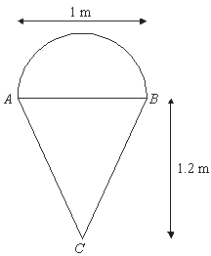
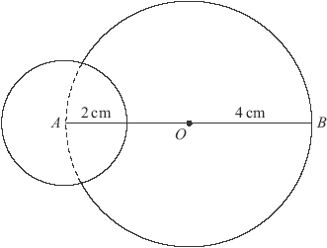
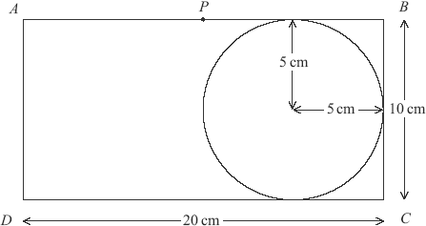
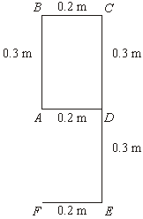
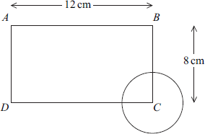



20 cm
A
30 cm
10 cm
10 cm
10 cm
A
A
A
$$5.5kg$$
A
2 cm
1 cm
A
O
$$1.5kg$$
$$1kg$$
A
3 cm
3 cm

Slide 2











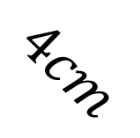

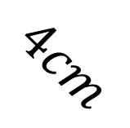

Put these diagrams in order of vertical centre of mass from each red line.
$$8cm$$
$$8cm$$
$$45°$$
$$45°$$
$$45°$$
$$45°$$
$$4cm$$
$$4cm$$
$$8cm$$
$$4cm$$
$$8cm$$
$$4cm$$
$$4cm$$
$$4cm$$
$$2cm$$

Slide 3
Now create some of your own

Slide 4
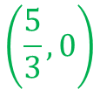





20 cm
A
30 cm
10 cm
10 cm
10 cm
A
$$\left(15,13.57\right)$$
$$\left(0.5,−0.053\right)$$
A
A
$$\left(11.4,−5\right)$$
$$\left(3.2,0\right)$$
$$5.5kg$$
A
2 cm
1 cm
A
O
$$\left(\frac{5}{3},0\right)$$
$$1.5kg$$
$$1kg$$
$$\left(0.11875,0.375\right)$$
A
3 cm
3 cm

Slide 5
Put these diagrams in order of vertical centre of mass from each red line.
$$8cm$$
$$8cm$$
$$45°$$
$$45°$$
$$45°$$
$$45°$$
$$4cm$$
$$4cm$$
$$8cm$$
$$4cm$$
$$8cm$$
$$4cm$$
$$4cm$$
$$4cm$$
$$2cm$$

Slide 6
Now create some of your own

