Slide 1
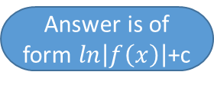
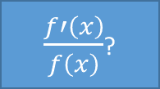
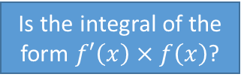
Yes
No
Start
You don’t need this flowchart
Is the integral straightforward?
Use that method
Does the question suggest a method to use?
Is the integral a fraction?
Does the integral involve a single-term denominator?
Inverse chain rule
Is the integral of the form $f′\left(x\right)×f\left(x\right)$?
Split into separate fractions and separate integrals
Use that method
Integration by Parts?
Prioritise u as:
Inverse trig
Logarithms
Algebraic polynomials
Trigonometry
Exponentials
Does the integral involve a polynomial denominator?
Use that method
Integration by Substitution?
Split into partial fractions and separate integrals
$\frac{f′\left(x\right)}{f\left(x\right)}$?
Try something creative!
Answer is of form $ln\left|f\left(x\right)\right|$+c
Use that method
Numerical Integration

