Slide 1
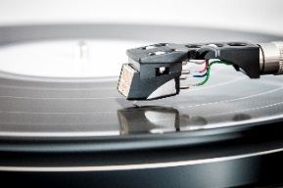
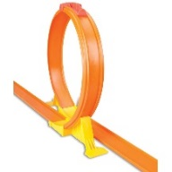
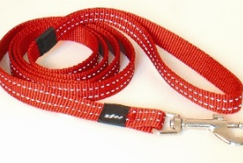
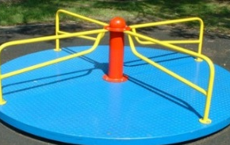
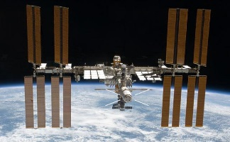
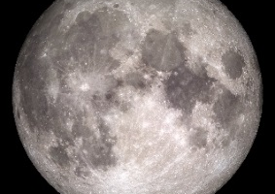
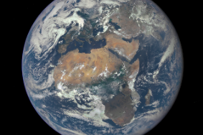
 | Item | Radius | Angular Velocity (simple units) | Angular Velocity (rads⁻¹) | Linear Velocity | Acceleration provided by…
 | Dust on a record
 | Loop the loop
 | Swinging dog lead
 | Children’s roundabout
 | Int. Space Station
 | Moon orbiting Earth
 | Earth orbiting Sun

Slide 2
WITH NUMBERS | Item | Radius | Angular Velocity (simple units) | Angular Velocity (rads⁻¹) | Linear Velocity | Acceleration provided by…
 | Dust on a record | 6 inch | 33rpm
 | Loop the loop | 20cm | 1 second
 | Swinging dog lead | 1m | 2 seconds
 | Children’s roundabout | 2m | 10 seconds
 | Int. Space Station | Earth radius +250 miles (=4209 miles) | 1 orbit in 90 mins
 | Moon orbiting Earth | 240,000 miles | 1 orbit in 28 days
 | Earth orbiting Sun | 93 million miles | 1 orbit in 365 days

Slide 3
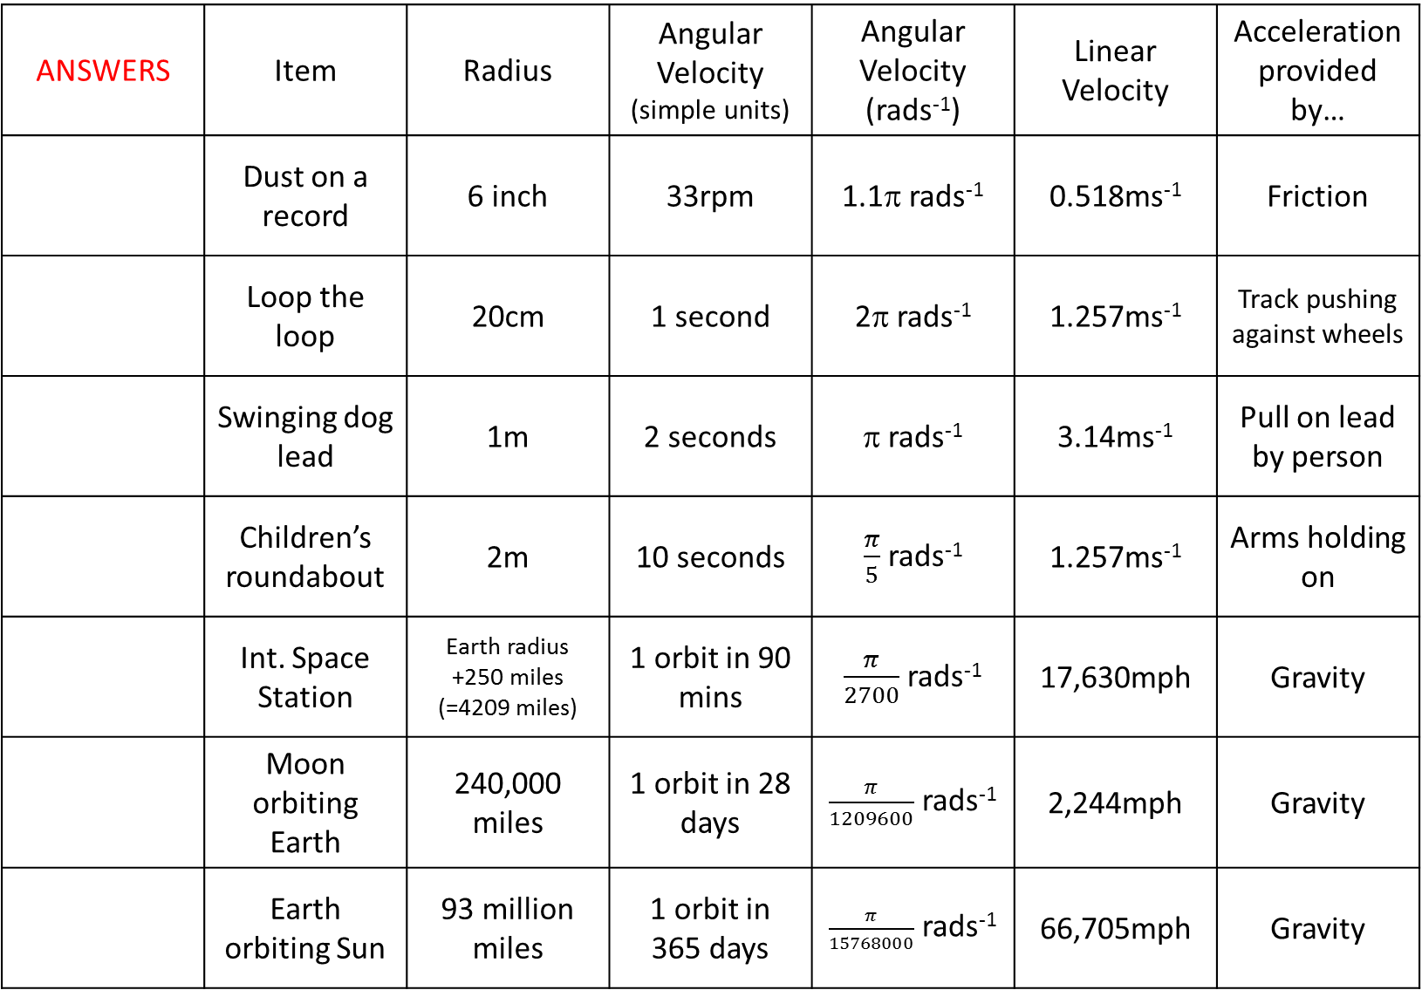
ANSWERS | Item | Radius | Angular Velocity (simple units) | Angular Velocity (rads⁻¹) | Linear Velocity | Acceleration provided by…
 | Dust on a record | 6 inch | 33rpm | 1.1π rads⁻¹ | 0.518ms⁻¹ | Friction
 | Loop the loop | 20cm | 1 second | 2π rads⁻¹ | 1.257ms⁻¹ | Track pushing against wheels
 | Swinging dog lead | 1m | 2 seconds | π rads⁻¹ | 3.14ms⁻¹ | Pull on lead by person
 | Children’s roundabout | 2m | 10 seconds | $\frac{π}{5}$ rads⁻¹ | 1.257ms⁻¹ | Arms holding on
 | Int. Space Station | Earth radius +250 miles (=4209 miles) | 1 orbit in 90 mins | $\frac{π}{2700}$ rads⁻¹ | 17,630mph | Gravity
 | Moon orbiting Earth | 240,000 miles | 1 orbit in 28 days | $\frac{π}{1209600}$ rads⁻¹ | 2,244mph | Gravity
 | Earth orbiting Sun | 93 million miles | 1 orbit in 365 days | $\frac{π}{15768000}$ rads⁻¹ | 66,705mph | Gravity

