Slide 1
Complex Numbers
Intro Questions
(Answers follow on each subsequent slide)

Slide 2
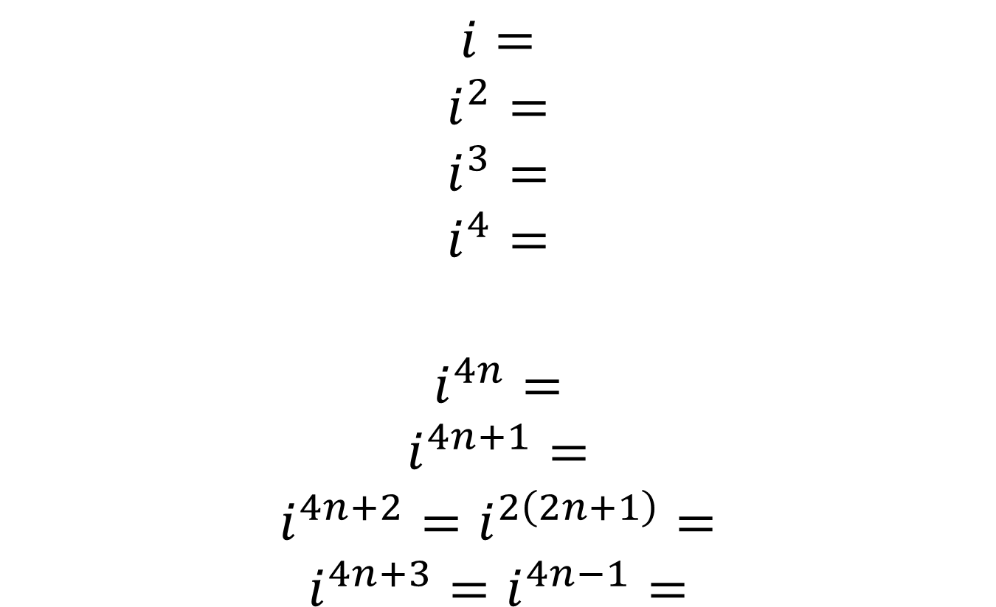
$$i=$$
$$i^{2}=$$
$$i^{3}=$$
$$i^{4}=$$
$$i^{4n}=$$
$$i^{4n+1}=$$
$$i^{4n+2}=i^{2\left(2n+1\right)}=$$
$$i^{4n+3}=i^{4n−1}=$$

Slide 3

$$i=i$$
$$i^{2}=−1$$
$$i^{3}=−i$$
$$i^{4}=1$$
$$i^{4n}=1$$
$$i^{4n+1}=i$$
$$i^{4n+2}=i^{2\left(2n+1\right)}=−1$$
$$i^{4n+3}=i^{4n−1}=−i$$

Slide 4

$$8+6i+3−4i=$$
$$8+6i−\left(3−4i\right)=$$
$$\left(8+6i\right)\left(3−4i\right)=$$
$$\left(8+6i\right)\left(8−6i\right)=$$
$$\left(3+4i\right)\left(3−4i\right)=$$

Slide 5
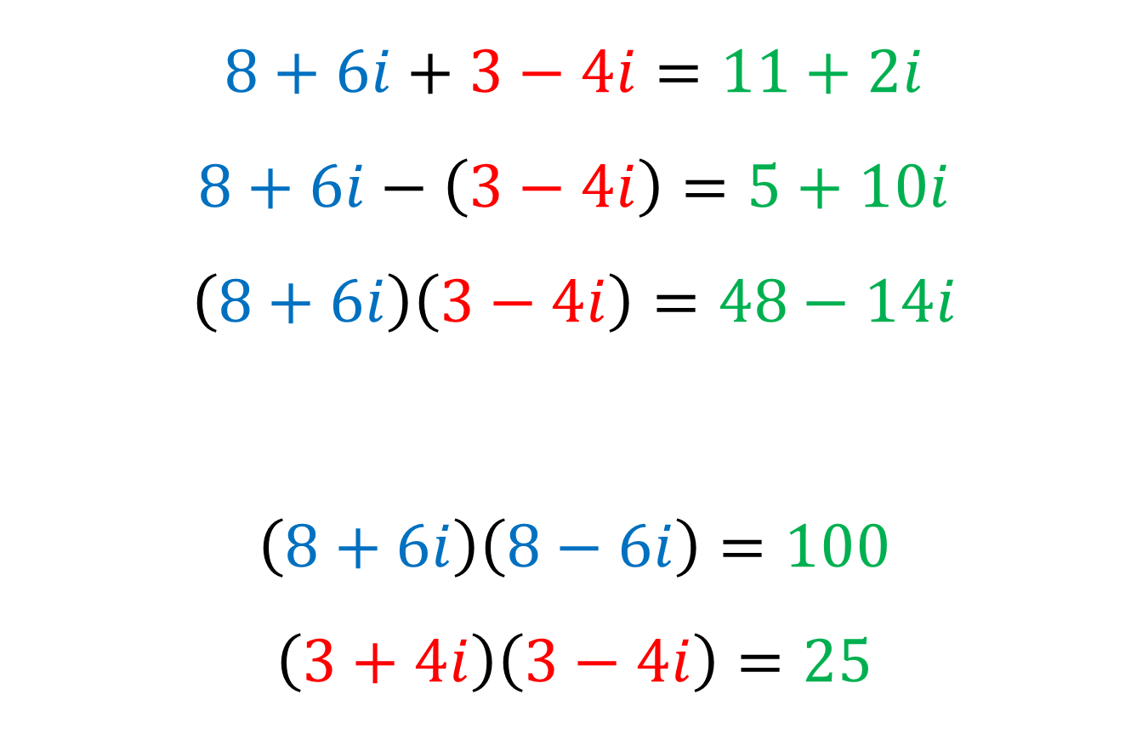
$$8+6i+3−4i=11+2i$$
$$8+6i−\left(3−4i\right)=5+10i$$
$$\left(8+6i\right)\left(3−4i\right)=48−14i$$
$$\left(8+6i\right)\left(8−6i\right)=100$$
$$\left(3+4i\right)\left(3−4i\right)=25$$

Slide 6

$$\frac{8+4i}{1+3i}=$$
$$\frac{8+i}{3+2i}=$$
$$\frac{4+2i}{2+3i}=$$

Slide 7
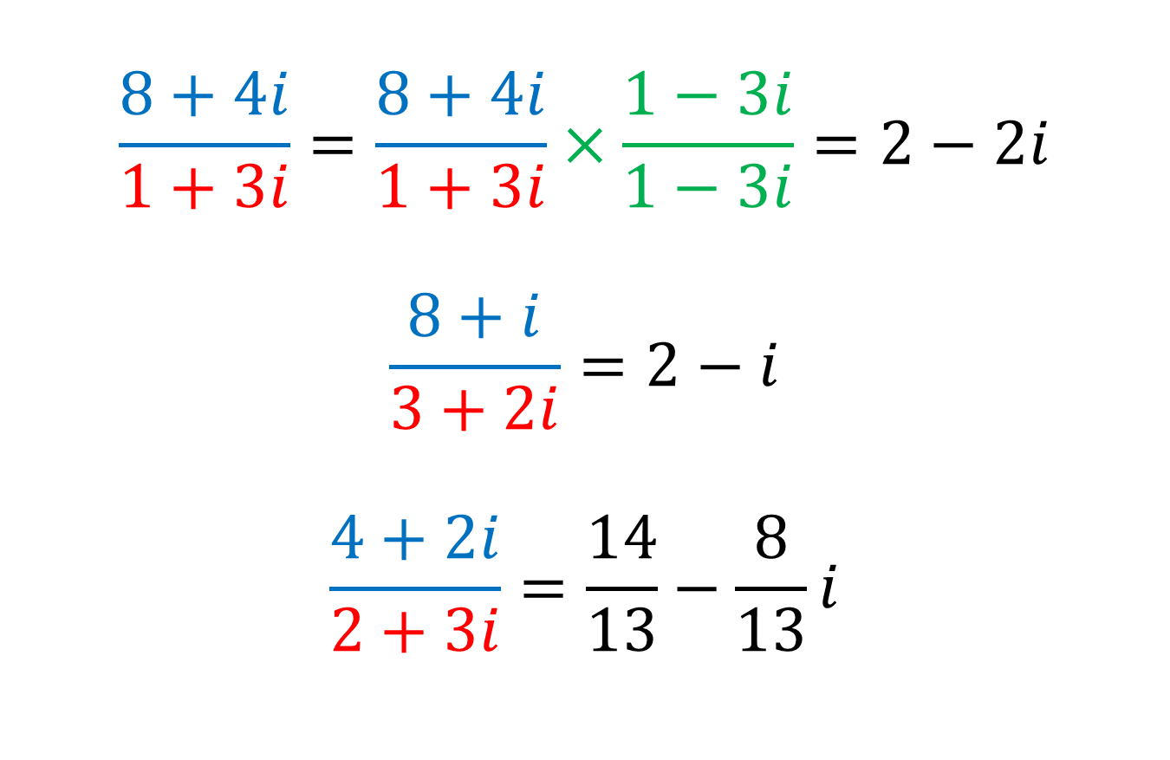
$$\frac{8+4i}{1+3i}=\frac{8+4i}{1+3i}×\frac{1−3i}{1−3i}=2−2i$$
$$\frac{8+i}{3+2i}=2−i$$
$$\frac{4+2i}{2+3i}=\frac{14}{13}−\frac{8}{13}i$$

Slide 8
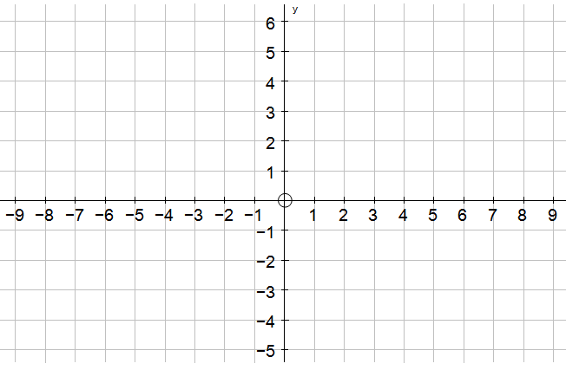

Illustrate on Argand diagram:
$8+6i$ and $3−4i$

Slide 9

Illustrate on Argand diagram:
$8+6i$ and $3−4i$
X
X

Slide 10
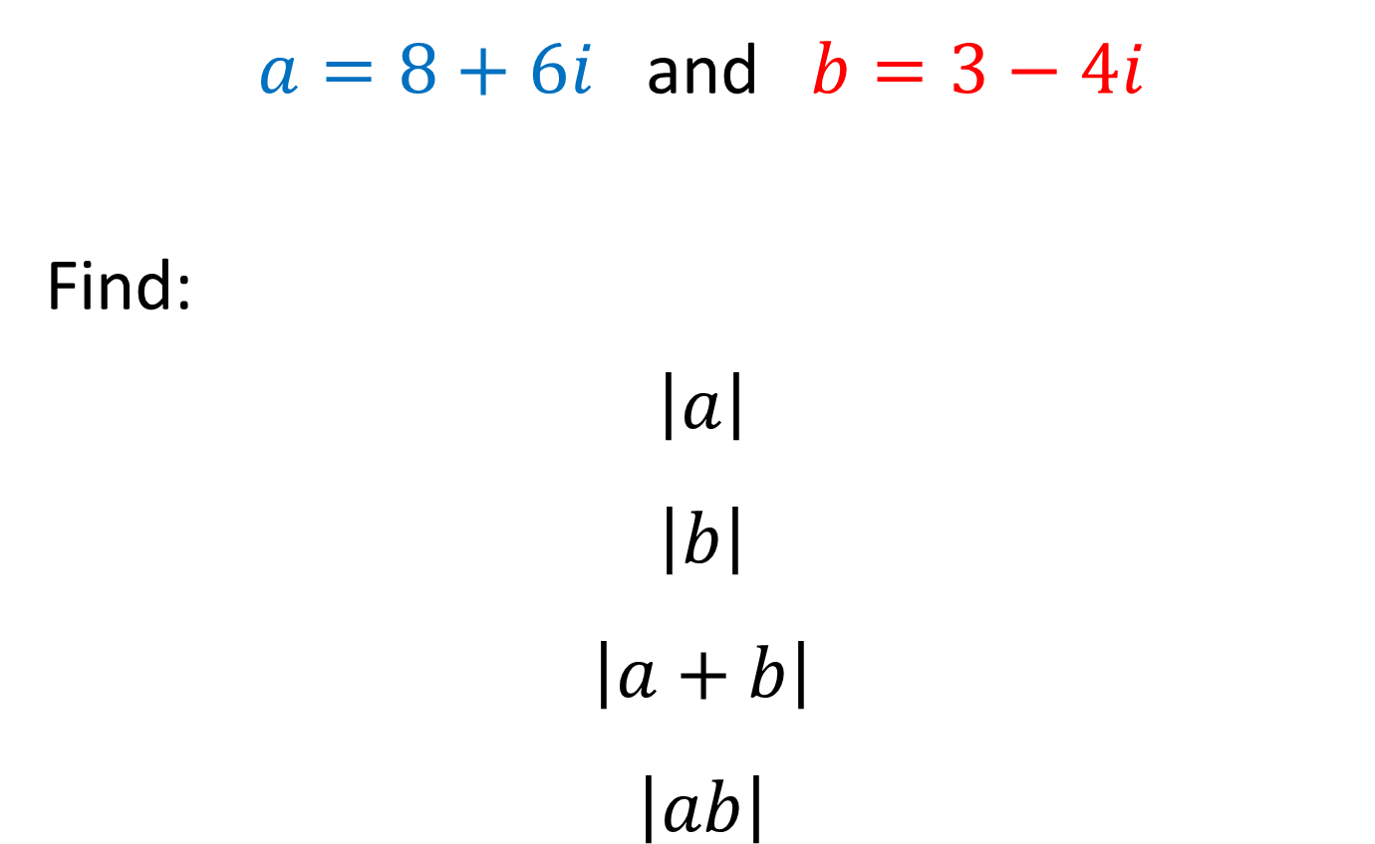
$a=8+6i$ and $b=3−4i$
Find:
$$\left|a\right|$$
$$\left|b\right|$$
$$\left|a+b\right|$$
$$\left|ab\right|$$

Slide 11

$a=8+6i$ and $b=3−4i$
Find:
$$\left|a\right|=10$$
$$\left|b\right|=5$$
$$\left|a+b\right|=5\sqrt{5}$$
$$\left|ab\right|=50$$

Slide 12

Find:
$$\text{arg}\left(3+3i\right)$$
$$\text{arg}\left(3−3i\right)$$
$$\text{arg}\left(3+\sqrt{3}i\right)$$
$$\text{arg}\left(−\sqrt{3}+3i\right)$$
$$\text{arg}\left(−\sqrt{3}−3i\right)$$
$$\text{arg}\left(i\right)$$

Slide 13

Find:
$$\text{arg}\left(3+3i\right)=\frac{π}{4}$$
$$\text{arg}\left(3−3i\right)=\frac{5π}{4}$$
$$\text{arg}\left(3+\sqrt{3}i\right)=\frac{π}{6}$$
$$\text{arg}\left(−\sqrt{3}+3i\right)=\frac{7π}{6}$$
$$\text{arg}\left(−\sqrt{3}−3i\right)=\frac{−7π}{6}$$
$$\text{arg}\left(i\right)=π$$

Slide 14

$a=8+6i$ and $b=3−4i$ and $c=−3+4i$
Find:
$$\text{arg}\left(a\right)$$
$$\text{arg}\left(b\right)$$
$$\text{arg}\left(ab\right)$$
$$\text{arg}\left(c\right)$$

Slide 15
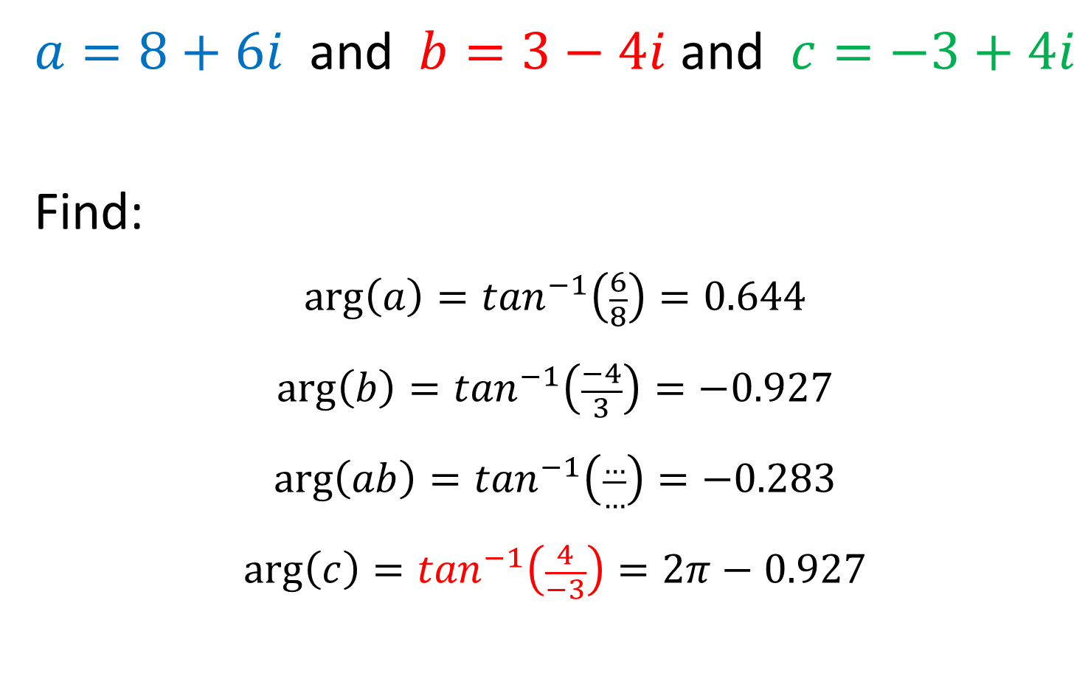
$a=8+6i$ and $b=3−4i$ and $c=−3+4i$
Find:
$$\text{arg}\left(a\right)=\tan^{−1}\left(\frac{6}{8}\right)=0.644$$
$$\text{arg}\left(b\right)=\tan^{−1}\left(\frac{−4}{3}\right)=−0.927$$
$$\text{arg}\left(ab\right)=\tan^{−1}\left(\frac{…}{…}\right)=−0.283$$
$$\text{arg}\left(c\right)=\tan^{−1}\left(\frac{4}{−3}\right)=2π−0.927$$

Slide 16
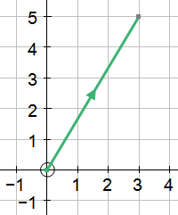

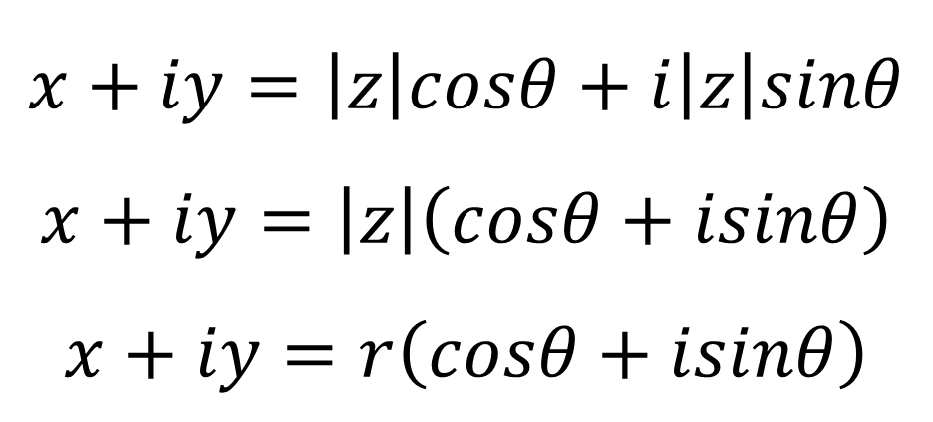


$x=\left|z\right|cosθ$ and $y=\left|z\right|sinθ$
$$x+iy=\left|z\right|cosθ+i\left|z\right|sinθ$$
$$x+iy=\left|z\right|\left(cosθ+isinθ\right)$$
$$x+iy=r\left(cosθ+isinθ\right)$$
$$\left|z\right|$$
$$θ$$

Slide 17
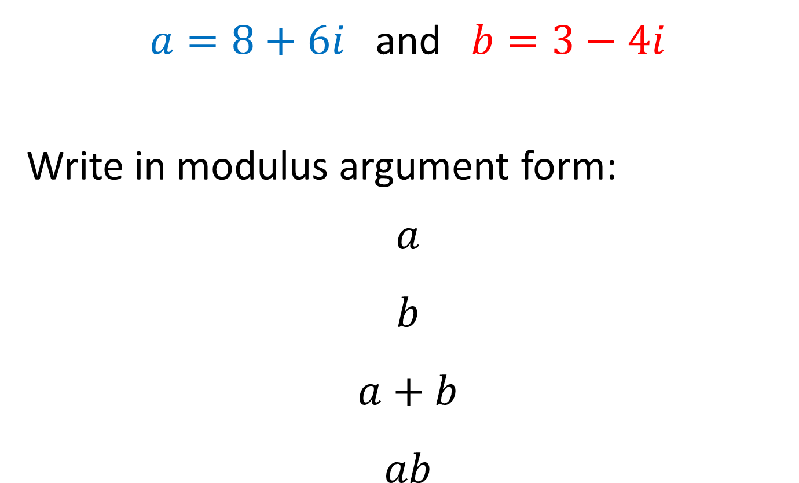
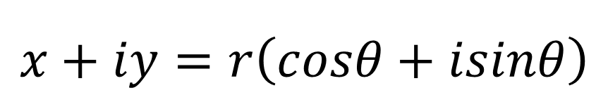


$a=8+6i$ and $b=3−4i$
Write in modulus argument form:
$$a$$
$$b$$
$$a+b$$
$$ab$$
$$\left|z\right|$$
$$θ$$
$$x+iy=r\left(cosθ+isinθ\right)$$

Slide 18
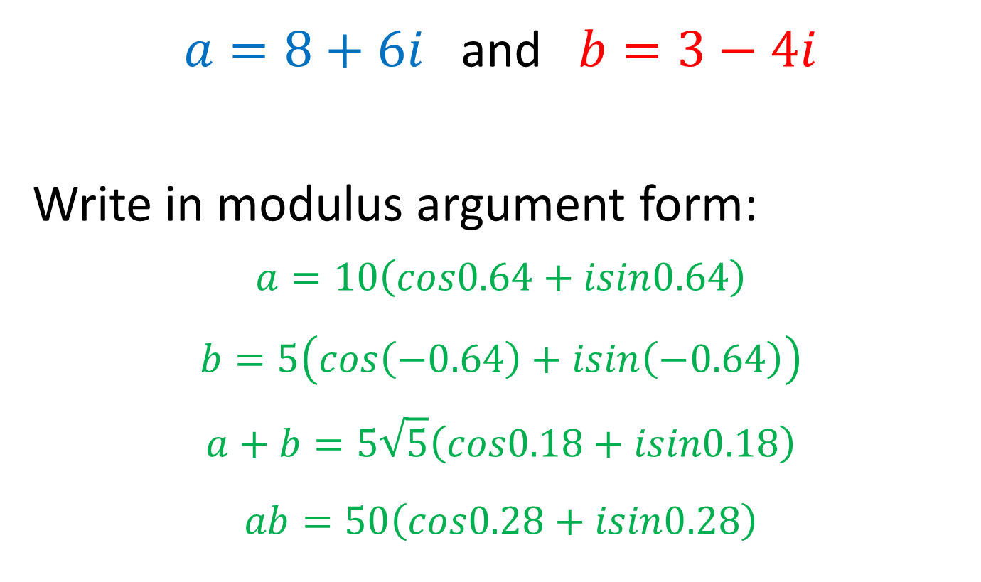


$a=8+6i$ and $b=3−4i$
Write in modulus argument form:
$$a=10\left(cos0.64+isin0.64\right)$$
$$b=5\left(cos\left(−0.64\right)+isin\left(−0.64\right)\right)$$
$$a+b=5\sqrt{5}\left(cos0.18+isin0.18\right)$$
$$ab=50\left(cos0.28+isin0.28\right)$$
$$\left|z\right|$$
$$θ$$
$$x+iy=r\left(cosθ+isinθ\right)$$

Slide 19
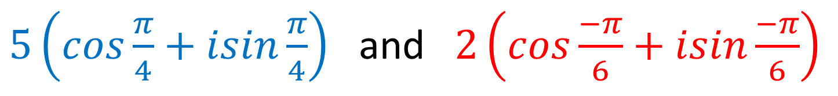

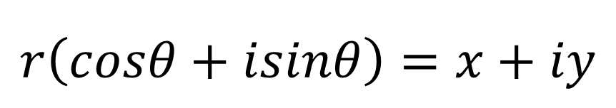
Write in Cartesian form:
$$a$$
$$b$$
$$a+b$$
$$ab$$
$5\left(cos\frac{π}{4}+isin\frac{π}{4}\right)$ and $2\left(cos\frac{−π}{6}+isin\frac{−π}{6}\right)$
$$\left|z\right|$$
$$θ$$
$$r\left(cosθ+isinθ\right)=x+iy$$

Slide 20
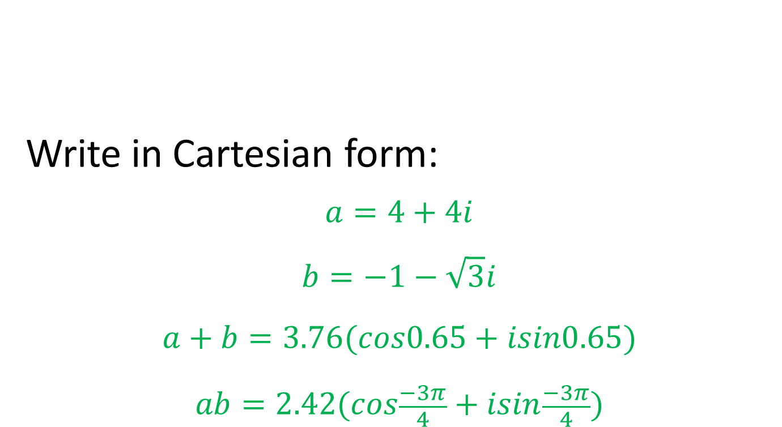
Write in Cartesian form:
$$a=4+4i$$
$$b=−1−\sqrt{3}i$$
$$a+b=3.76(cos0.65+isin0.65)$$
$$ab=2.42(cos\frac{−3π}{4}+isin\frac{−3π}{4})$$
$5\left(cos\frac{π}{4}+isin\frac{π}{4}\right)$ and $2\left(cos\frac{−π}{6}+isin\frac{−π}{6}\right)$
$$r\left(cosθ+isinθ\right)=x+iy$$

Slide 21
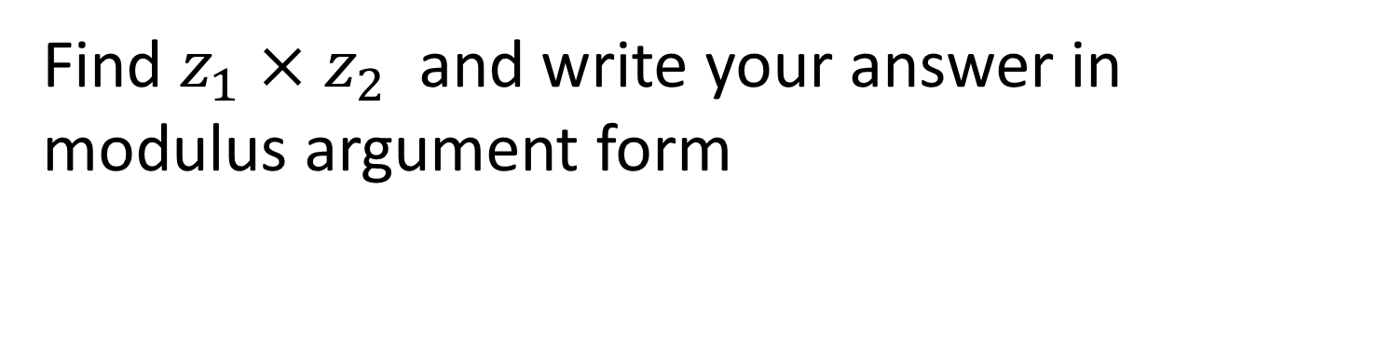
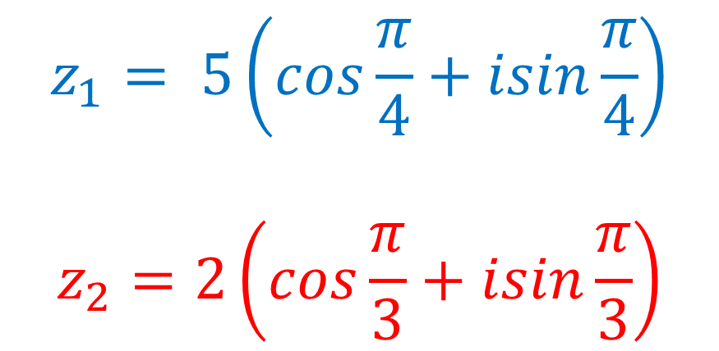
$$z_{1}= 5\left(cos\frac{π}{4}+isin\frac{π}{4}\right)$$
$$z_{2}=2\left(cos\frac{π}{3}+isin\frac{π}{3}\right)$$
Find $z_{1}×z_{2}$ and write your answer in modulus argument form
$$r\left(cosθ+isinθ\right)=x+iy$$

Slide 22

$$z_{1}= 5\left(cos\frac{π}{4}+isin\frac{π}{4}\right)$$
$$z_{2}=2\left(cos\frac{π}{3}+isin\frac{π}{3}\right)$$
Find $z_{1}×z_{2}$ and write your answer in modulus argument form
$$z_{1}×z_{2}=10\left(cos\frac{7π}{12}+isin\frac{7π}{12}\right)$$
$$r\left(cosθ+isinθ\right)=x+iy$$

Slide 23
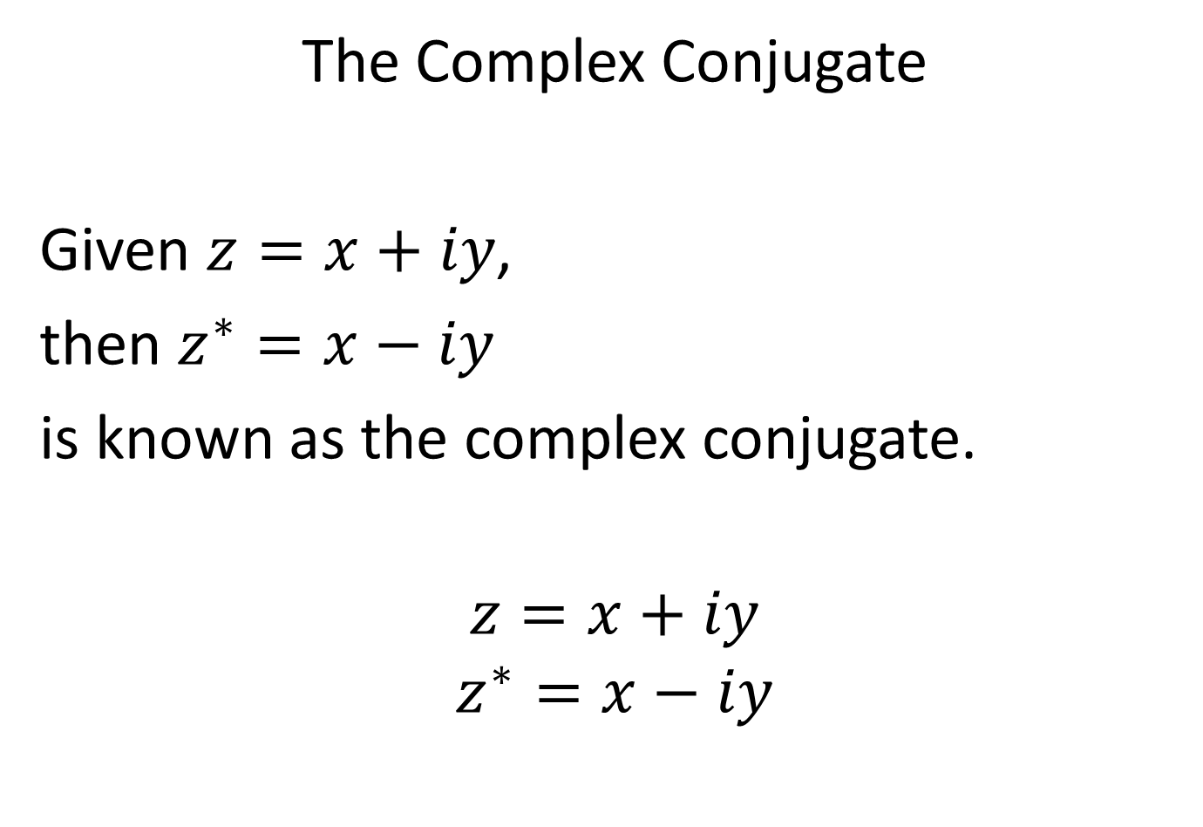
The Complex Conjugate
Given $z=x+iy$,
then $z^{∗}=x−iy$
is known as the complex conjugate.
$$z=x+iy$$
$$z^{∗}=x−iy$$

Slide 24

$$z=2+5i$$
Find:
$$z+z^{∗}$$
$$z−z^{∗}$$
$$zz^{∗}$$

Slide 25
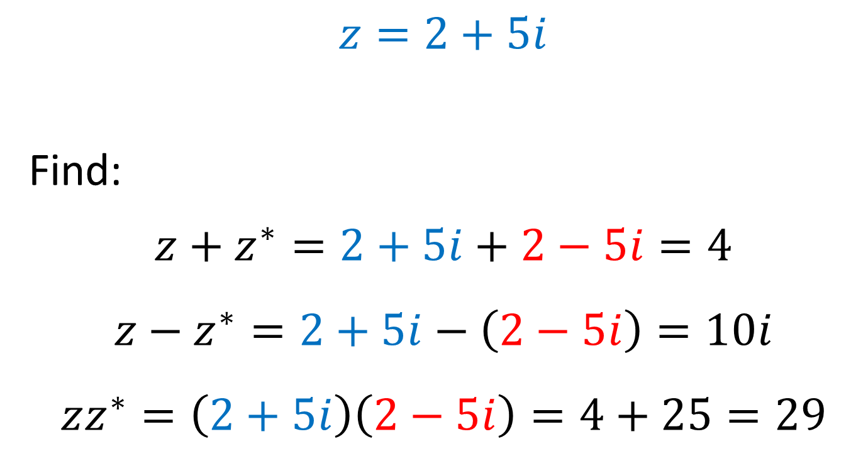
$$z=2+5i$$
Find:
$$z+z^{∗}=2+5i+2−5i=4$$
$$z−z^{∗}=2+5i−\left(2−5i\right)=10i$$
$$zz^{∗}=\left(2+5i\right)\left(2−5i\right)=4+25=29$$

Slide 26

Solve
$$z^{2}+2z+4=0$$
$${3z}^{2}+6z+9=0$$
$${3z}^{2}+4z+6=0$$

Slide 27
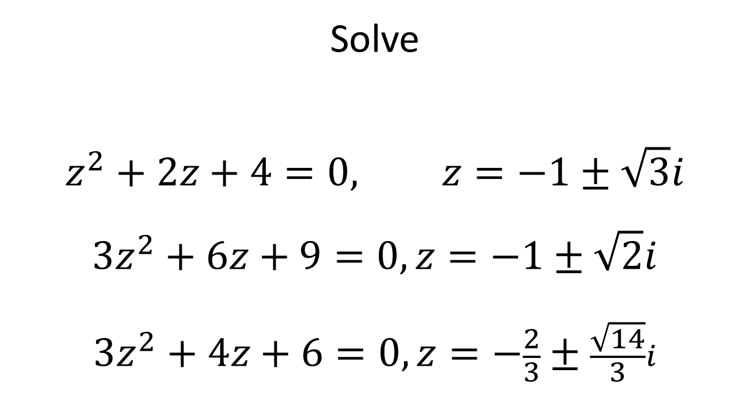
Solve
$$z^{2}+2z+4=0, z=−1±\sqrt{3}i$$
$${3z}^{2}+6z+9=0,z=−1±\sqrt{2}i$$
$${3z}^{2}+4z+6=0,z=−\frac{2}{3}±\frac{\sqrt{14}}{3}i$$

Slide 28
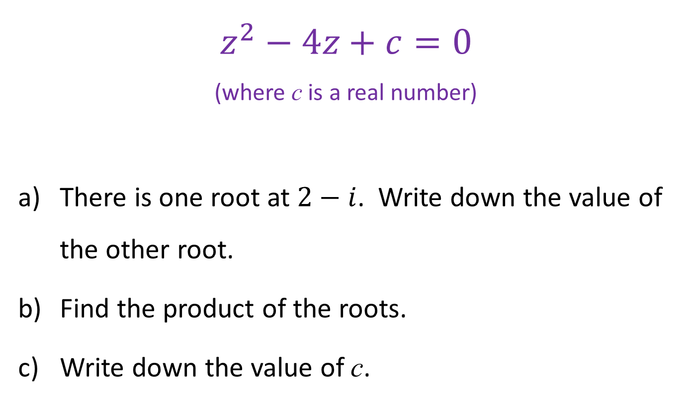
$$z^{2}−4z+c=0$$
(where c is a real number)
There is one root at $2−i$. Write down the value of the other root.
Find the product of the roots.
Write down the value of c.

Slide 29
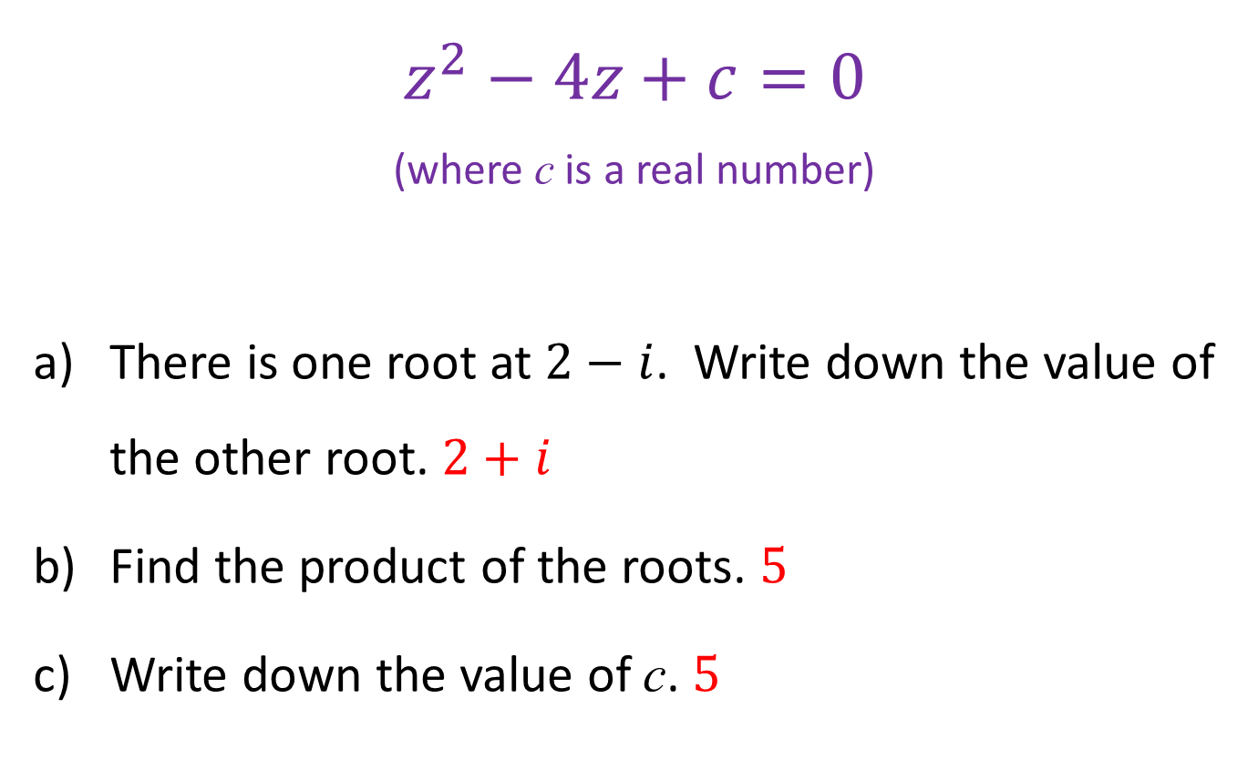
$$z^{2}−4z+c=0$$
(where c is a real number)
There is one root at $2−i$. Write down the value of the other root. $2+i$
Find the product of the roots. $5$
Write down the value of c. $5$

Slide 30
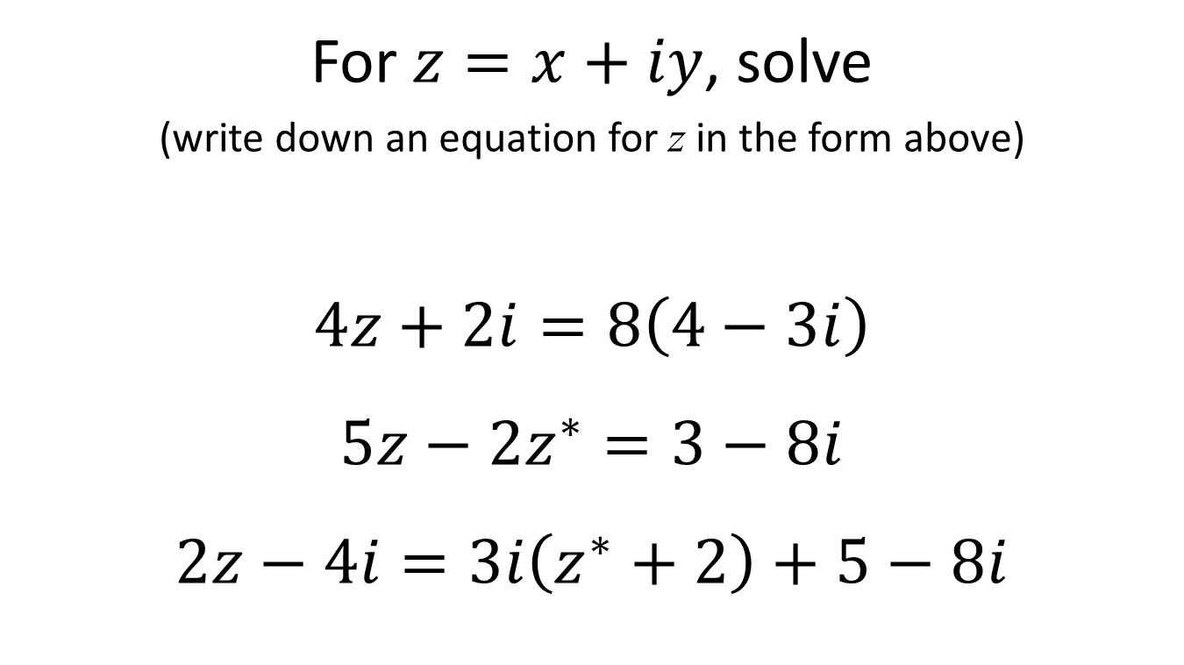
For $z=x+iy$, solve
(write down an equation for z in the form above)
$$4z+2i=8\left(4−3i\right)$$
$$5z−2z^{∗}=3−8i$$
$$2z−4i=3i\left(z^{∗}+2\right)+5−8i$$

Slide 31
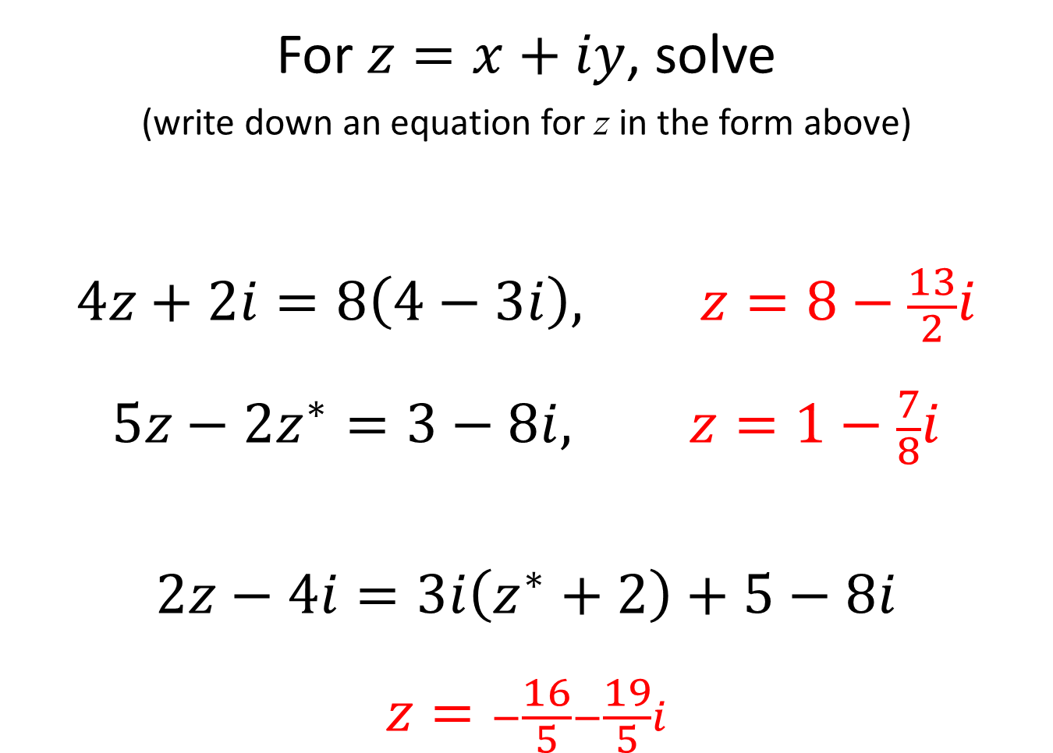
For $z=x+iy$, solve
(write down an equation for z in the form above)
$$4z+2i=8\left(4−3i\right), z=8−\frac{13}{2}i$$
$$5z−2z^{∗}=3−8i, z=1−\frac{7}{8}i$$
$$2z−4i=3i\left(z^{∗}+2\right)+5−8i$$
$$z=−\frac{16}{5}−\frac{19}{5}i$$

Slide 32
Deduce a method for multiplying and dividing complex numbers written in modulus-argument form
Sketch these on an Argand diagram
Multiply these
Sketch the result on the Argand diagram
Suggest how new angle is related to original angles
Suggest how new size is related to original size
Check and conclude
$$z=3+4i$$ | $$z=2+5i$$

