Slide 1
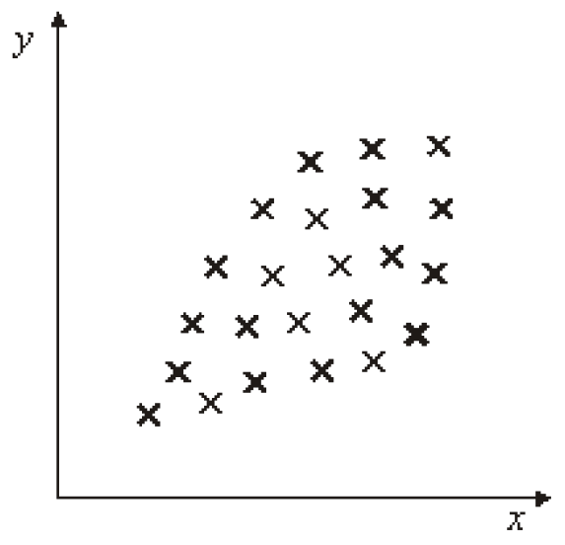
Discuss these correlations
A
B
C
D
F
G
H

