Slide 1
Two Differentiation Puzzles
This file contains two puzzles to consolidate understanding of differentiation.
Puzzle 1 on slide 2 involves positive, integer powers
Puzzle 2 on slide 3 involves negative and/or fractional powers.
To support students completing puzzle 1, slide 4 shows each of the graphs of puzzle 1.

Slide 2
When x = 2,
gradient = 4
Stationary
point at
(0, 4)
Equation of tangent at x = 2 is y = 4x
When x = 2,
y = 8
Stationary
points at
(0, 0) and
(2/3, -4/27)
Equation of tangent at x = 2 is y = 8x – 12
When x = 2,
gradient = 8
When x = 2,
y = 4
When x = 2,
gradient = 6
When x = 2,
y = 16
Stationary
point at
(5, 25)
Equation of tangent at x = 2 is y = 6x + 4
When x = 2,
gradient = 0
When x = 2,
y = 1
Stationary
points at
(-2, 9) and (2, 1)
Equation of tangent at x = 2 is y = 1
Stationary
points at
(-1, 3/4) and
(2, -6)
Equation of tangent at x = 2 is y = -6
When x = 2,
gradient = 0
When x = 2,
y = -6

Slide 3
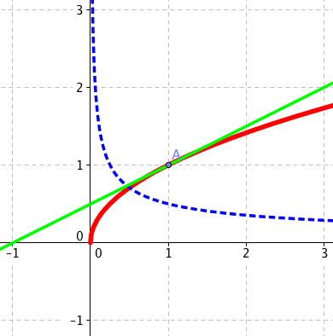
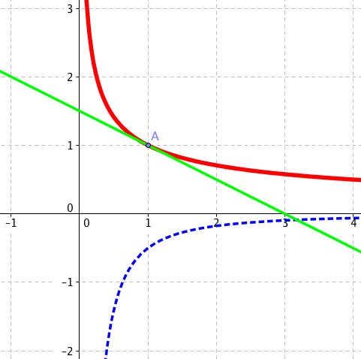
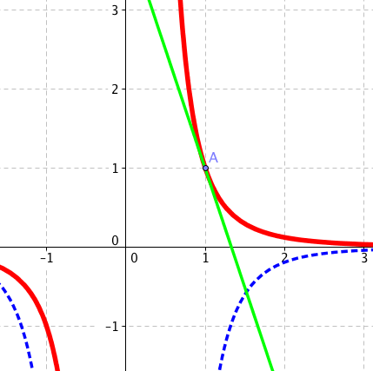
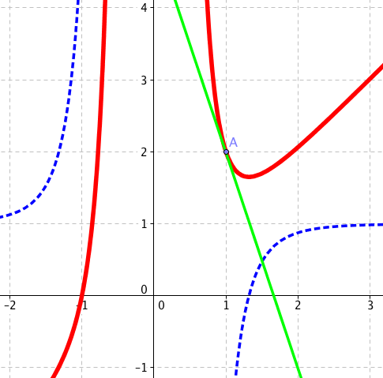
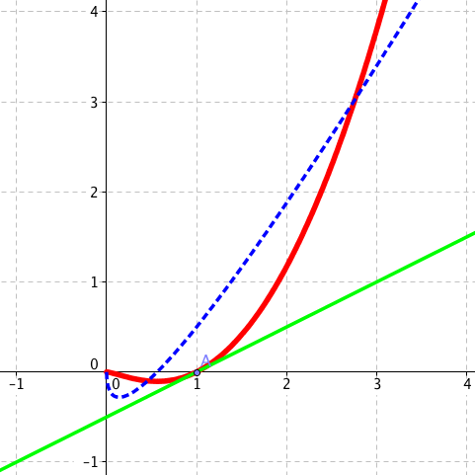
When x = 1,
gradient = 1/2
Equation of tangent at x = 1 is 2y = x + 1
When x = 1,
y = 1
Equation of tangent at x = 1 is 2y + x –3 = 0
When x = 1,
gradient = -1/2
When x = 1,
y = 1
When x = 1,
gradient = -3
When x = 1,
y = 1
Equation of tangent at x = 1 is y = 4 – 3x
When x = 1,
gradient = -3
When x = 1,
y = 2
Equation of tangent at x = 1 is y = 5 – 3x
Equation of tangent at x = 1 is 2y – x + 1 = 0
When x = 1,
gradient = 1/2
When x = 1,
y = 0

Slide 4
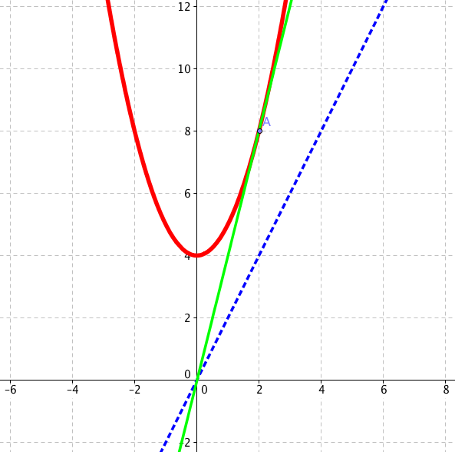
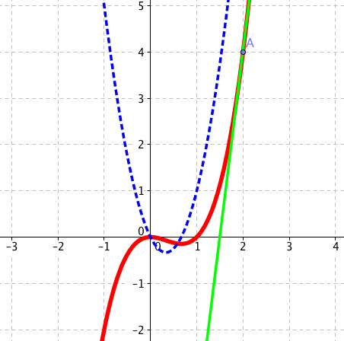
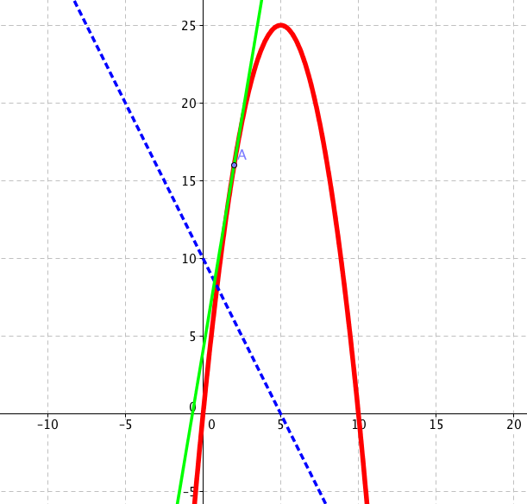
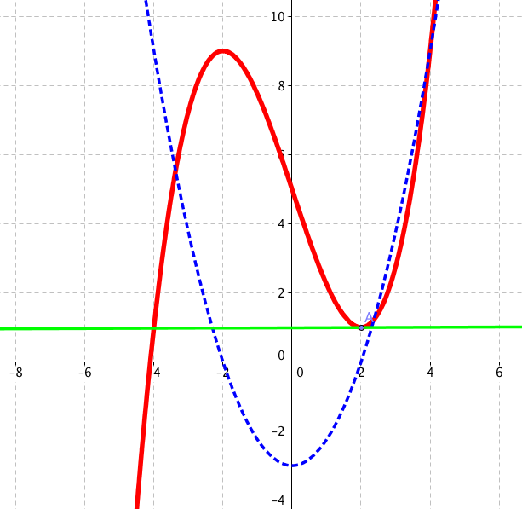
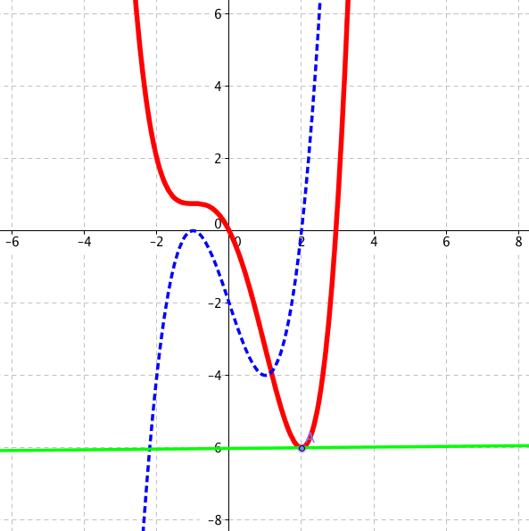
These graphs to support students completing task 1.

