Slide 1
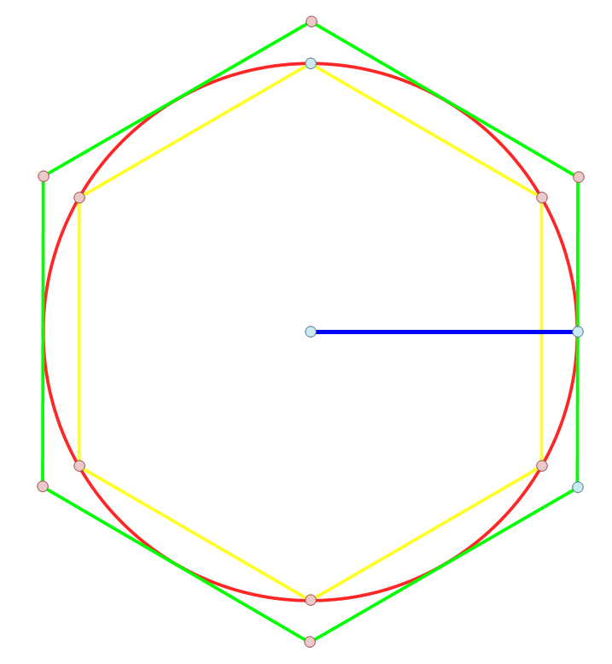
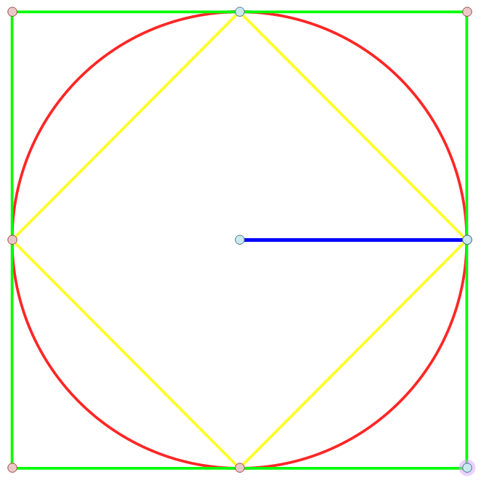
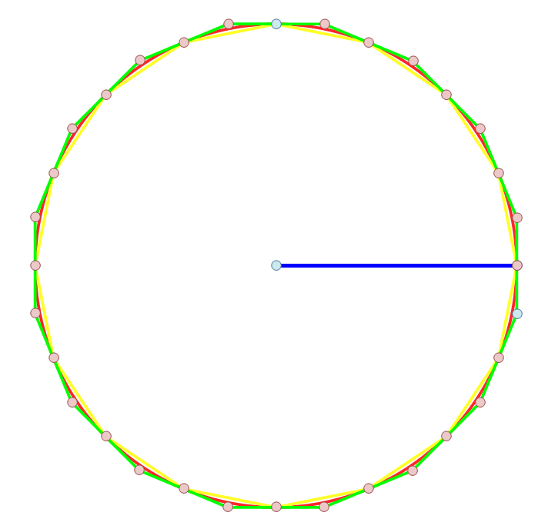



Use the yellow and green shapes below to find upper and lower bounds for $π$, refining your accuracy each time.
Squares
Hexagons
Hexadecagons
$$r=1$$
$$r=1$$
$$r=1$$
How about a general formula for $n$ sides?

Slide 2
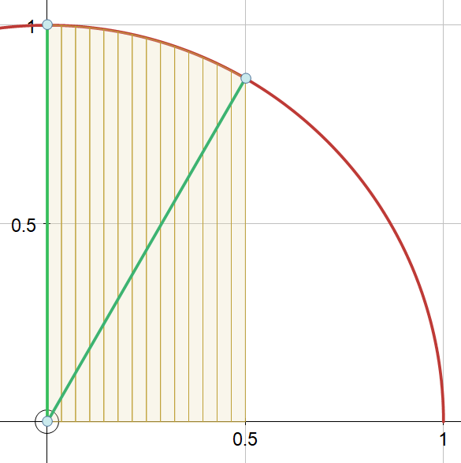
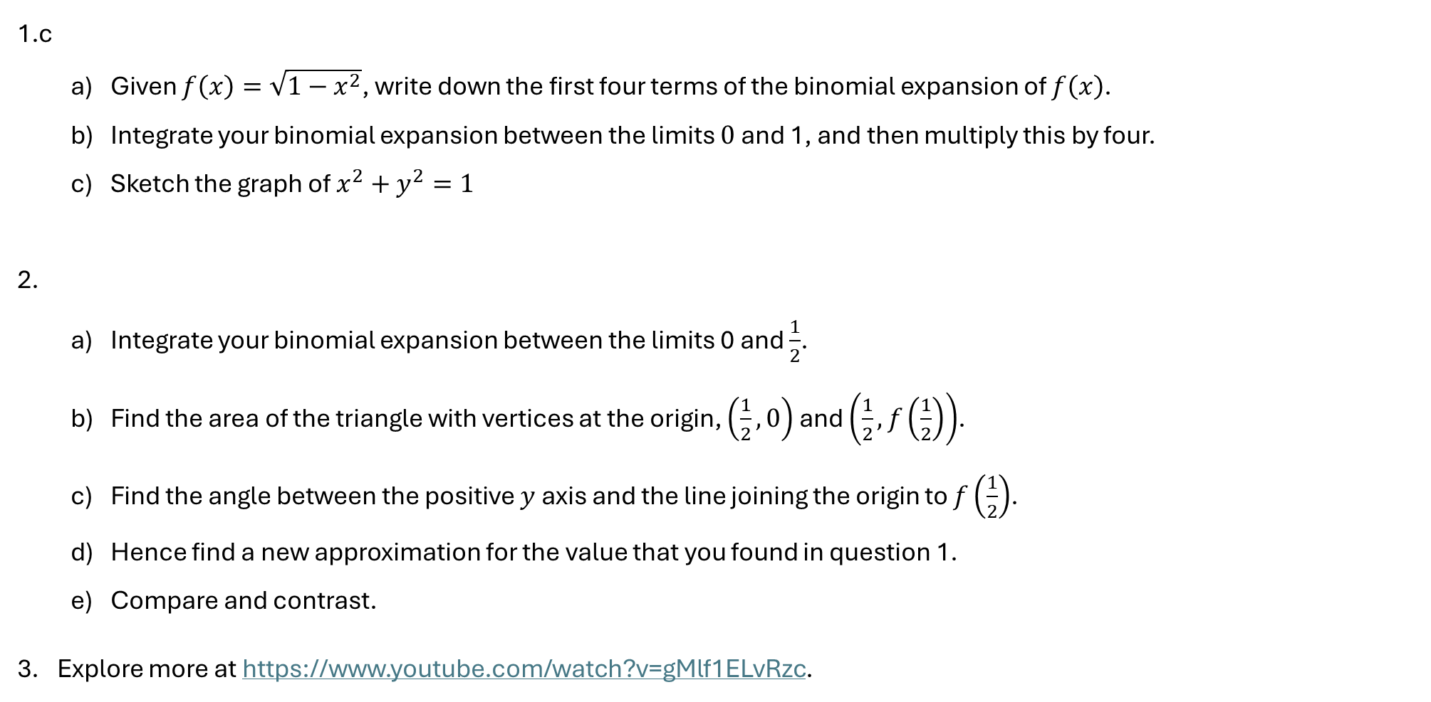
Application of Binomial Expansion
1.c
  Given $f\left(x\right)=\sqrt{1−x^{2}}$, write down the first four terms of the binomial expansion of $f\left(x\right)$.
  Integrate your binomial expansion between the limits $0$ and 1, and then multiply this by four.
  Sketch the graph of $x^{2}+y^{2}=1$
2.
  Integrate your binomial expansion between the limits 0 and $\frac{1}{2}$.
  Find the area of the triangle with vertices at the origin, $\left(\frac{1}{2},0\right)$ and $\left(\frac{1}{2},f\left(\frac{1}{2}\right)\right)$.
  Find the angle between the positive $y$ axis and the line joining the origin to $f\left(\frac{1}{2}\right)$.
  Hence find a new approximation for the value that you found in question 1.
  Compare and contrast.
Explore more at https://www.youtube.com/watch?v=gMlf1ELvRzc.

Slide 3
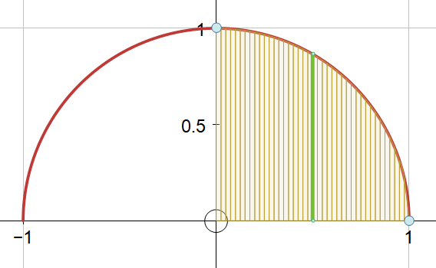
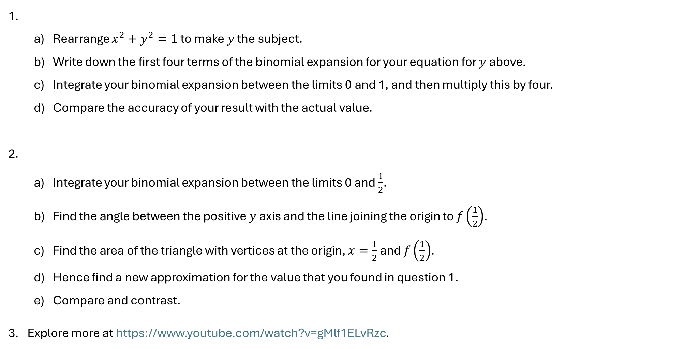
We’re gonna need a quicker method
1.
  Rearrange $x^{2}+y^{2}=1$ to make $y$ the subject.
  Write down the first four terms of the binomial expansion for your equation for $y$ above.
  Integrate your binomial expansion between the limits $0$ and 1, and then multiply this by four.
  Compare the accuracy of your result with the actual value.
2.
  Integrate your binomial expansion between the limits 0 and $\frac{1}{2}$.
  Find the angle between the positive $y$ axis and the line joining the origin to $f\left(\frac{1}{2}\right)$.
  Find the area of the triangle with vertices at the origin, $x=\frac{1}{2}$ and $f\left(\frac{1}{2}\right)$.
  Hence find a new approximation for the value that you found in question 1.
  Compare and contrast.
Explore more at https://www.youtube.com/watch?v=gMlf1ELvRzc.

Slide 4
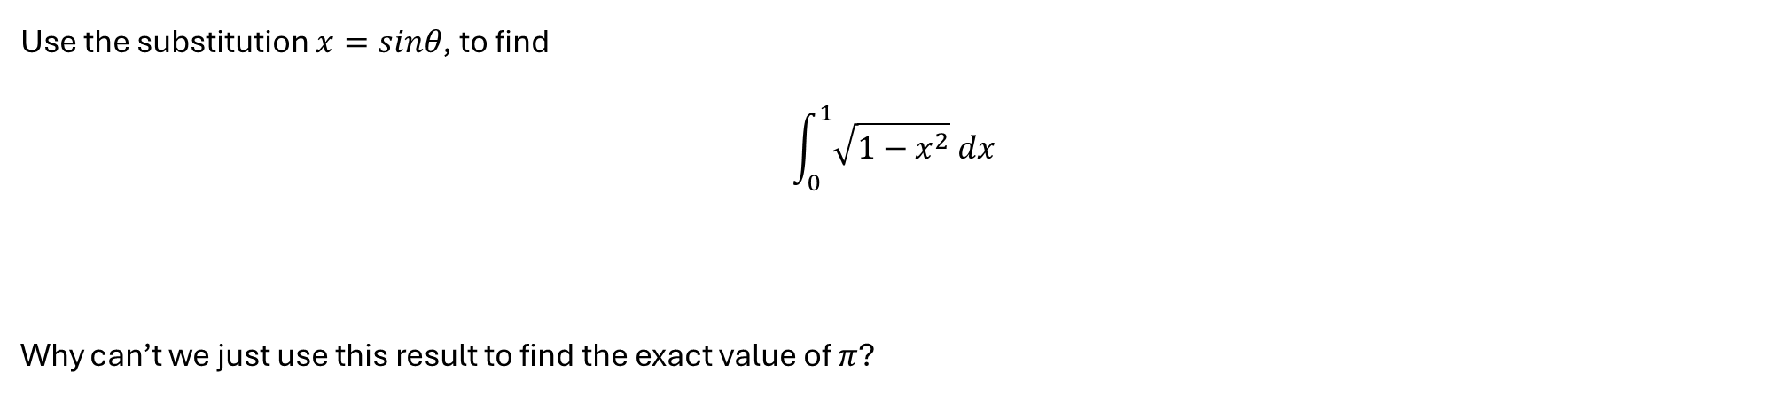
We’re gonna need a quicker method
Use the substitution $x=sinθ$, to find
$$\int_{0}^{1}{\sqrt{1−x^{2}} dx}$$
Why can’t we just use this result to find the exact value of $π$?

