Slide 1
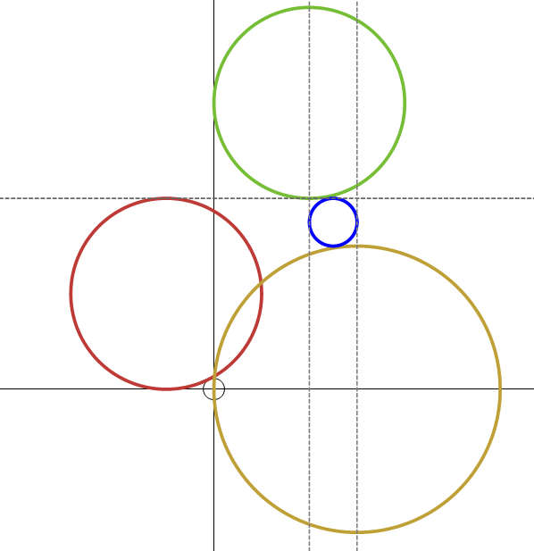
What is the equation of the blue circle?
2
-1
3

Slide 2
What is the equation of the blue circle?
$${\left(x−2\right) }^{2}+{\left(y−6\right) }^{2}=4$$
$${\left(x−\frac{5}{2}\right) }^{2}+{\left(y−\frac{7}{2}\right) }^{2}=\frac{1}{4}$$
$${\left(x+1\right) }^{2}+{\left(y−2\right) }^{2}=4$$
2
-1
3
$${\left(x−3\right) }^{2}+{y }^{2}=9$$

