Slide 1
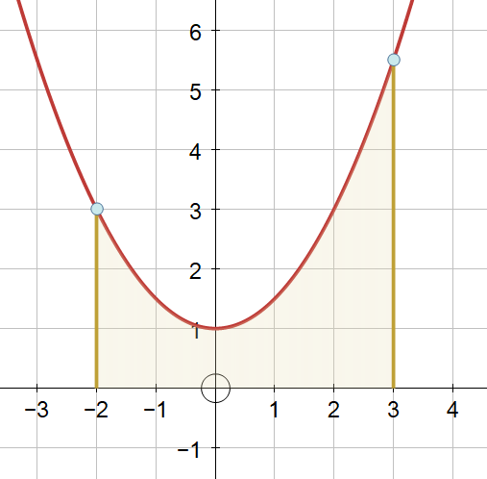
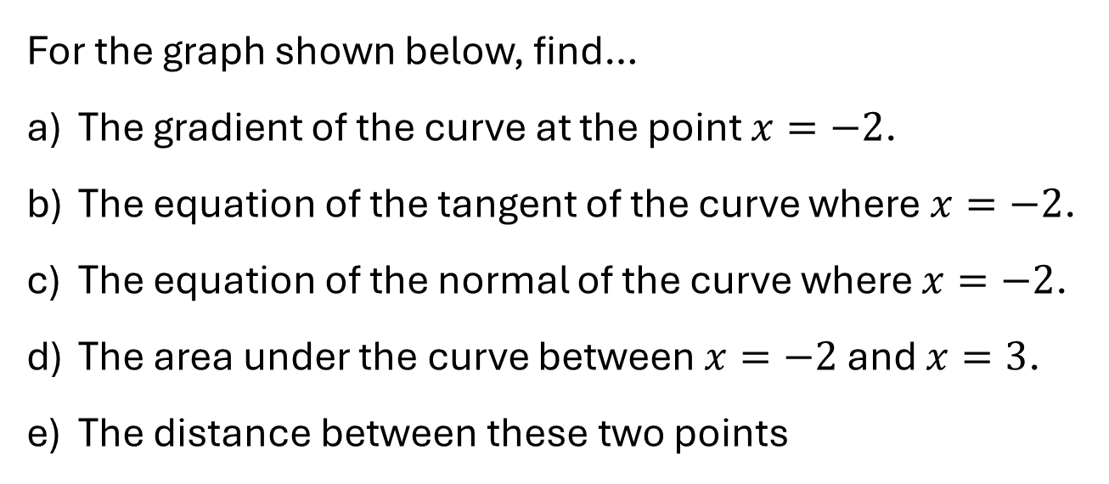

Questions
For the graph shown below, find…
The gradient of the curve at the point $x=−2$.
The equation of the tangent of the curve where $x=−2$.
The equation of the normal of the curve where $x=−2$.
The area under the curve between $x=−2$ and $x=3$.
The distance between these two points
$$f\left(x\right)=\frac{1}{2}x^{2}+1$$

Slide 2





Questions - answers
For the graph shown below, find…
The gradient of the curve at the point $x=−2$.
The equation of the tangent of the curve where $x=−2$.
The equation of the normal of the curve where $x=−2$.
The area under the curve between $x=−2$ and $x=3$.
The distance between these two points
$$−2$$
$$y=−2x−1$$
$$y=\frac{1}{2}x+4$$
$$\frac{65}{6}$$
$$f\left(x\right)=\frac{1}{2}x^{2}+1$$
$$\frac{5\sqrt{5}}{2}$$

Slide 3
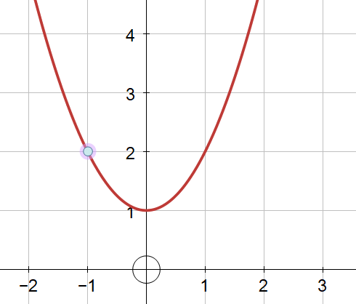
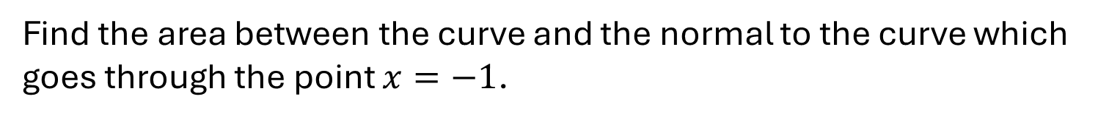

Now Try This
Find the area between the curve and the normal to the curve which goes through the point $x=−1$.
(it’s a different value to the previous one)
(it’s a different value to the previous one)
$$f\left(x\right)=x^{2}+1$$

Slide 4
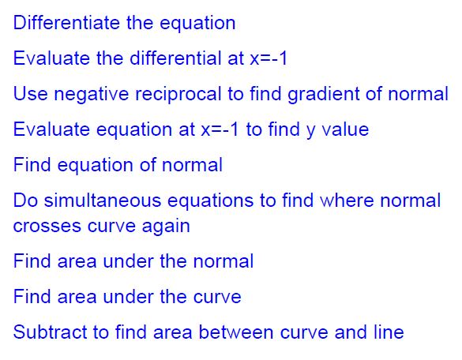
Now Try This
Find the area between the curve and the normal to the curve which goes through the point $x=−1$.
(it’s a different value to the previous one)
(it’s a different value to the previous one)
$$f\left(x\right)=x^{2}+1$$

Slide 5
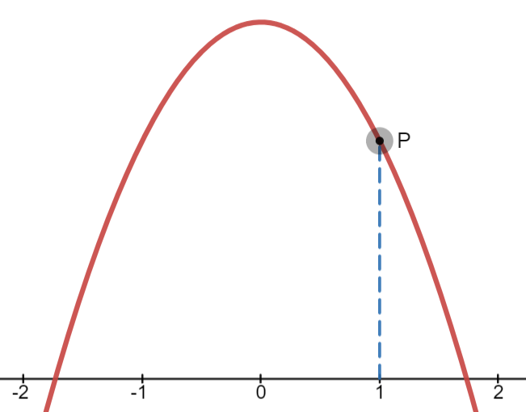


Shade these areas…
Between the curve, the y-axis, and the tangent to the curve at P.
Between the curve, the x-axis, and the tangent to the curve at P.
The finite area between the curve, and the normal to the curve at P.
why ‘finite’?
$$f\left(x\right)=3−x^{2}$$
$$f\left(x\right)=3−x^{2}$$

Slide 6
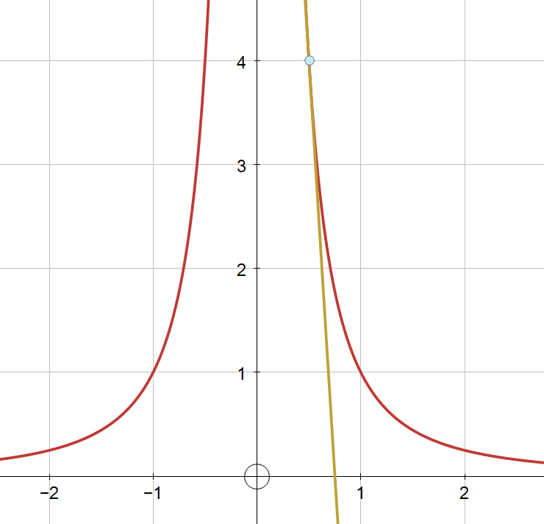
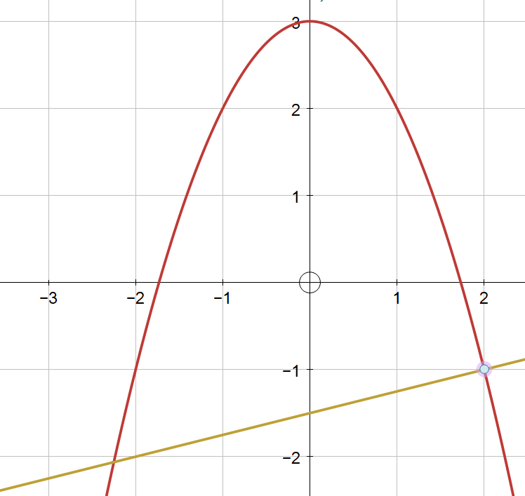
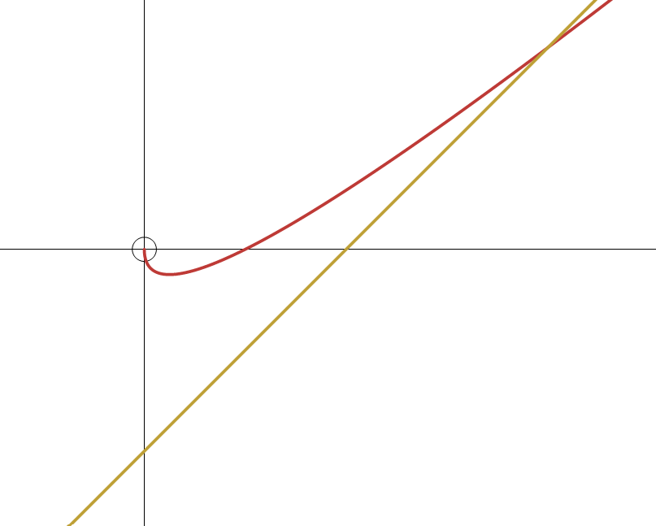
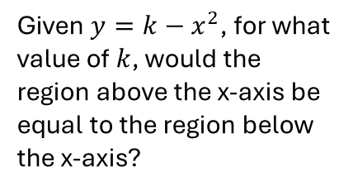
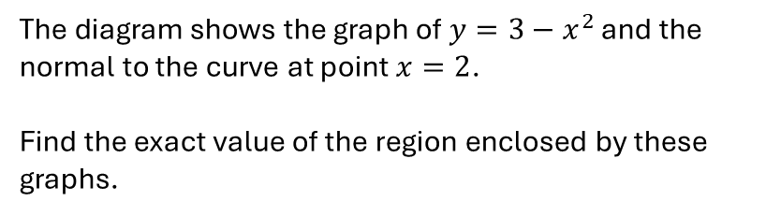
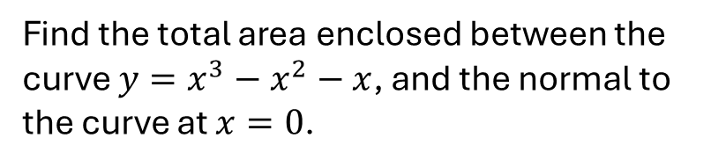

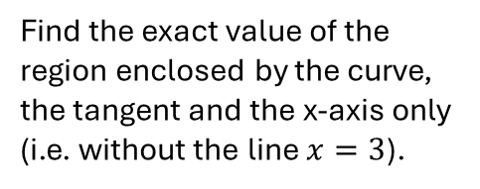

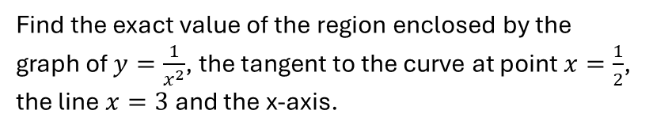
Find the exact value of the region enclosed by the graph of $y=\frac{1}{x^{2}}$, the tangent to the curve at point $x=\frac{1}{2}$, the line $x=3$ and the x-axis.
The diagram shows the graph of $y=3−x^{2}$ and the normal to the curve at point $x=2$.
Find the exact value of the region enclosed by these graphs.
Find the exact value of the region enclosed by the curve, the tangent and the x-axis only (i.e. without the line $x=3$).
Given $y=k−x^{2}$, for what value of $k$, would the region above the x-axis be equal to the region below the x-axis?
Find the total area enclosed between the curve $y=x^{3}−x^{2}−x$, and the normal to the curve at $x=0$.
Find the area between the curve and the line shown, and the y-axis.
$$y=x−\sqrt{x}$$
$y=x−2$

Slide 7
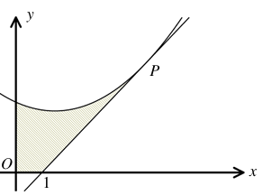
Answers…
TBC
TBC
TBC
TBC

Slide 8
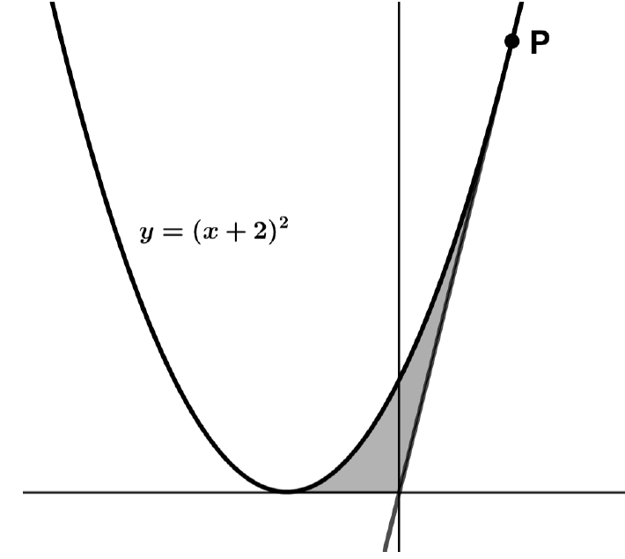
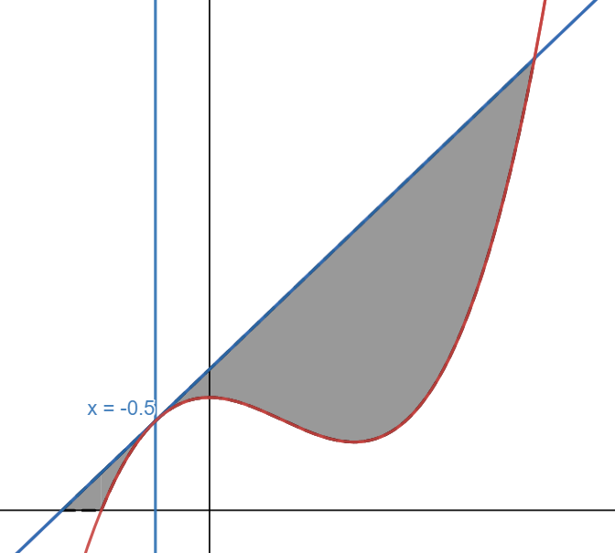

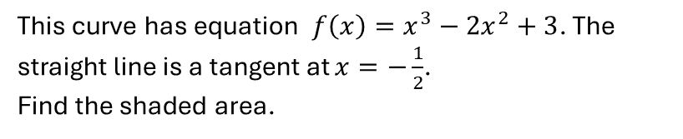
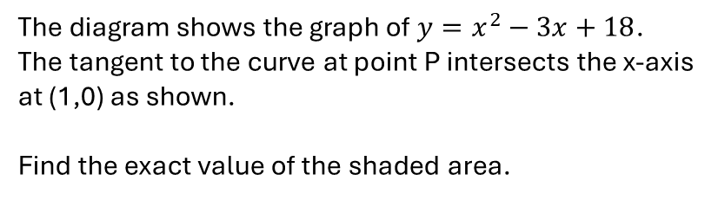


Find the area between the curve, the y-axis, and the tangent to the curve which goes through the point P.
The diagram shows the graph of $y=x^{2}−3x+18$.
The tangent to the curve at point P intersects the x-axis at (1,0) as shown.
Find the exact value of the shaded area.
Find the finite area between the curve, and the normal to the curve which goes through the point P.
$$y=3−x^{2}$$
The tangent to the curve at point P passes through the origin. Work out the shaded area.
This curve has equation $f\left(x\right)=x^{3}−2x^{2}+3$. The straight line is a tangent at $x=−\frac{1}{2}$.
Find the shaded area.
$$y$$
$$x$$

Slide 9

Answers…
Area is $\frac{1}{3}$, Area is $\frac{125}{48}$
Area = $\frac{16}{3}$
Area = $\frac{229}{6}$
Area = $\frac{424}{33}$

