Slide 1
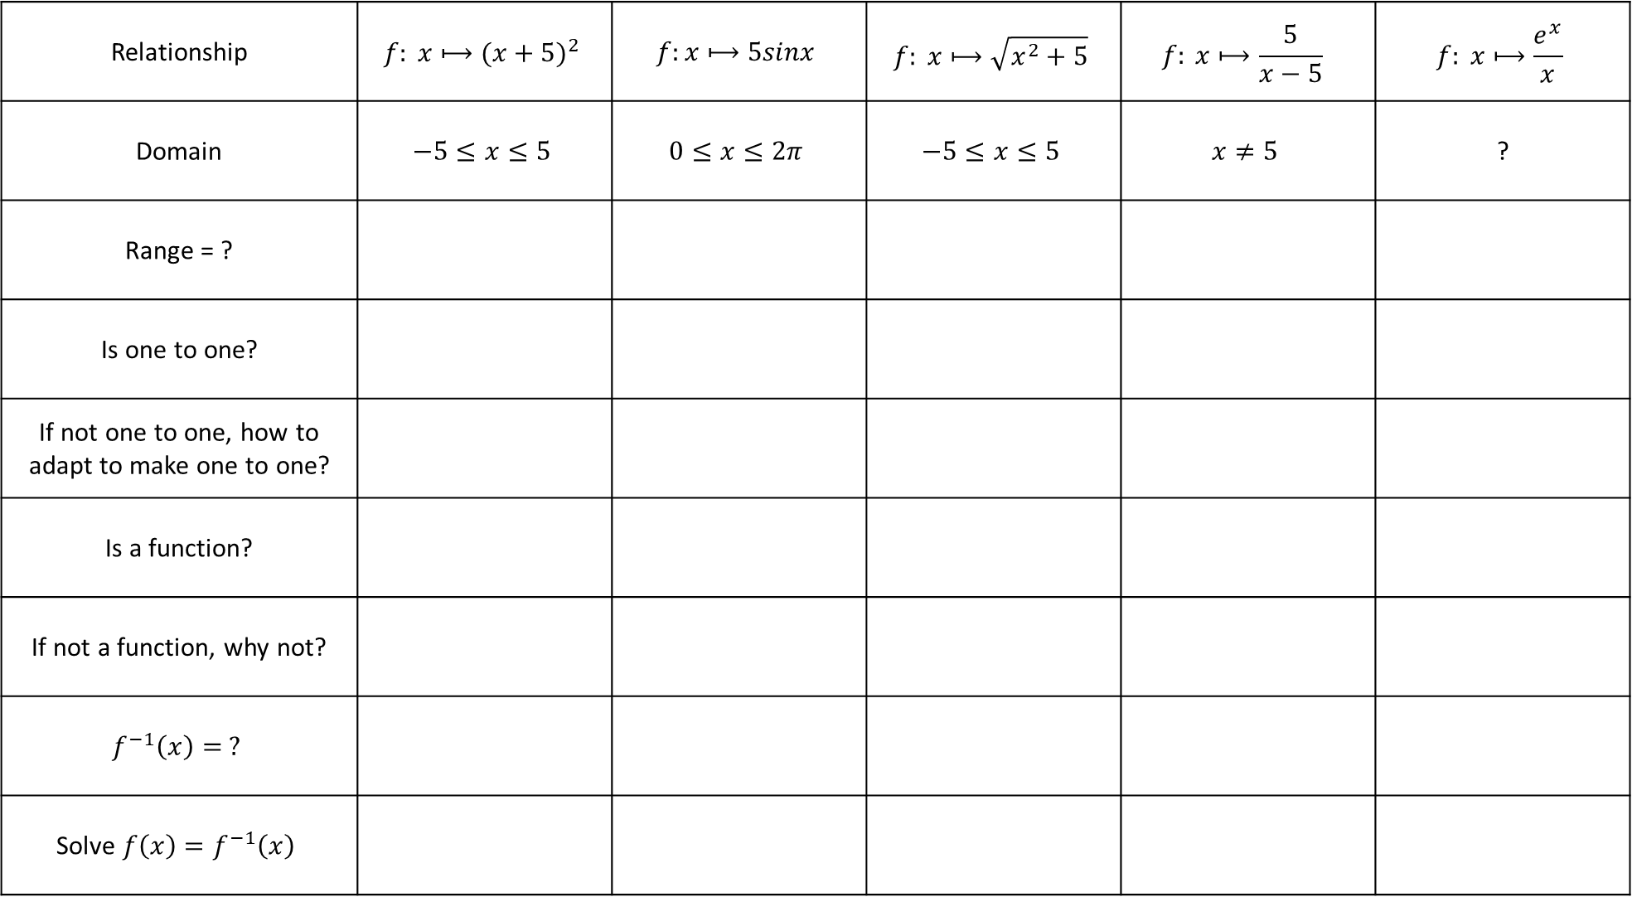
Relationship | $$f: x⟼{(x+5)}^{2}$$ | $$f:x⟼5sinx$$ | $$f: x⟼\sqrt{x^{2}+5}$$ | $$f: x⟼\frac{5}{x−5}$$ | $$f: x⟼\frac{e^{x}}{x}$$
Domain | $$−5≤x≤5$$ | $$0≤x≤2π$$ | $$−5≤x≤5$$ | $$x≠5$$ | ?
Range = ?
Is one to one?
If not one to one, how to adapt to make one to one?
Is a function?
If not a function, why not?
$$f^{−1}\left(x\right)= ?$$
Solve ${f\left(x\right)=f}^{−1}\left(x\right)$
How many graphs will you sketch?

Slide 2
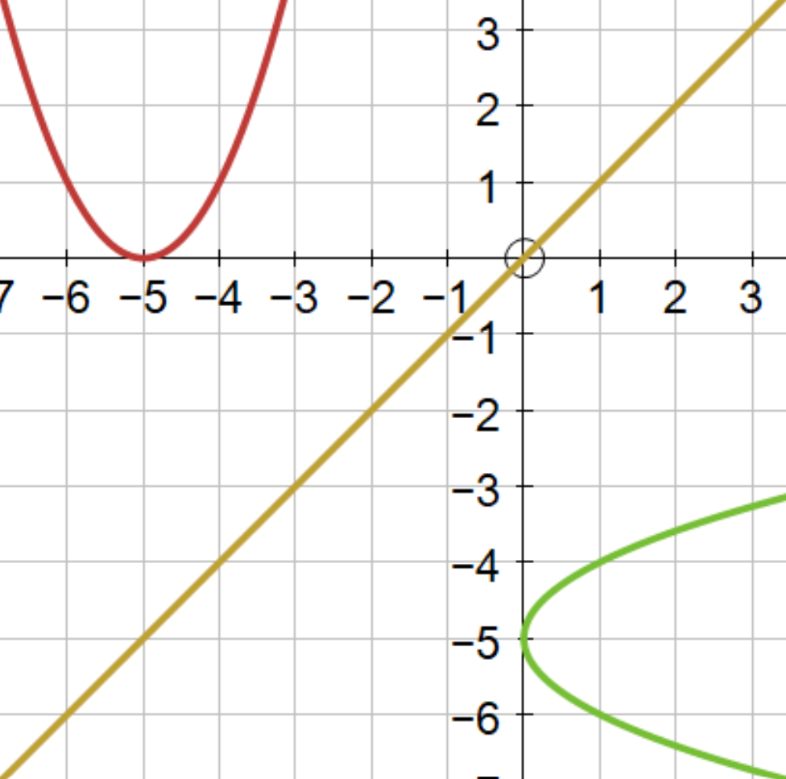
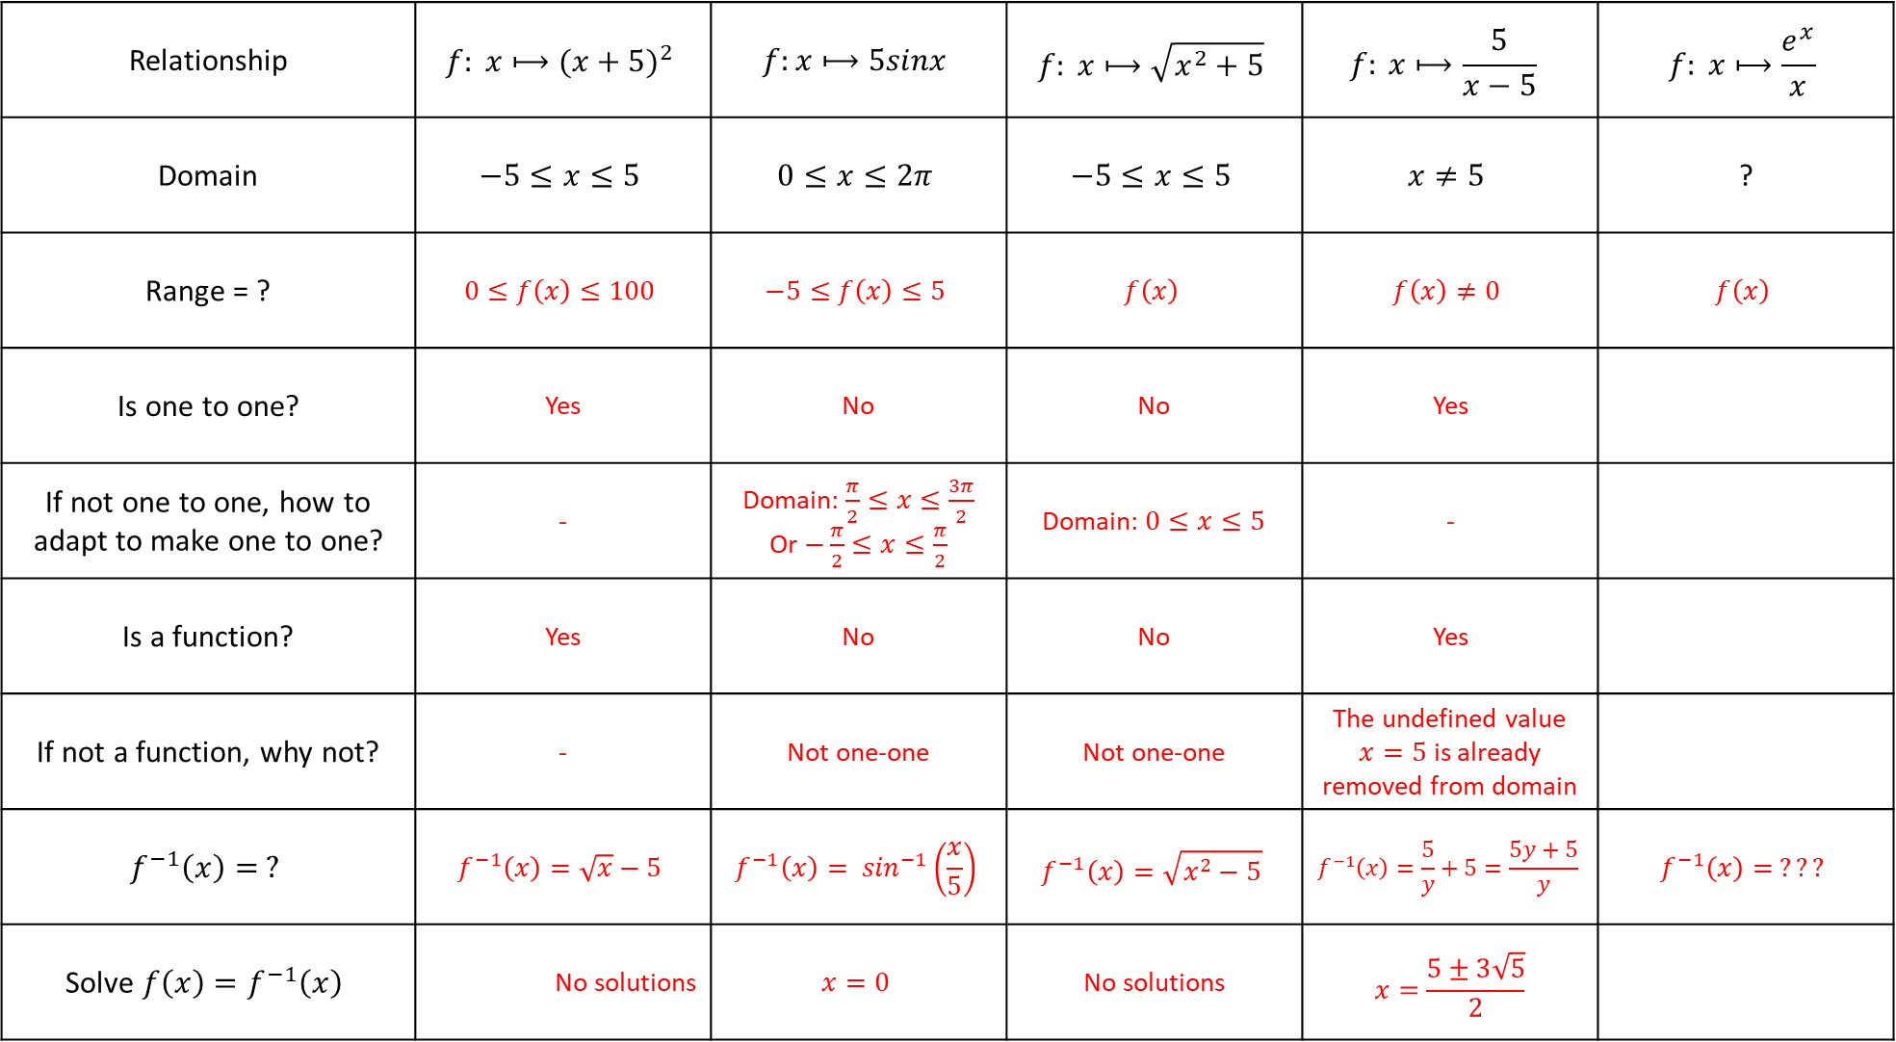
Relationship | $$f: x⟼{(x+5)}^{2}$$ | $$f:x⟼5sinx$$ | $$f: x⟼\sqrt{x^{2}+5}$$ | $$f: x⟼\frac{5}{x−5}$$ | $$f: x⟼\frac{e^{x}}{x}$$
Domain | $$−5≤x≤5$$ | $$0≤x≤2π$$ | $$−5≤x≤5$$ | $$x≠5$$ | ?
Range = ? | $$0≤f\left(x\right)≤100$$ | $$−5≤f\left(x\right)≤5$$ | $$f\left(x\right)$$ | $$f\left(x\right)≠0$$ | $$f\left(x\right)$$
Is one to one? | Yes | No | No | Yes
If not one to one, how to adapt to make one to one? | - | Domain: $\frac{π}{2}≤x≤\frac{3π}{2}$ Or $−\frac{π}{2}≤x≤\frac{π}{2}$ | Domain: $0≤x≤5$ | -
Is a function? | Yes | No | No | Yes
If not a function, why not? | - | Not one-one | Not one-one | The undefined value $x=5$ is already removed from domain
$$f^{−1}\left(x\right)= ?$$ | $$f^{−1}\left(x\right)=\sqrt{x}−5$$ | $$f^{−1}\left(x\right)= \sin^{−1}\left(\frac{x}{5}\right)$$ | $$f^{−1}\left(x\right)=\sqrt{x^{2}−5}$$ | $$f^{−1}\left(x\right)=\frac{5}{y}+5=\frac{5y+5}{y}$$ | $$f^{−1}\left(x\right)= ???$$
Solve ${f\left(x\right)=f}^{−1}\left(x\right)$ | No solutions | $$x=0$$ | No solutions | $$x=\frac{5±3\sqrt{5}}{2}$$
How many graphs did you sketch?

