Slide 1
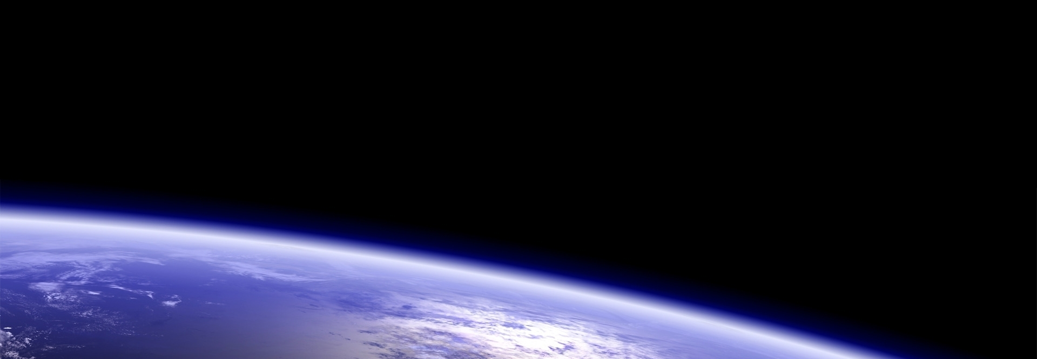
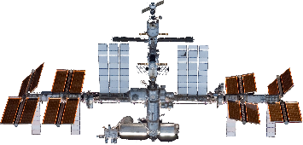
How High?
Rank these objects by distance
from Earth’s surface

Slide 2
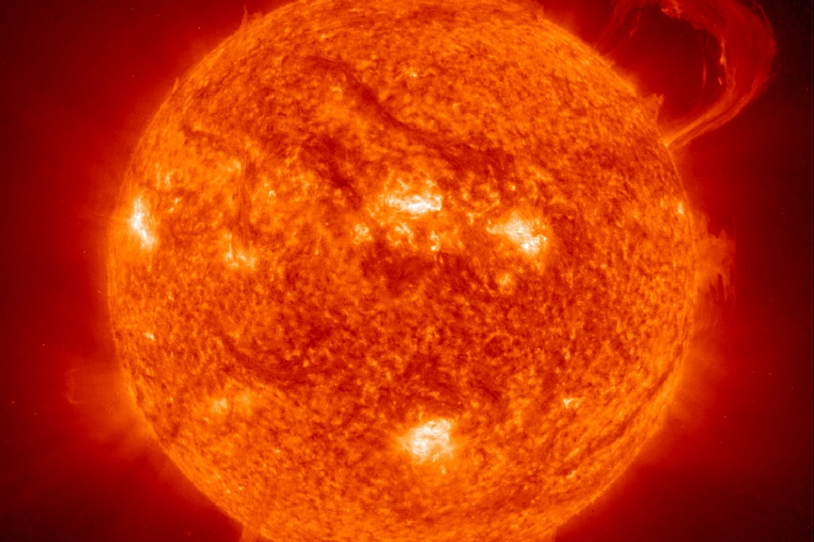
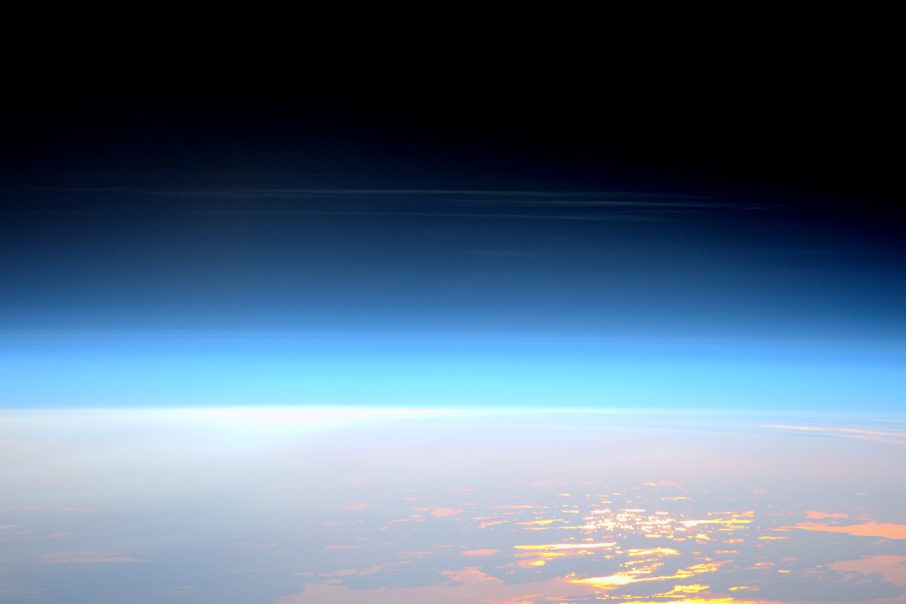
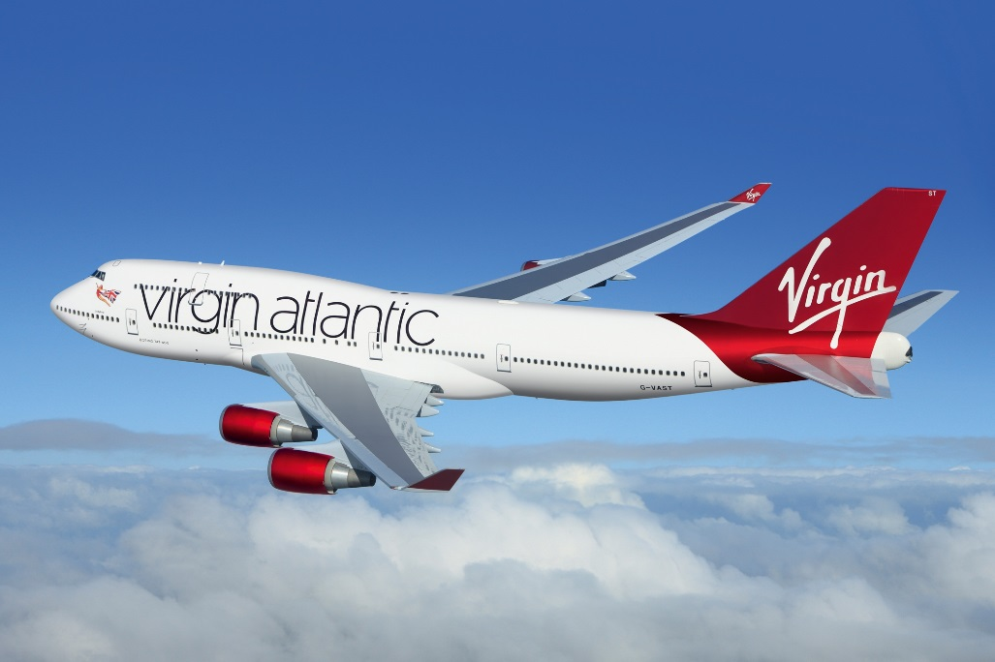
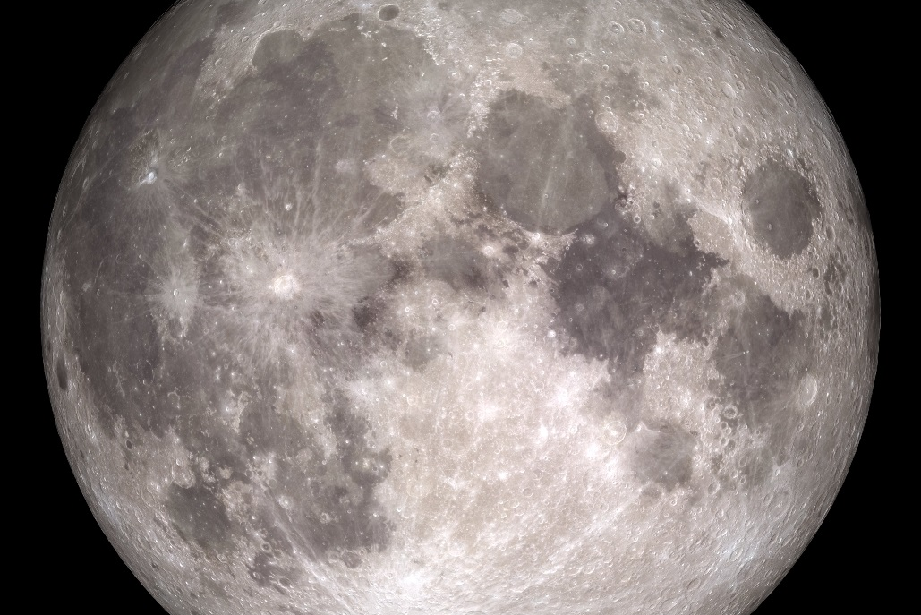
Our Sun
Official Limit of Space
Transatlantic Jet
The Moon

Slide 3
93,000,000 miles = 1AU
50 miles
AU = Astronomical Unit
http://www.science20.com/satellite_diaries/how_high_space-69753
35,000 feet = 6.62 miles
363,000 to 405,000 km
(approx 240,000 miles)

Slide 4
This is the distance to our Sun and is important as it enables us to work out much of the science of life here on Earth.
This distance is a standard unit in astronomy and provides a guide to other distances relative to our Earth and Sun.
This distance was unknown until the 1761 Transit of Venus across the face of the Sun.
This figure is actually rather arbitrary and disputable as there is no definitive line or marking, instead rather more of a blurring.
It will however be important to private space companies seeking to claim to be able to provide trips into space.
Beyond Earth’s environment there is no air or pressure meaning that aeroplanes or jet engines would no longer function.
This distance is important as it is the optimal height at which aeroplanes fly.
In the higher altitudes the air is thinner so there is less drag on the aeroplane meaning greater fuel efficiency and increased speeds (shorter travel time). However, this is negated by the need for air intake into the jet engines so a compromise is reached at this altitude.
This astronomical body is Earth’s only natural satellite. Without this natural satellite life on Earth would be very different indeed as it effects the tides and protects us from meteorites, amongst many other things.
Only twelve humans, all American men, have explored this body, all between the years of 1969-1972. This distance was very important in working out how to achieve this goal before the end of that decade.

Slide 5
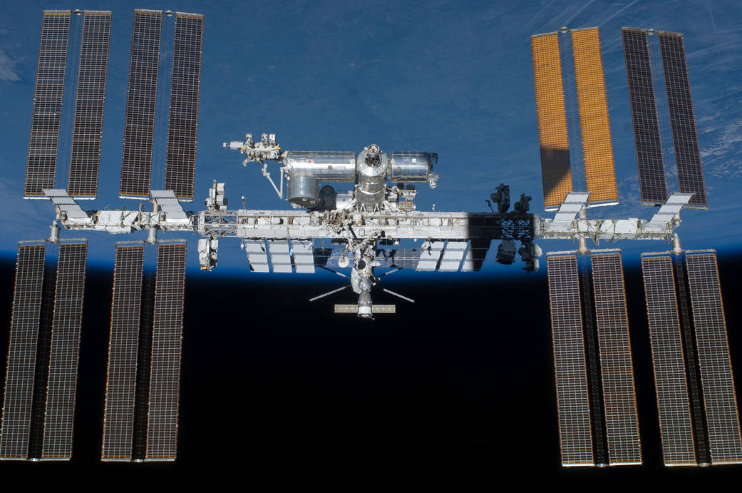
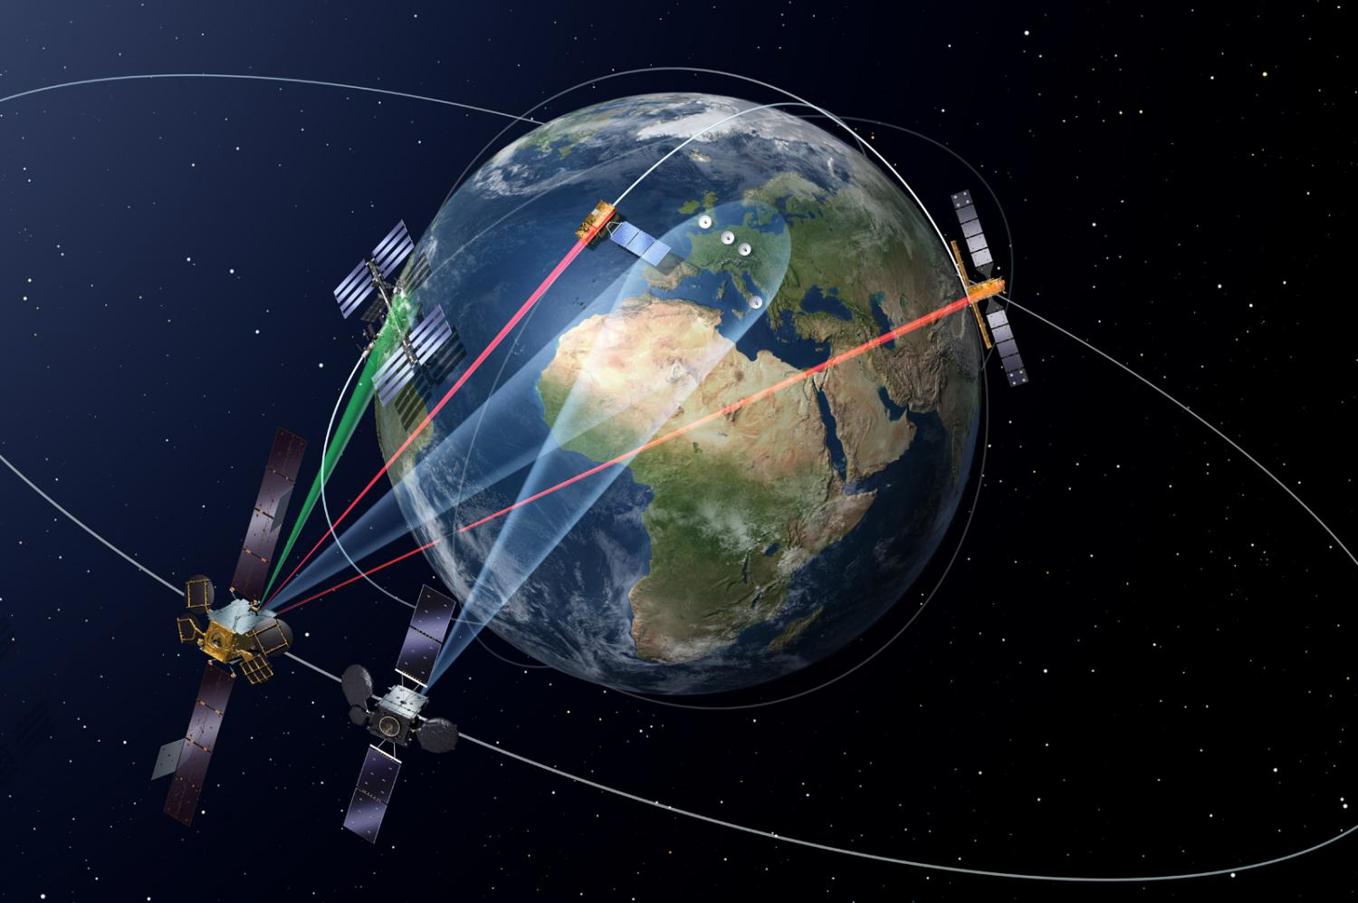
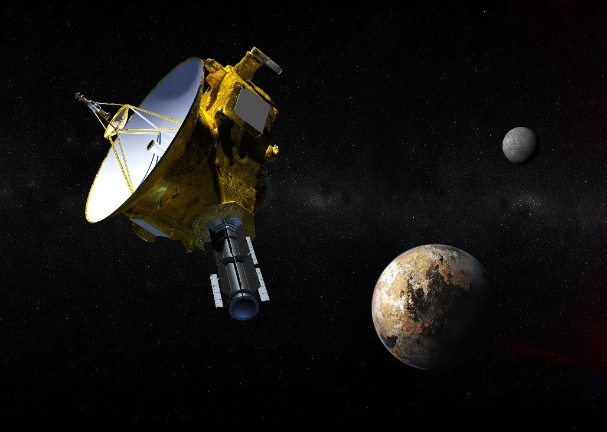
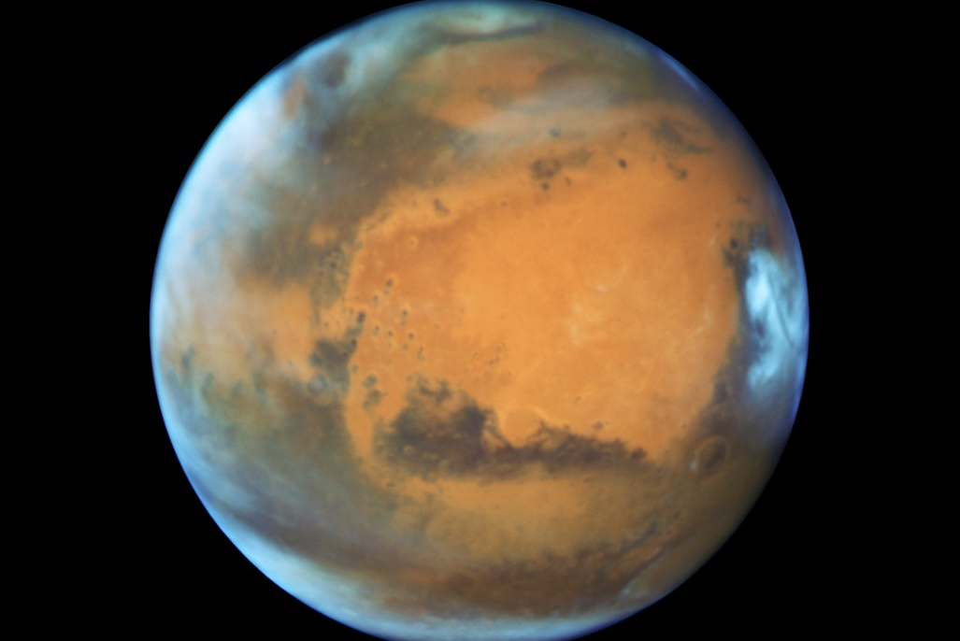
International Space Station
Geostationary Orbit
New Horizons Spacecraft
Mars

Slide 6
250 miles ≈ 400 km
22,236 miles
48,000,000 to 234,000,000 miles
39.53 AU

Slide 7
At this distance, satellites orbit the Earth once every 90 minutes. This means that astronauts experience 16 sunrises and sunsets every 24 hours.
This distance is known as low Earth orbit and is important as it is the smallest distance at which human spacecraft can safely orbit the Earth.
This spacecraft is the size of two football pitches and has been permanently manned since 2000.
This is the distance at which satellites orbiting the Earth complete one orbit every 24 hours.
This is important because this is the same speed as the rotation of the Earth meaning that the satellites effectively remain above a fixed point on the Earth.
GPS, television and communication satellites are all examples of geostationary satellites.
This spacecraft was launched in 2006 and performed a flyby of Pluto in 2015, being the first ever spacecraft to achieve this.
The spacecraft has since continued to travel beyond Pluto’s orbit and to reach the Kuiper Belt in 2019.
This distance is important as it provides an effective size (radius) of our solar system.
These distances are the closest and farthest between this planet and the Earth. The distance varies as the Earth orbits our Sun much faster than this planet, consequently they are sometimes closer together and sometimes further apart.
These distances are extremely important in planning any space mission to this planet, and will be particularly so for any manned mission.

Slide 8
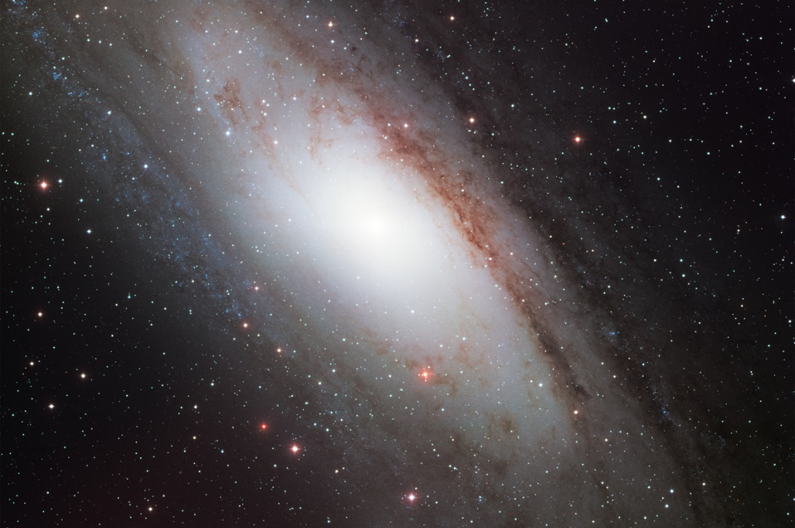
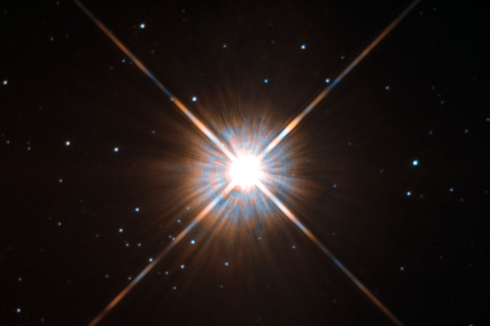
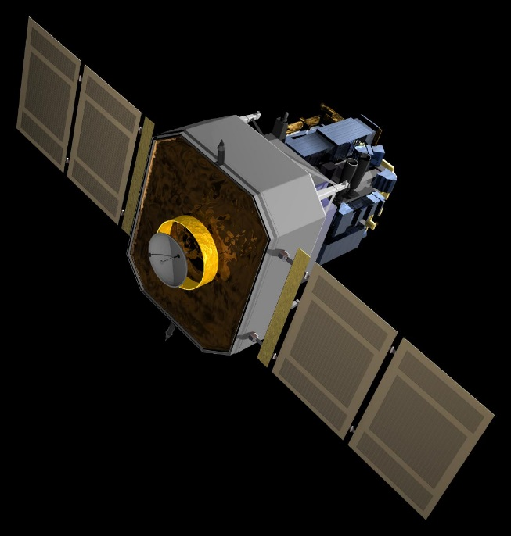
Andromeda Galaxy
Alpha Centauri
SOHO Solar Observatory

Slide 9
2,537,000 light years
4.367 light years
1 light year ≈ 5.879 × 10¹² miles
1 light second ≈ 186,000 miles
1 light year ≈ 5.879 × 10¹² miles
1 light second ≈ 186,000 miles
932,000 miles
≈ 1,500,000 km

Slide 10
Of the 100 billion galaxies in the universe, this is the closest to us.
This distance is important because this galaxy is travelling towards our own and will one day collide with ours.
This galaxy is a spiral galaxy and contains around 1 trillion stars.
Beyond the solar system, this is the nearest star to Earth.
This distance is important because it is the smallest distance that light from the stars has to travel to reach us. It is also the shortest time in which light has travelled from any star to reach us on Earth.
This satellite enables scientists and astronomers to study and learn about our Sun. As a result of the satellite we now understand a lot more about how our Sun works and its effects on our Earth.
This distance is important at it is the position of one of four Lagrange points around the Earth and, for this particular point, at which the gravitational pull of the Sun matches the opposing gravitational pull of the Earth.

