Slide 1
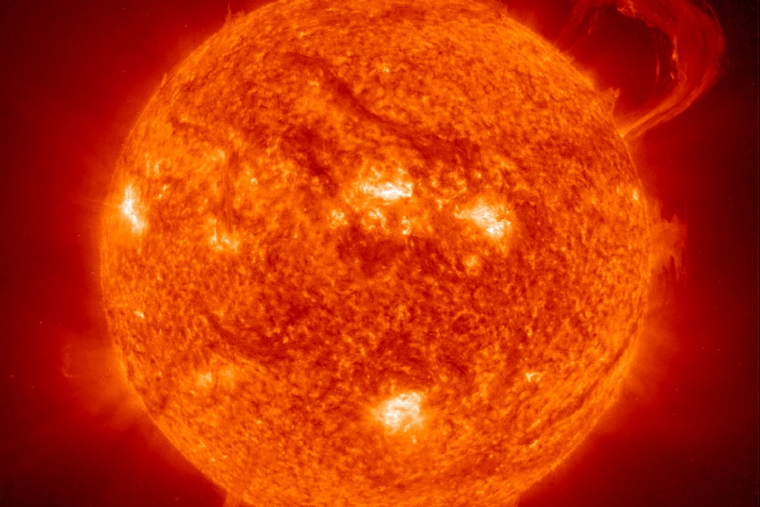
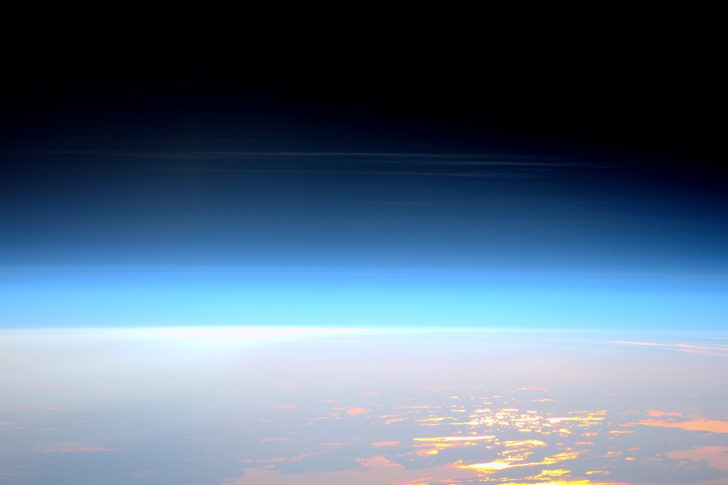
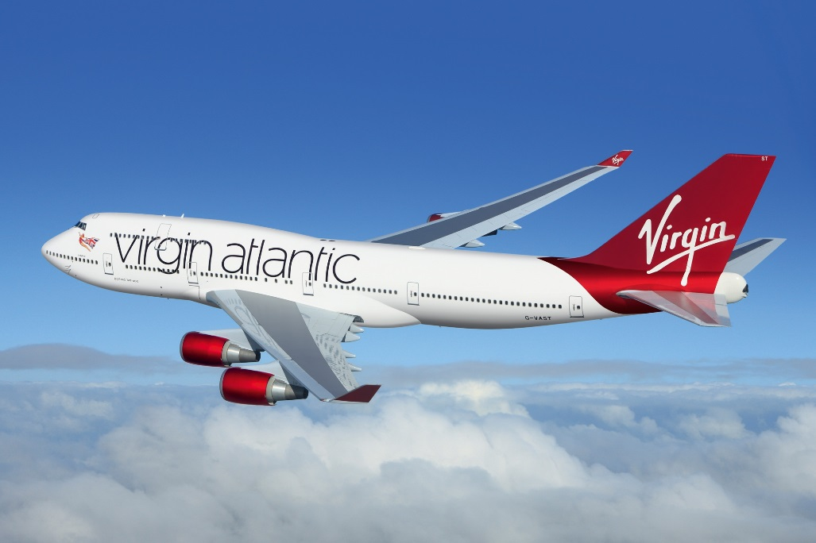
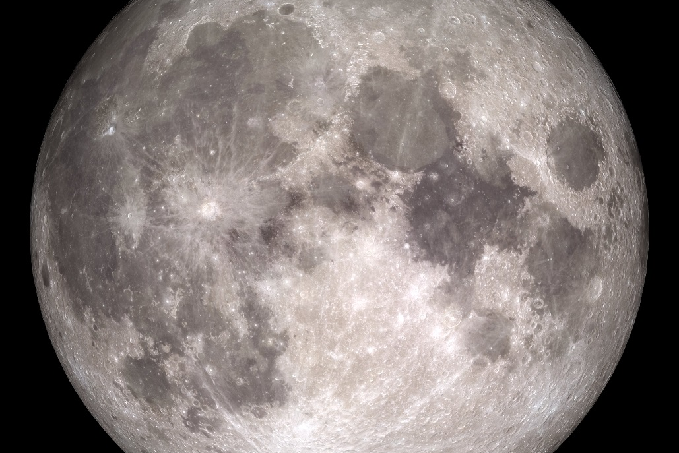
Our Sun
Official Limit of Space
Transatlantic Jet
The Moon

Slide 2
93,000,000 miles = 1AU
50 miles
AU = Astronomical Unit
35,000 feet = 6.62 miles
About 240,000 miles

Slide 3
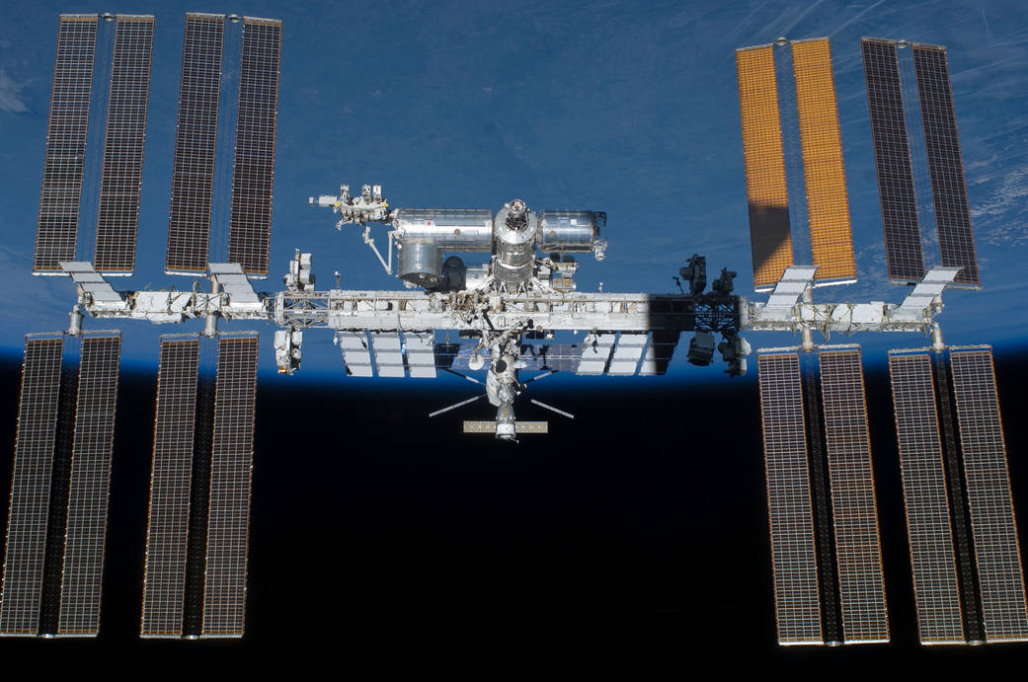
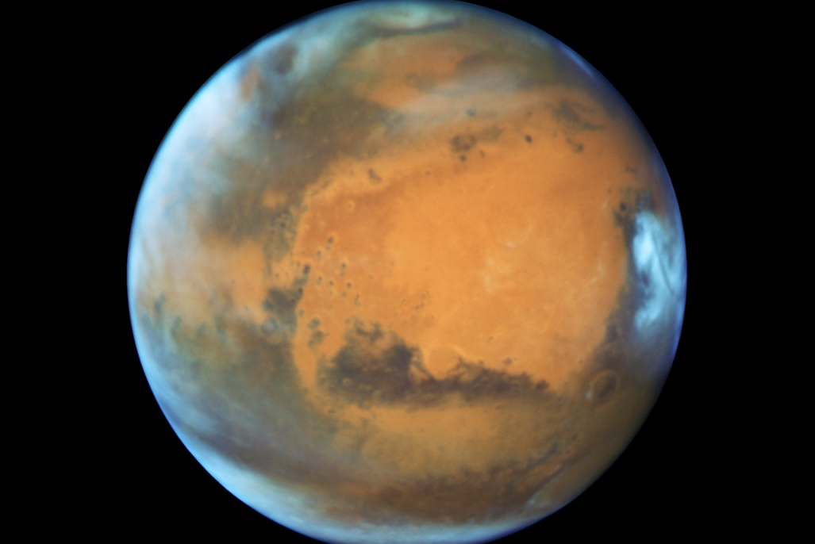
Between
48 million to 234 million miles
International Space Station
250 miles = 400 km
Mars

Slide 4
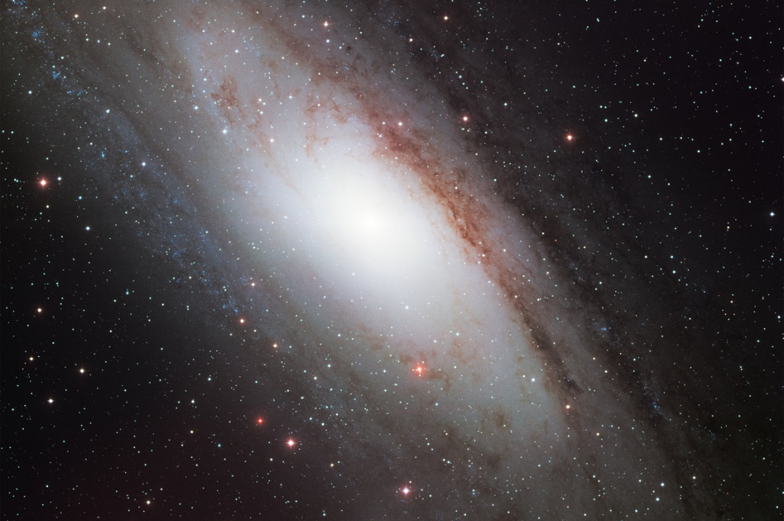
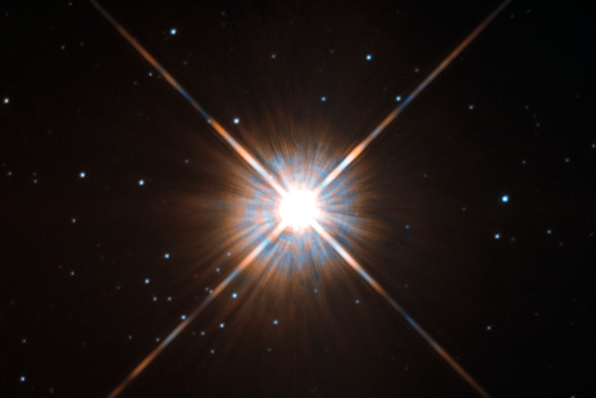
Andromeda Galaxy
Alpha Centauri
2,537,000 light years
4.367 light years
1 light second = 186,000 miles
1 light second = 186,000 miles

