Slide 1

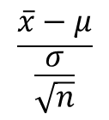

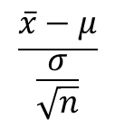

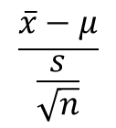
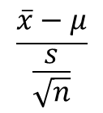

$$\frac{\overline{x}−μ}{\frac{σ}{\sqrt{n}}}$$
$$N\left(0,1\right)$$
Yes
Use normal distribution.
Is population variance known?
No
$$\frac{\overline{x}−μ}{\frac{s}{\sqrt{n}}}$$
Yes
$$N\left(0,1\right)$$
Is n ≥ 30?
Use normal distribution
$$N\left(0,1\right)$$
$$\frac{\overline{x}−μ}{\frac{σ}{\sqrt{n}}}$$
No
Yes
Is population variance known?
No
Use students-t distribution
$$t_{n−1}$$
$$\frac{\overline{x}−μ}{\frac{s}{\sqrt{n}}}$$

