Slide 1

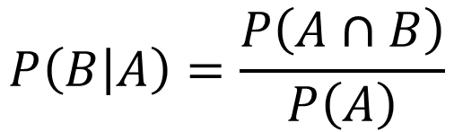










Non-Independent
$$P\left(B | A\right)$$
$$P\left(A∩B\right)=P\left(A\right)×P\left(B | A\right)$$
$$P\left(A\right)$$
$$P\left(B′ | A\right)$$
$$P\left(A∩B′\right)=P\left(A\right)×P\left(B′ | A\right)$$
$$P\left(B | A′\right)$$
$$P\left(A′∩B\right)=P\left(A′\right)×P\left(B | A′\right)$$
$$P\left(A′\right)$$
$$P\left(B′ | A′\right)$$
$$P\left(A′∩B′\right)=P\left(A′\right)×P\left(B′ | A′\right)$$
$$P\left(B | A\right)=\frac{P\left(A∩B\right)}{P\left(A\right)}$$
$$P\left(A∩B\right)=P\left(A\right)×P\left(B | A\right)$$

Slide 2

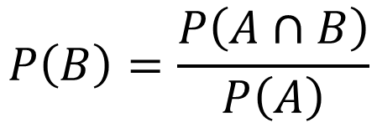








Independent
$$P\left(B\right)$$
$$P\left(A∩B\right)=P\left(A\right)×P\left(B\right)$$
$$P\left(A\right)$$
$$P\left(B\right)′$$
$$P\left(A∩B′\right)=P\left(A\right)×P\left(B′\right)$$
$$P\left(B\right)$$
$$P\left(A′∩B\right)=P\left(A′\right)×P\left(B\right)$$
$$P\left(A′\right)$$
$$P\left(B′\right)$$
$$P\left(A′∩B′\right)=P\left(A′\right)×P\left(B′\right)$$
$$P\left(B\right)=\frac{P\left(A∩B\right)}{P\left(A\right)}$$
$$P\left(A∩B\right)=P\left(A\right)×P\left(B\right)$$

Slide 3
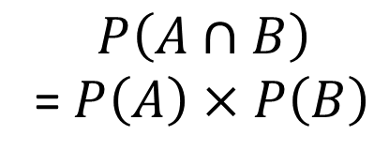
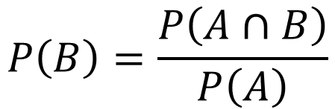
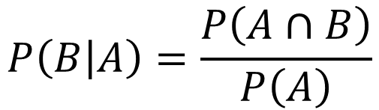
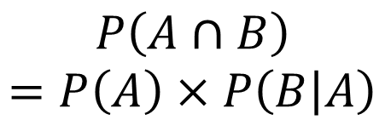
Non-Independent
Independent
$$P\left(A∩B\right)$$
$$=P\left(A\right)×P\left(B | A\right)$$
$$P\left(B | A\right)=\frac{P\left(A∩B\right)}{P\left(A\right)}$$
$$P\left(A∩B\right)$$
= $P\left(A\right)×P\left(B\right)$
$$P\left(B\right)=\frac{P\left(A∩B\right)}{P\left(A\right)}$$

