Slide 1




Integration by Substitution Writing Frame
What I’m asked to integrate…
1) The substitution
$$u=$$
$$x=$$
$$\frac{du}{dx}=$$
$$\frac{dx}{du}=$$
2) Rewrite the question. If any x terms cancel then do so, otherwise include substitutions for all x variables. Decide if you will convert the x limits into u limits or integrate without limits and re-substitute for x.
3) Do the integration
4) Evaluate the integral between the limits

Slide 2
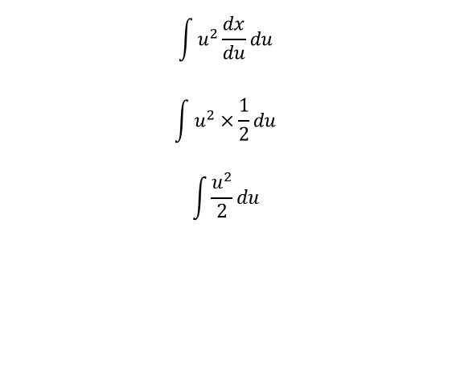

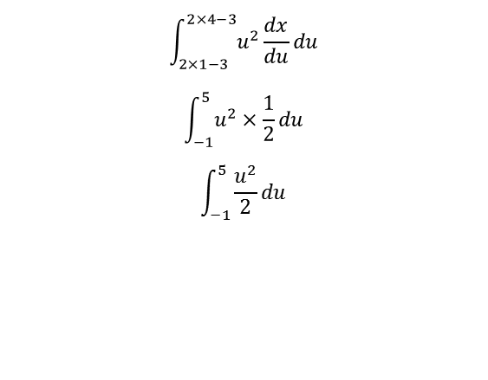



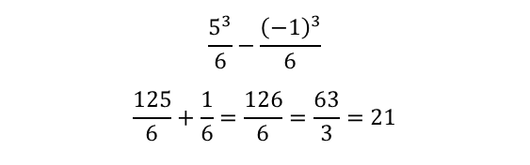




Integration by Substitution Writing Frame
What I’m asked to integrate…
$$\int_{1}^{4}{{\left(2x−3\right)}^{2}}dx$$
1) The substitution
$$u=2x−3$$
$$x=\frac{u+3}{2}$$
$$\frac{du}{dx}=2$$
$$\frac{dx}{du}=\frac{1}{2}$$
2) Rewrite the question. If any x terms cancel then do so, otherwise include substitutions for all x variables. Decide if you will convert the x limits into u limits or integrate without limits and re-substitute for x.
$$\int_{2×1−3}^{2×4−3}{u^{2}}\frac{dx}{du}du$$
$$\int_{−1}^{5}{u^{2}}×\frac{1}{2}du$$
$$\int_{−1}^{5}{\frac{u^{2}}{2}}du$$
$$\int{u^{2}}\frac{dx}{du}du$$
$$\int{u^{2}}×\frac{1}{2}du$$
$$\int{\frac{u^{2}}{2}}du$$
or
3) Do the integration
$$\int_{−1}^{5}{\frac{u^{2}}{2}}du$$
$${\left[\frac{u^{3}}{6}\right]}_{−1}^{5}$$
$$\int{\frac{u^{2}}{2}}du$$
$$\left[\frac{u^{3}}{6}\right]$$
or
4) Evaluate the integral between the limits
$$\frac{5^{3}}{6}−\frac{{\left(−1\right)}^{3}}{6}$$
$$\frac{125}{6}+\frac{1}{6}=\frac{126}{6}=\frac{63}{3}=21$$
$${\left[\frac{{\left(2x−3\right)}^{3}}{6}\right]}_{1}^{4}$$
$$\left(\frac{{\left(2×4−3\right)}^{3}}{6}\right)−\left(\frac{{\left(2×1−3\right)}^{3}}{6}\right)$$
$$\left(\frac{5^{3}}{6}\right)−\left(\frac{{\left(−1\right)}^{3}}{6}\right)$$
$$\frac{125}{6}+\frac{1}{6}=\frac{126}{6}=\frac{63}{3}=21$$
or

