Slide 1
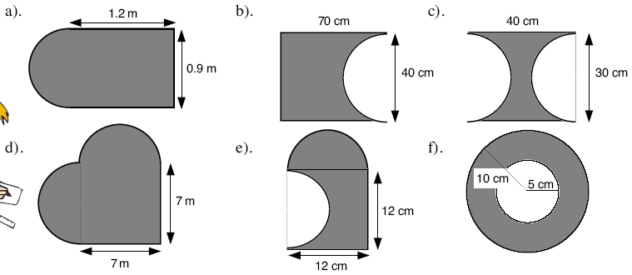
For each shape find the area and the perimeter.

Slide 2
1cm
1cm
4cm
8cm
4cm
How many small circles could we
fit into the large circle?
4cm
4cm
1cm

Slide 3
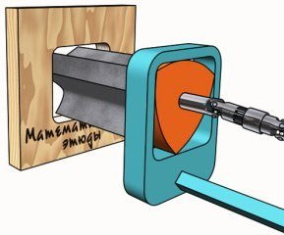
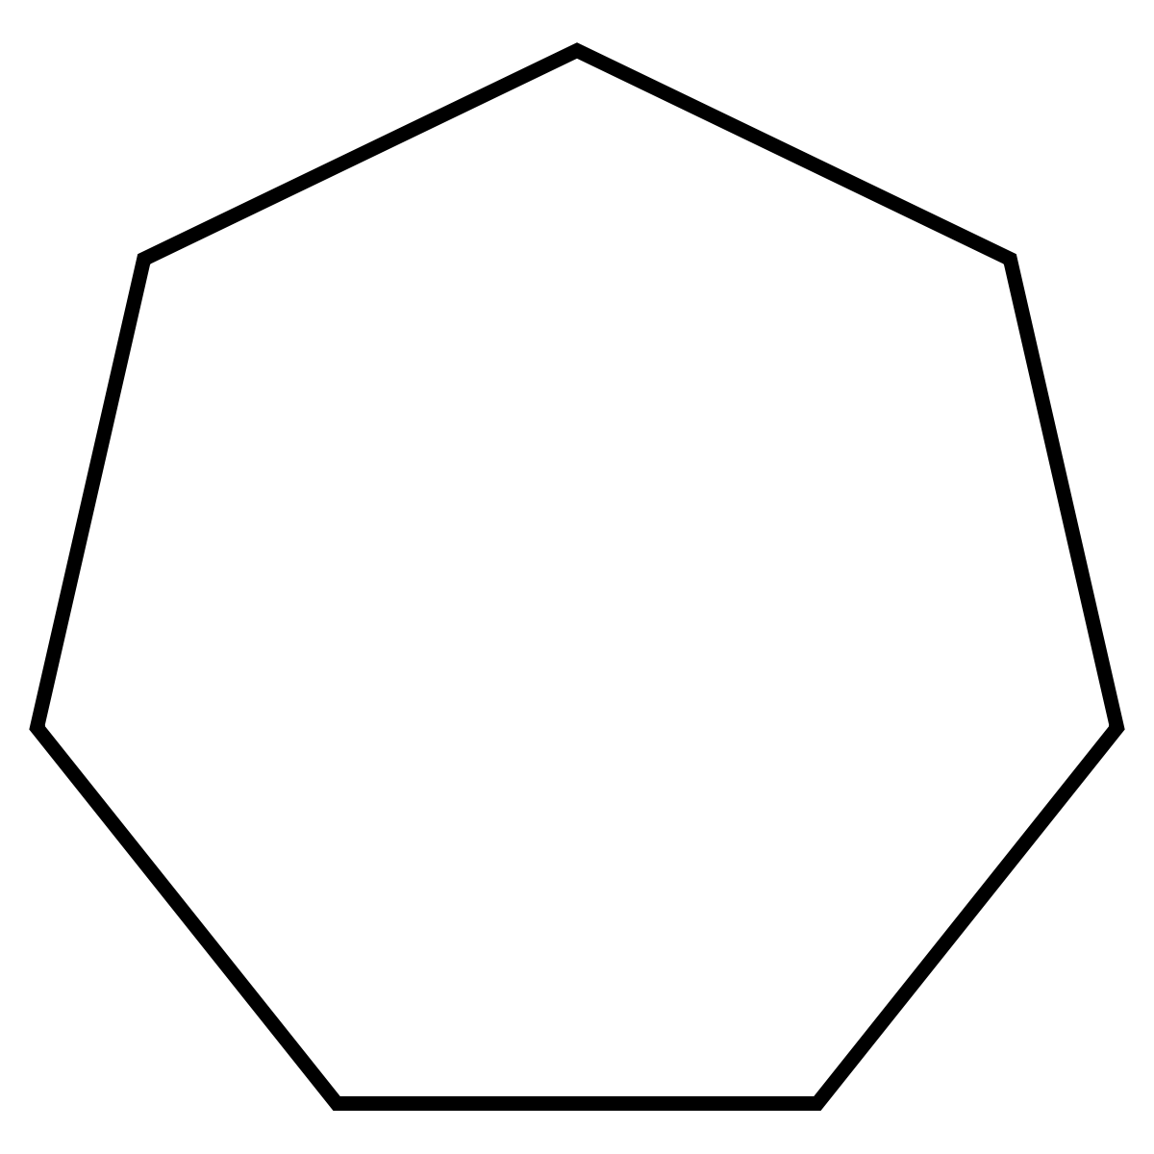

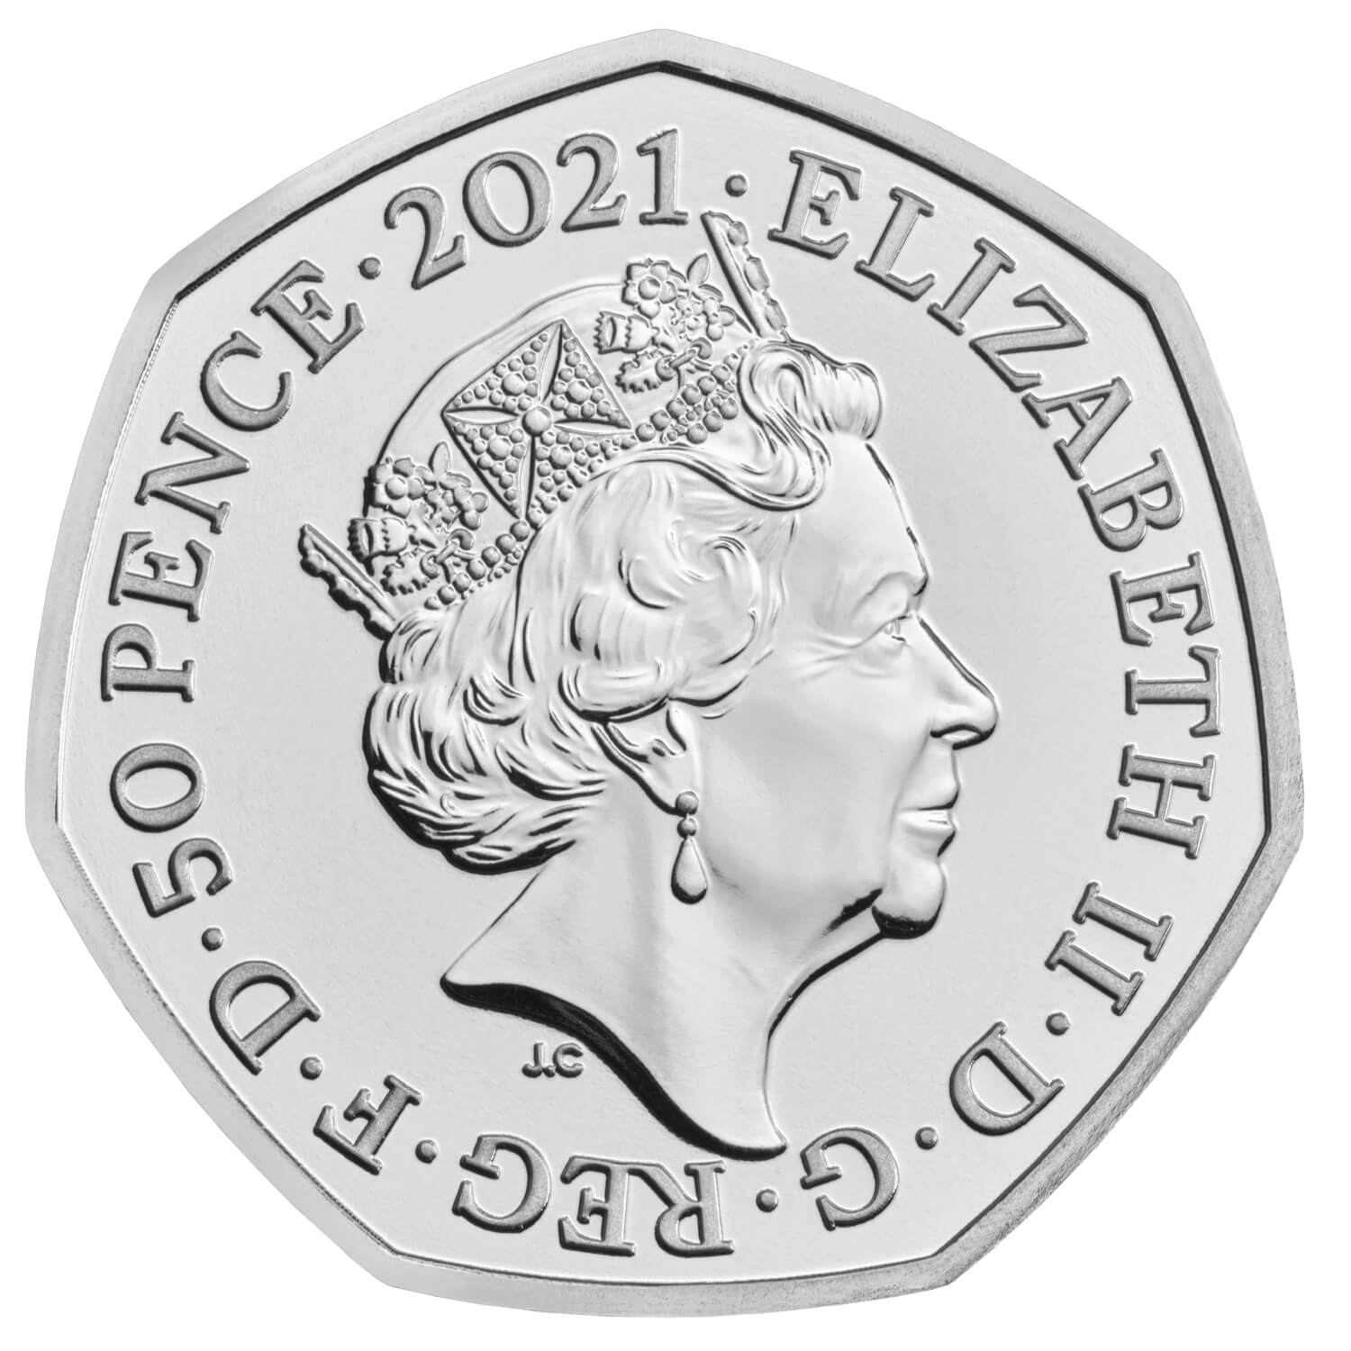
8cm
8cm
8cm
This is a Reuleaux triangle
4cm
6cm
8cm
Diameter = 27.5mm

Slide 4
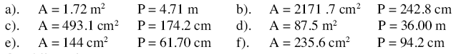
For each shape find the area and the perimeter - answers
1.40

Slide 5
1cm
1cm
4cm
8cm
4cm
How many small circles could we
fit into the large circle?
4cm
4cm
1cm

Slide 6





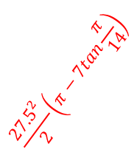
$$32\sqrt{3}−16π$$
$$32π−32\sqrt{3}$$
8cm
8cm
8cm
This is a Reuleaux triangle
$$16\sqrt{3}+24π$$
$$\frac{46π}{3}+4\sqrt{3}$$
4cm
6cm
8cm
$$\frac{{27.5}^{2}}{2}\left(π−7tan\frac{π}{14}\right)$$
$$72\sqrt{3}−\frac{31π}{4}$$
Diameter = 27.5mm

