Slide 1
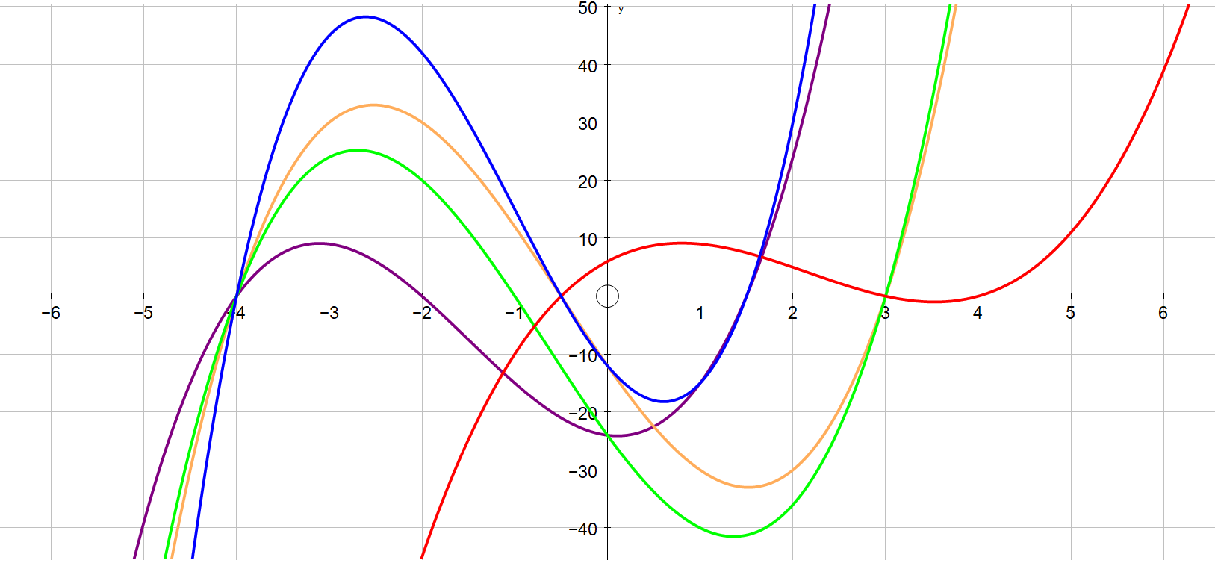
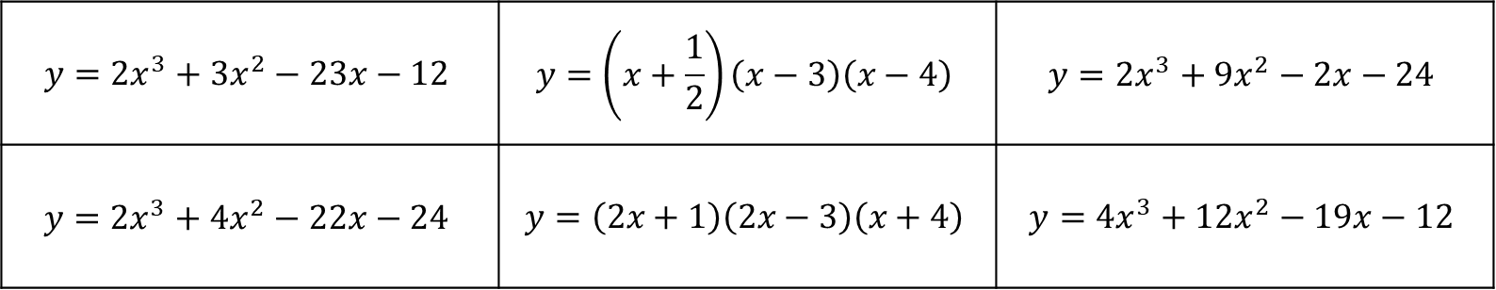
Relationships presented in different formats
$$y=2x^{3}+3x^{2}−23x−12$$ | $$y=\left(x+\frac{1}{2}\right)\left(x−3\right)\left(x−4\right)$$ | $$y=2x^{3}+9x^{2}−2x−24$$
$$y=2x^{3}+4x^{2}−22x−24$$ | $$y=\left(2x+1\right)\left(2x−3\right)\left(x+4\right)$$ | $$y=4x^{3}+12x^{2}−19x−12$$

Slide 2
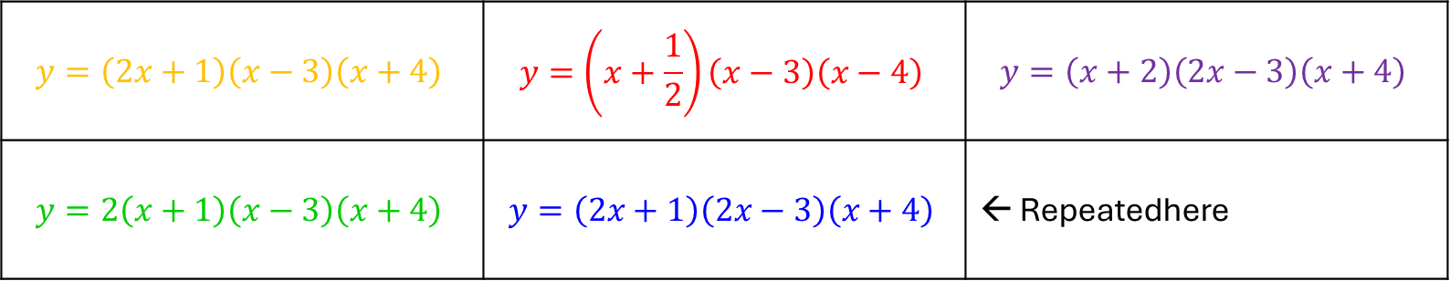
Relationships presented in different formats - answers
$$y=\left(2x+1\right)\left(x−3\right)\left(x+4\right)$$ | $$y=\left(x+\frac{1}{2}\right)\left(x−3\right)\left(x−4\right)$$ | $$y=\left(x+2\right)\left(2x−3\right)\left(x+4\right)$$
$$y=2\left(x+1\right)\left(x−3\right)\left(x+4\right)$$ | $$y=\left(2x+1\right)\left(2x−3\right)\left(x+4\right)$$ | ← Repeatedhere

