Slide 1
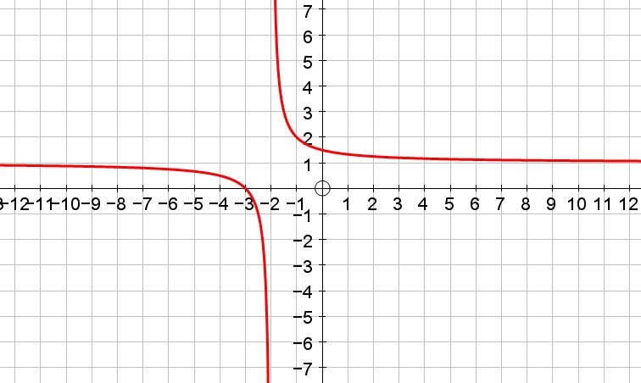
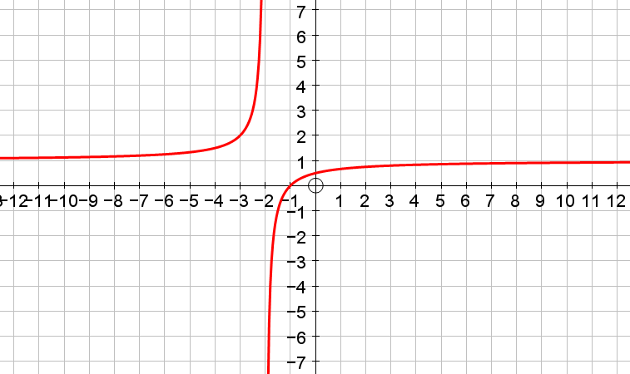
Instructions
Matchup the graphs to the equations.
There are 8 equations but only 6 graphs. You draw the other 2 graphs.
Extension question
What is the connection between the shape of the graph and its equation?
Ie this way round vs this way round
Answers
Labeling equations horizontally 1-8 then;
1 = bottom right / top right, 2 = bottom left, 3 = middle left, 4 = -,
5 = middle right, 6 = top left, 7 = -, 8 = bottom right / top right
(Notice also that 1 = 8)

Slide 2
