Slide 1
Solar System Matchup
Match up the…
Name
Picture
Number of moons
Length of day
Length of year
Interesting fact
…to each planet

Slide 2
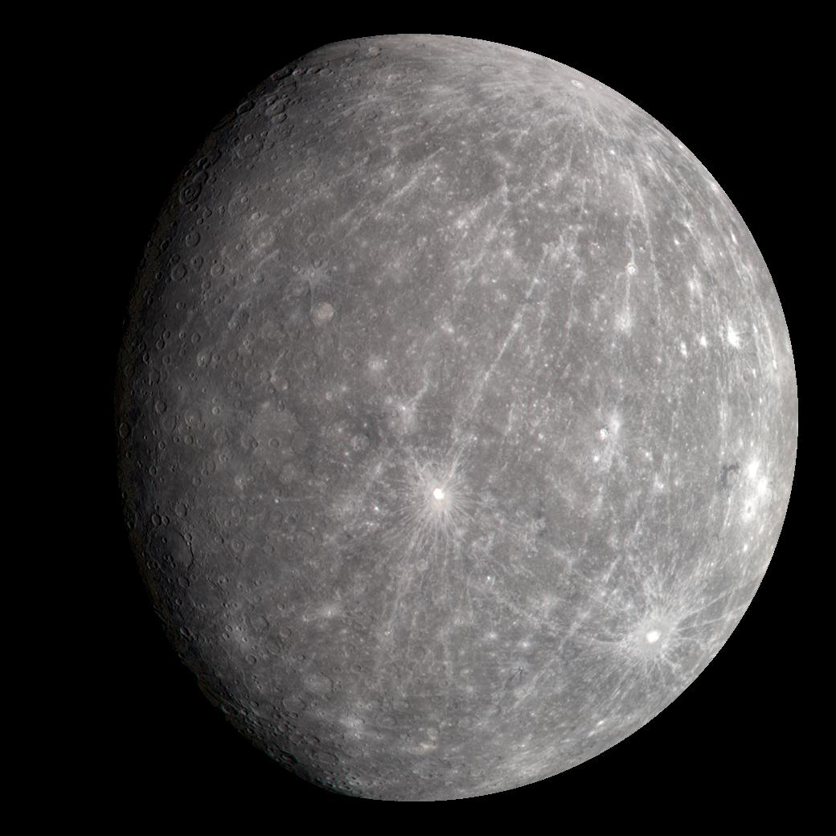
Mercury
No moons
One year = 88 Earth days
One day = 59 Earth days
0.39 AU From the Sun

Slide 3
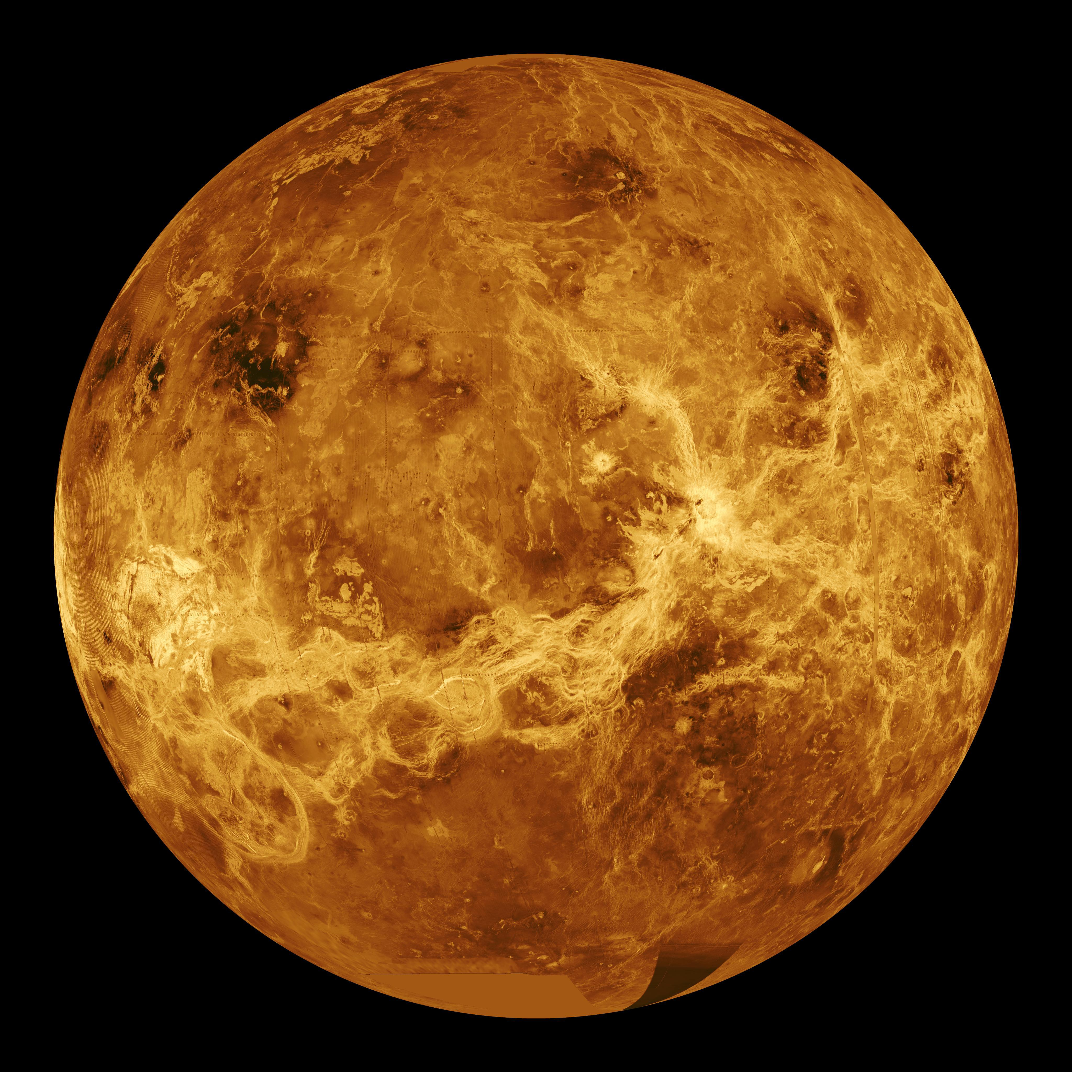
Venus
No moons
One year = 225 days
One day = 243 Earth days
0.72 AU From the Sun

Slide 4
Earth
One moon
One year = 365 days
One day = 24 hours
1 AU From the Sun

Slide 5
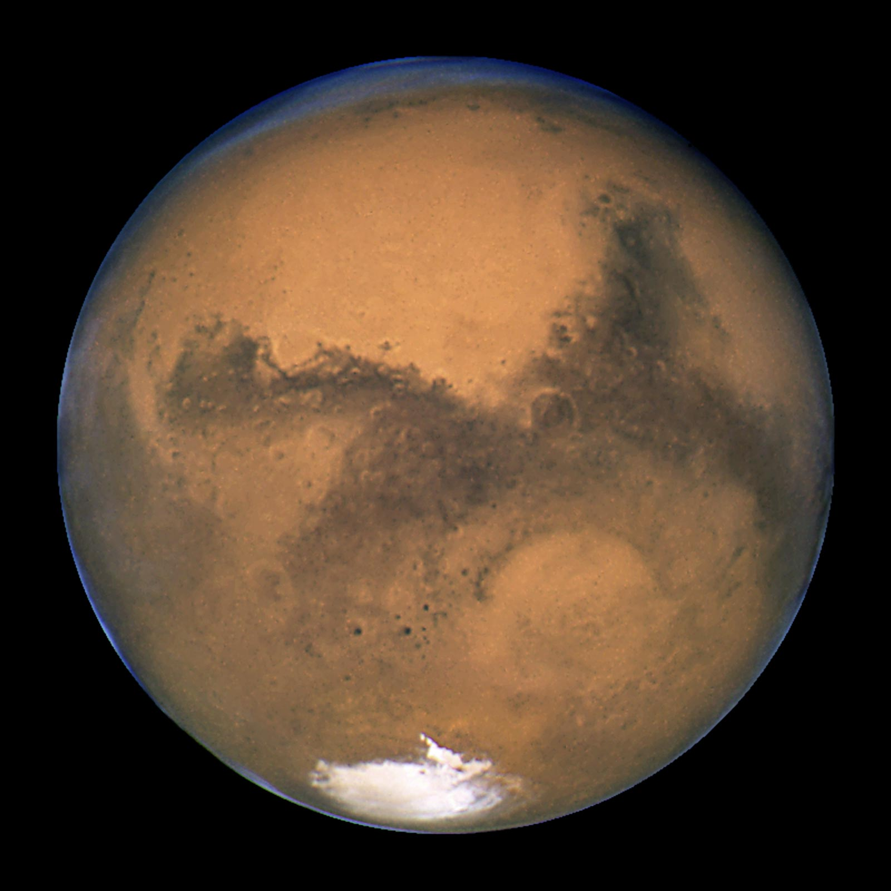
Mars
Two moons
One year = nearly 2 Earth years
One day =
24 hours and 40 minutes
1.5 AU From the Sun

Slide 6
Jupiter
80-95 moons
One year = 12 Earth years
One day = 10 Earth hours
5.2 AU From the Sun

Slide 7
Saturn
145 moons
One year = 29 Earth years
One day = 10.5 Earth hours
9.6 AU From the Sun

Slide 8
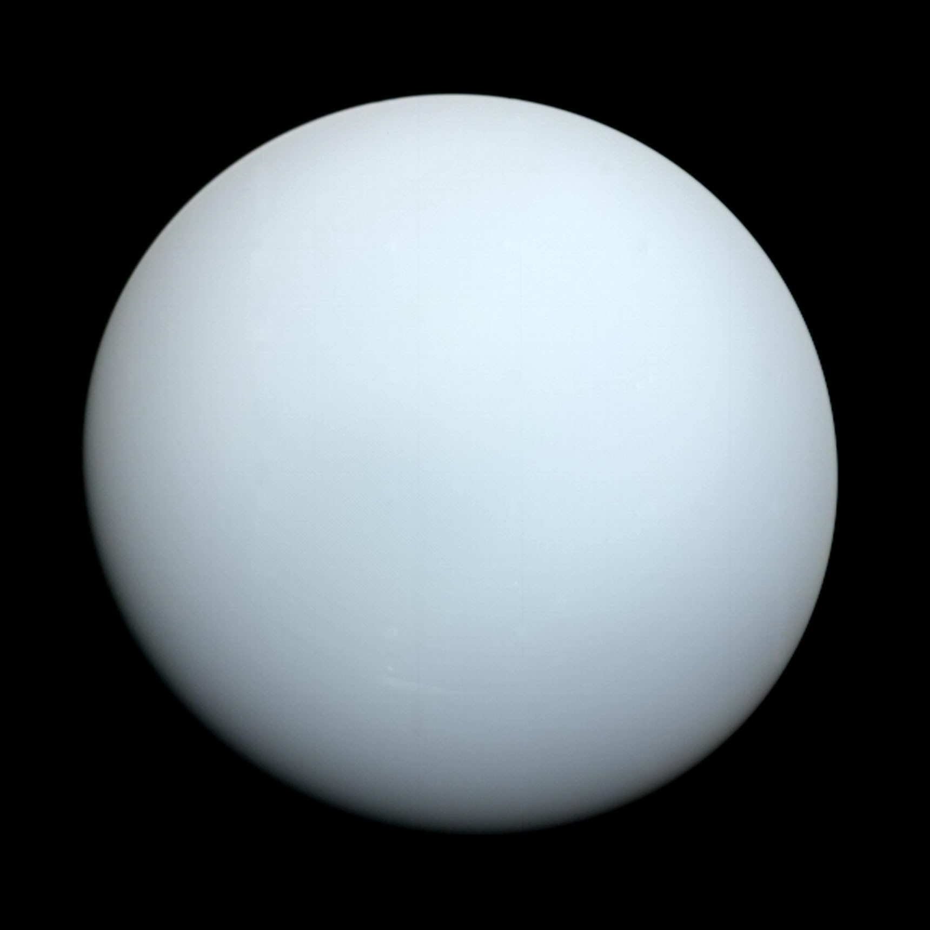
Uranus
27 moons
One year = 84 Earth years
One day = 17 Earth hours
19 AU From the Sun

Slide 9
Neptune
14 moons
One year = 165 Earth years
One day = 16 Earth hours
30 AU From the Sun

Slide 10
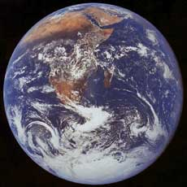

Slide 11
Mercury
Venus
Earth
Mars
Jupiter
Saturn
Uranus
Neptune

Slide 12
This planet has
No moons
This planet has
No moons
This planet has
1 moon
This planet has
2 moons
(Phobos & Deimos)
This planet has
80 - 95 moons
(Io, Europa, Ganymede, Callisto…)
This planet has
145 moons
This planet has
27 moons
This planet has
14 moons

Slide 13
This planet takes 88 Earth days to orbit the sun.
This planet takes 225 Earth days to orbit the sun
(shorter than it’s day!).
This planet takes 365 days to orbit the sun.
This planet takes nearly 2 Earth years to orbit the sun.
This planet takes 12 Earth years to orbit the sun.
This planet takes 29 Earth years to orbit the sun.
This planet takes 84 Earth years to orbit the sun.
This planet takes 165 Earth years to orbit the sun.

Slide 14
A day on this planet lasts for
59 Earth days
A day on this planet lasts for
243 Earth days
(longer than it’s year!)
A day on this planet lasts for
24 hours
A day on this planet lasts for 40 minutes more than one Earth day
A day on this planet lasts for about 10 hours
A day on this planet lasts for about 10.5 hours
A day on this planet lasts for about 17 hours
A day on this planet lasts for about 16 hours

Slide 15
This is the smallest planet in our solar system, only slightly larger than the Moon.
This isn’t the closest planet to the sun but it’s the hottest planet in the solar system.
This planet is in the Goldilocks zone where the temperature is just right for water to exist.
This red planet has a giant volcano called Olympus Mons which is three times as high as Mount Everest.
This planet has a great red spot and protects Earth by catching asteroids.
This planet has the most spectacular ring system, with seven rings and several gaps between them.
This planet is dark, cold, and very windy. It’s blue colour is due to the gases in its atmosphere.
This planet is tilted on it’s side.

Slide 20
