Slide 1
Toilet Roll Constellations
Look through the tubes and match up each of the constellations to the images on the paper.
Use the names and learn the patterns of the constellations as you go.

Slide 2
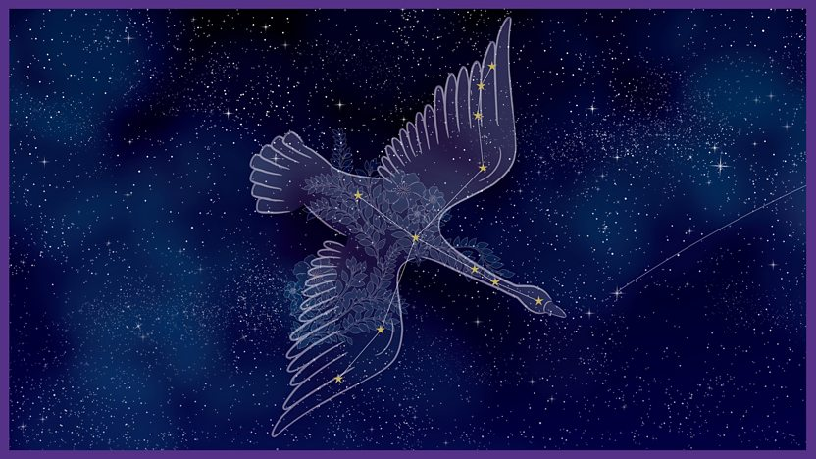
CYGNUS (The Swan)
September

Slide 3
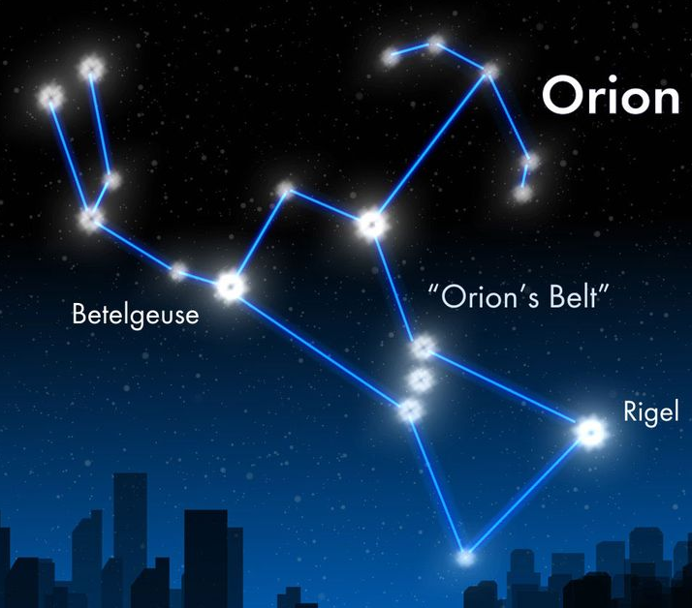
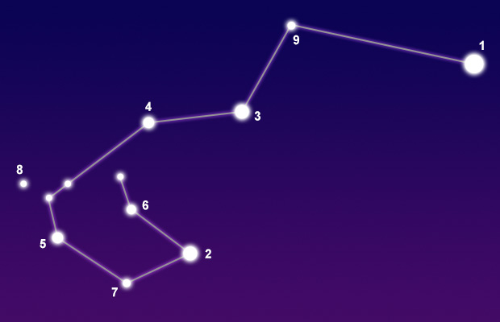
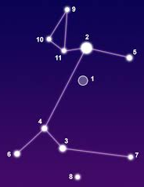
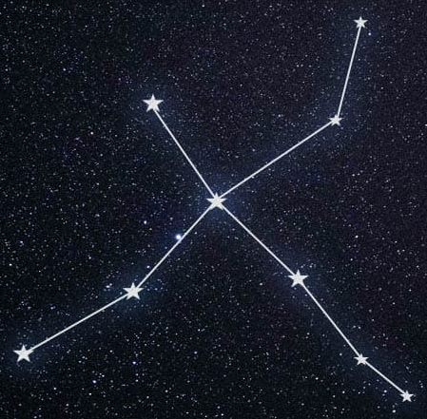
CYGNUS (The Swan)
September

Slide 6
ANSWERS
CYGNUS (The Swan)
September

Slide 7
ANSWERS
CYGNUS (The Swan)
September

Slide 8
Colour | Name | Draw it
 | Ursa Major / Big Dipper / The Plough
 | Cassiopeia
 | Orion
 | Crux / The Southern Cross
 | Cygnus / The Swan
 | Canis Major / The Dog
 | Centaurus
 | Carina
Colour | Name | Draw it
 | Ursa Major / Big Dipper / The Plough
 | Cassiopeia
 | Orion
 | Crux / The Southern Cross
 | Cygnus / The Swan
 | Canis Major / The Dog
 | Centaurus
 | Carina

Slide 9
Colour | Name | Draw it
Colour | Name | Draw it

Slide 10
CYGNUS (The Swan)
September

Slide 11
Answer
Answer
Answer
Answer
Answer
Answer
CYGNUS (The Swan)
September
Answer
Answer

