Slide 1
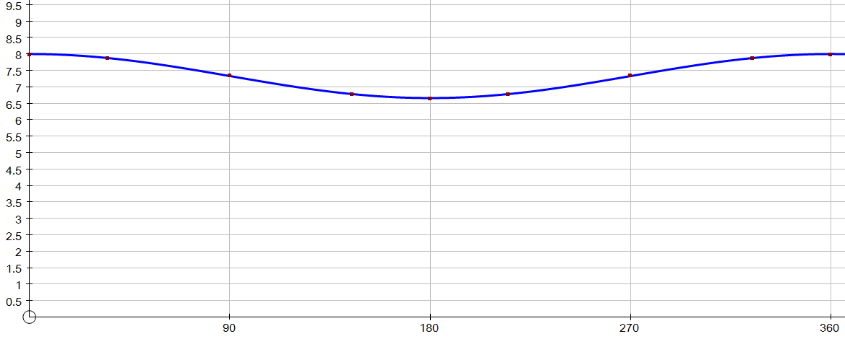
$$GPE=mgh$$
$$u=8ms^{−1}$$
GPE =
0.1 × 9.8 × 1 =
0.98
$$m=0.1kg$$
KE =
v² = 44.4
$$KE=\frac{1}{2}mv^{2}$$
0.5 × 0.1 × v² =
2.22
$$r=0.5m$$
v = 6.66
Total =
3.2
h = 0.5-0.5cos215 = 0.91
h = 0.5-0.5cos145 = 0.91
GPE =
0.1 × 9.8 × 0.91 =
0.89
C
GPE =
0.1 × 9.8 × 0.91 =
0.89
KE =
v² = 46.2
v² = 46.2
0.5 × 0.1 × v² =
2.31
H
E
KE =
0.5 × 0.1 × v² =
2.31
v = 6.79
v = 6.79
Total =
3.2
Total =
3.2
v
$$35°$$
$$145°$$
GPE =
0.1 × 9.8 × 0.5 =
0.49
F
B
v² = 54.2
KE =
0.5 × 0.1 × v² =
2.71
θ
v = 7.36
Total =
3.2
A
D
B
E
C
H
F
G
A
$$35°$$
h = 0.5-0.5cos35 = 0.09
G
D
GPE =
0.1 × 9.8 × 0.09 =
0.89
KE =
v² = 62.2
Zero line
0.5 × 0.1 × v² =
3.11
A
v = 7.89
Total =
3.2
GPE =
0.1 × 9.8 × 0 =
0
KE =
0.5 × 0.1 × 8² =
3.2
Total =
3.2

Slide 2
$$GPE=mgh$$
$$u=ms^{−1}$$
GPE =
m × g × 2r =
$$m=kg$$
KE =
v² =
0.5 × m × v² =
TE-GPE
$$KE=\frac{1}{2}mv^{2}$$
$$r=m$$
v =
Total =
TE
h = r – rcosθ
h = r – rcosθ
GPE =
m × g × (r-rcosθ) =
C
GPE =
m × g × (r-rcosθ) =
KE =
v² =
v² =
0.5 × m × v² =
TE-GPE
H
E
KE =
0.5 × m × v² =
TE-GPE
v =
v =
Total =
TE
Total =
TE
v
$$35°$$
$$145°$$
GPE =
m × g × r =
F
B
v² =
KE =
0.5 × m × v² =
TE-GPE
v =
θ
Total =
TE
A
D
B
E
C
H
F
G
A
$$35°$$
h = r – rcosθ
GPE =
m × g × (r-rcosθ) =
KE =
v² =
G
D
0.5 × m × v² =
TE-GPE
v =
Zero line
Total =
TE
A
GPE =
0
KE =
0.5 × m × v² =
KE
Total =
TE

