Slide 1
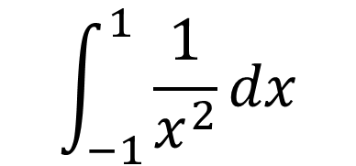
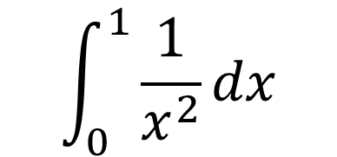
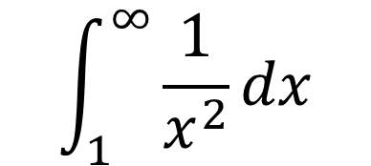
Type 1
Type 2
$±∞$ as one of the limits
Undefined at one of the limits
Undefined between the limits
$$\int_{1}^{∞}{\frac{1}{x^{2}}dx}$$
$$\int_{0}^{1}{\frac{1}{x^{2}}dx}$$
$$\int_{−1}^{1}{\frac{1}{x^{2}}dx}$$

Slide 2
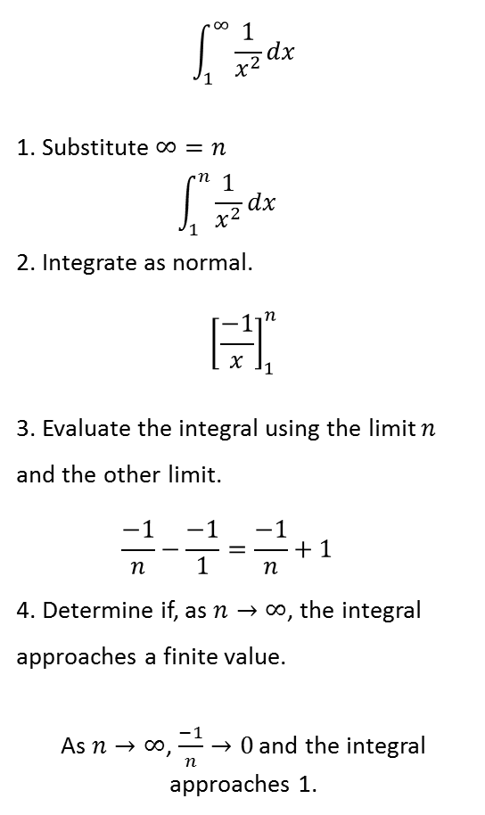
Type 1
Type 2
$±∞$ as one of the limits
Undefined at one of the limits
Undefined between the limits
$$\int_{1}^{∞}{\frac{1}{x^{2}}dx}$$
1. Substitute $∞=n$
$$\int_{1}^{n}{\frac{1}{x^{2}}dx}$$
2. Integrate as normal.
$${\left[\frac{−1}{x}\right]}_{1}^{n}$$
3. Evaluate the integral using the limit $n$ and the other limit.
$$\frac{−1}{n}−\frac{−1}{1}=\frac{−1}{n}+1$$
4. Determine if, as $n→∞$, the integral approaches a finite value.
As $n→∞$, $\frac{−1}{n}→0$ and the integral approaches 1.
$$\int_{0}^{1}{\frac{1}{x^{2}}dx}$$
1. Determine where the integral is undefined. If undefined between the limits then split the single integral into two integrals at this point.
Undefined at $x=0$ so integral stays as is.
2. Substitute the $x$ value where the integral is undefined for $p$.
$$\int_{p}^{1}{\frac{1}{x^{2}}dx}$$
3. Integrate as normal.
$${\left[\frac{−1}{x}\right]}_{p}^{1}$$
4. Evaluate the integral(s) using the limit $p$ and the other limit.
$$\frac{−1}{1}+\frac{1}{p}=−1+\frac{1}{p}$$
5. Determine as $p→the limit which was replaced$, the integral approaches a finite value.
As $p→0$, $\frac{1}{p}→∞$.
6. If no then the improper integral cannot be found and does not have a finite value.
The integral cannot be found, the limit does not exist, there is no limit.
$$\int_{−1}^{1}{\frac{1}{x^{2}}dx}$$
1. Determine where the integral is undefined. If undefined between the limits then split the single integral into two integrals at this point.
Undefined at $x=0$ so integral becomes…
$$\int_{−1}^{0}{\frac{1}{x^{2}}dx}+\int_{0}^{1}{\frac{1}{x^{2}}dx}$$
2. Substitute the $x$ value where the integral is undefined for $p$.
$$\int_{−1}^{p}{\frac{1}{x^{2}}dx}+\int_{p}^{1}{\frac{1}{x^{2}}dx}$$
3. Integrate as normal.
$${\left[\frac{−1}{x}\right]}_{−1}^{p}+ {\left[\frac{−1}{x}\right]}_{p}^{1}$$
4. Evaluate the integral(s) using the limit $p$ and the other limit.
$$\frac{−1}{p}−\frac{−1}{−1}+\frac{−1}{1}−\frac{−1}{p}=−2$$
5. Determine as $p→the limit which was replaced$, the integral approaches a finite value.
(In this case, the limit $p$ has already cancelled out)
6. If yes then the improper integral can be found and the answer is this finite value. If split into two, final answer is both parts added together.
The integral can be found and the answer is 2.

