Slide 1
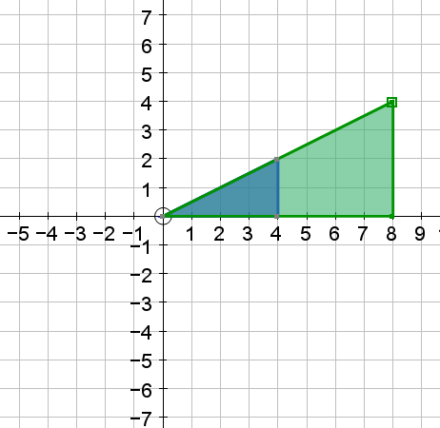
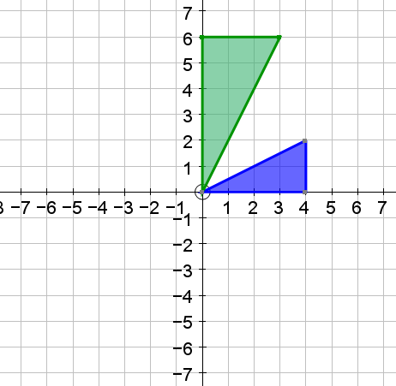
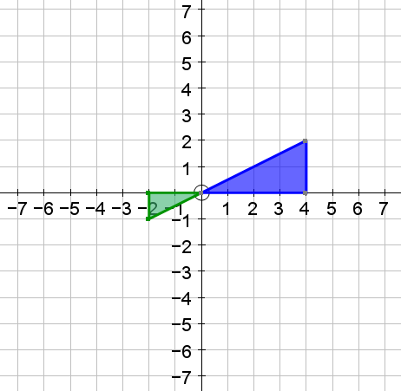
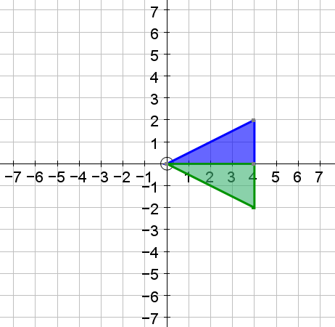
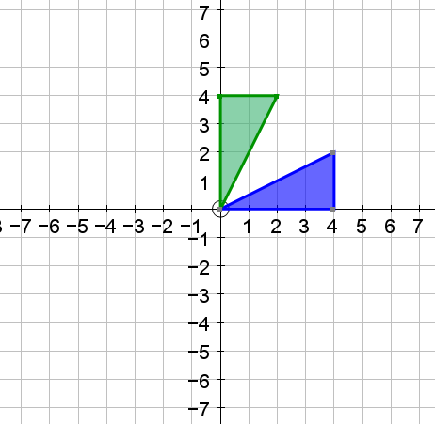
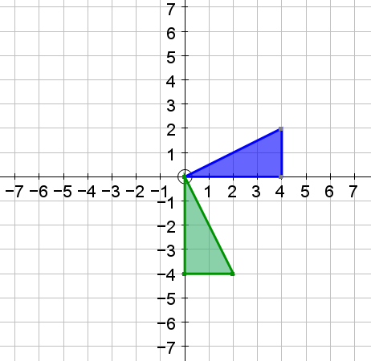
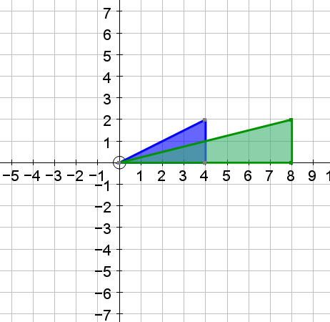
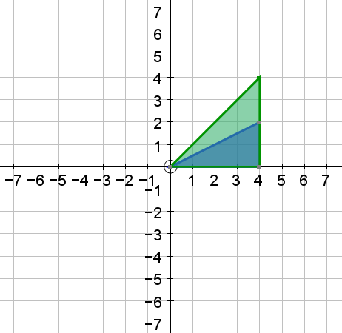
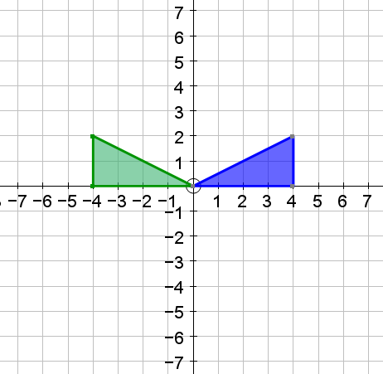
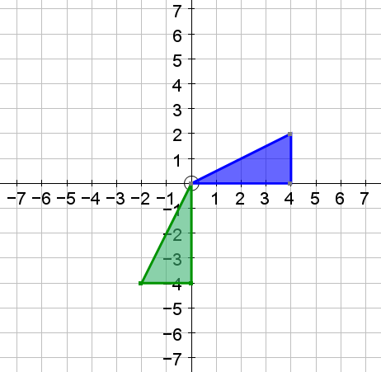
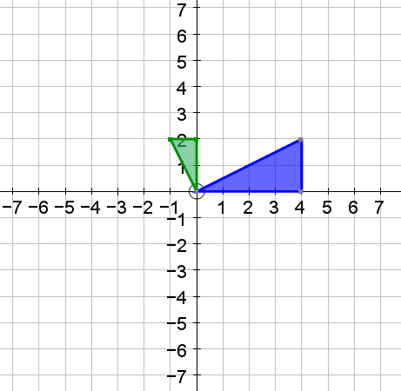
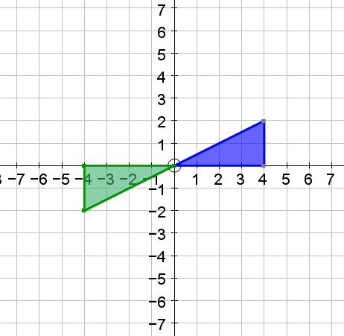

Slide 2
Rotate
Around (0,0)
By 180°
Stretch
Scale factor ½
In x and y directions
Stretch
Scale factor 2
In x and y directions
Reflect
In line y=x
Stretch
Scale factor 3/2
In x and y directions
Reflect
In x axis
Reflect
In line y=x
Rotate
Around (0,0)
By 90°
Clockwise
Stretch
Scale factor 2
In x direction
Stretch
Scale factor 2
In y direction
Rotate
Around (0,0)
By 90°
Anti-clockwise
Stretch
Scale factor ½
In x and y directions
Reflect
In y axis
Reflect
In line y=-x
Rotate
Around (0,0) By 180°

Slide 3
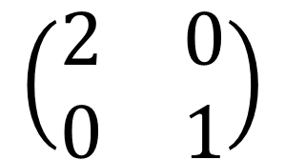
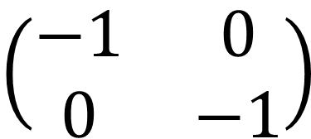
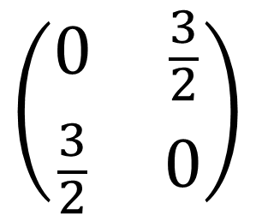
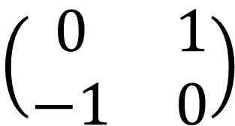
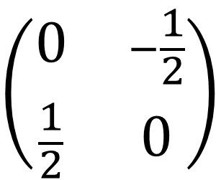
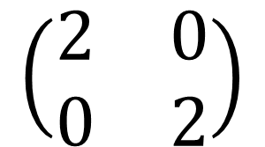
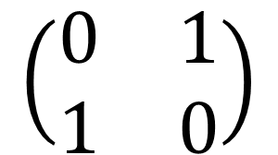
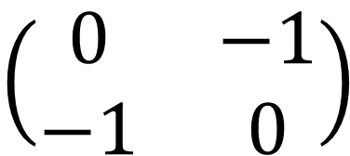
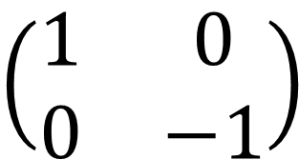
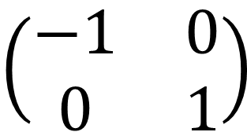
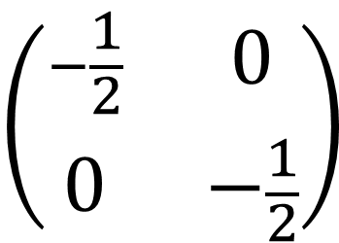
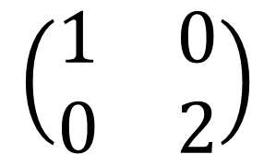
$$\left(\begin{matrix}0 & \frac{3}{2} \\ \frac{3}{2} & 0\end{matrix}\right)$$
$$\left(\begin{matrix}−\frac{1}{2} & 0 \\ 0 & −\frac{1}{2}\end{matrix}\right)$$
$$\left(\begin{matrix}2 & 0 \\ 0 & 2\end{matrix}\right)$$
$$\left(\begin{matrix}1 & 0 \\ 0 & −1\end{matrix}\right)$$
$$\left(\begin{matrix}0 & 1 \\ 1 & 0\end{matrix}\right)$$
$$\left(\begin{matrix}0 & 1 \\ −1 & 0\end{matrix}\right)$$
$$\left(\begin{matrix}2 & 0 \\ 0 & 1\end{matrix}\right)$$
$$\left(\begin{matrix}1 & 0 \\ 0 & 2\end{matrix}\right)$$
$$\left(\begin{matrix}−1 & 0 \\ 0 & 1\end{matrix}\right)$$
$$\left(\begin{matrix}0 & −1 \\ −1 & 0\end{matrix}\right)$$
$$\left(\begin{matrix}0 & −\frac{1}{2} \\ \frac{1}{2} & 0\end{matrix}\right)$$
$$\left(\begin{matrix}−1 & 0 \\ 0 & −1\end{matrix}\right)$$

