Slide 1
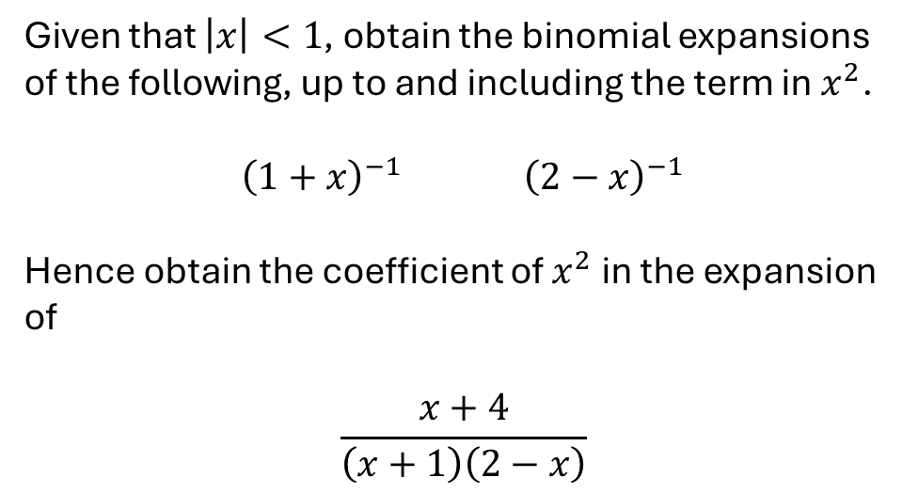
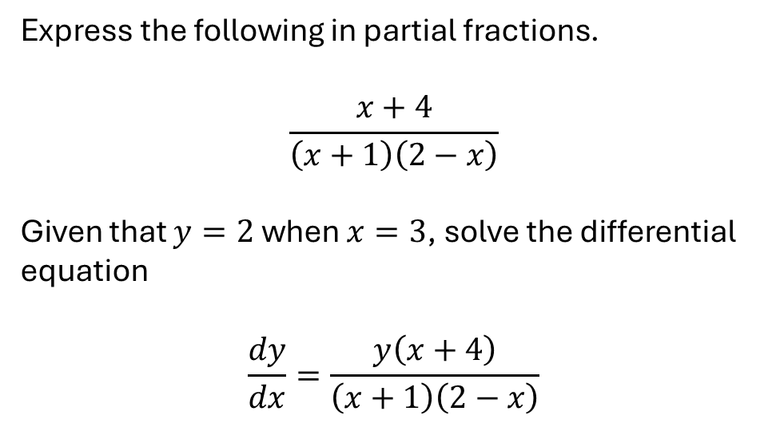
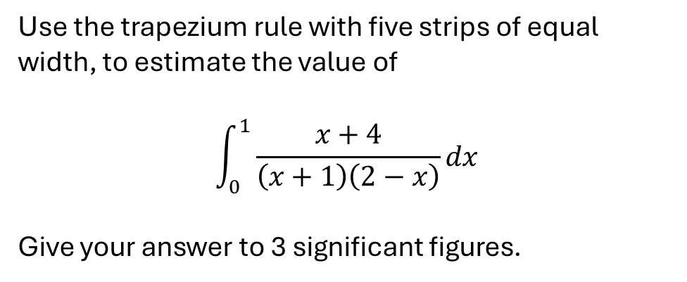
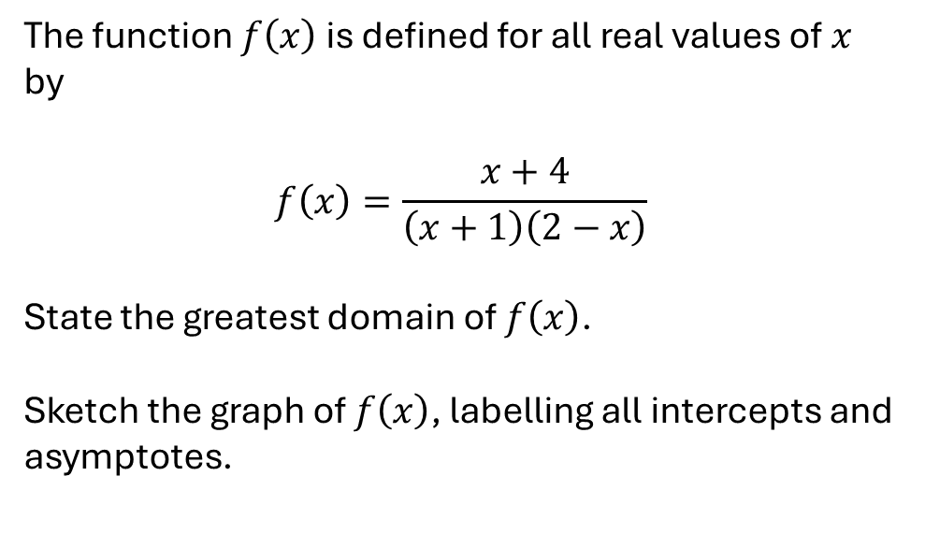
Express the following in partial fractions.
$$\frac{x+4}{\left(x+1\right)\left(2−x\right)}$$
Given that $y=2$ when $x=3$, solve the differential equation
$$\frac{dy}{dx}=\frac{y\left(x+4\right)}{\left(x+1\right)\left(2−x\right)}$$
The function $f\left(x\right)$ is defined for all real values of $x$ by
$$f\left(x\right)=\frac{x+4}{\left(x+1\right)\left(2−x\right)}$$
State the greatest domain of $f\left(x\right)$.
Sketch the graph of $f\left(x\right)$, labelling all intercepts and asymptotes.
Given that $\left|x\right|<1$, obtain the binomial expansions of the following, up to and including the term in $x^{2}$.
${\left(1+x\right)}^{−1}$ ${\left(2−x\right)}^{−1}$
Hence obtain the coefficient of $x^{2}$ in the expansion of
$$\frac{x+4}{\left(x+1\right)\left(2−x\right)}$$
Use the trapezium rule with five strips of equal width, to estimate the value of
$$\int_{0}^{1}{\frac{x+4}{\left(x+1\right)\left(2−x\right)}}dx$$
Give your answer to 3 significant figures.

