Slide 1
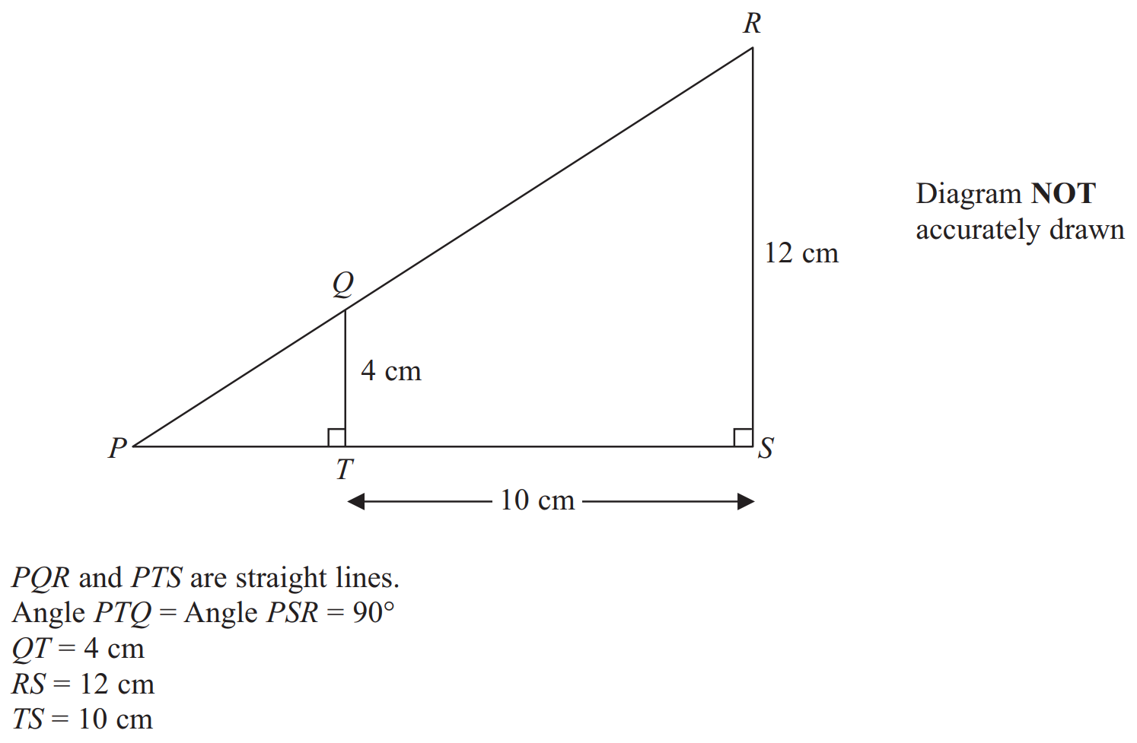

Edexcel GCSE higher. Paper 2, March 2013

Slide 2
